Slide 1
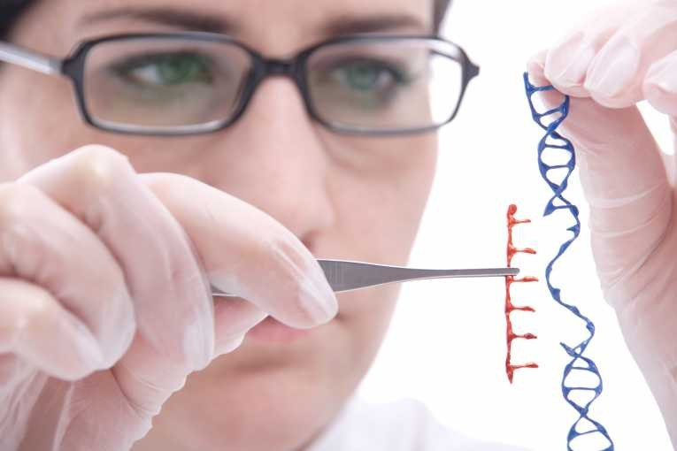
Topic 4: Genetics
4.4 Genetic Engineering and Biotechnology

Slide 2
ASSESSMENT STATEMENTS
4.4.1 Outline the use of polymerase chain reaction (PCR) to copy and amplify minute quantities of DNA.
4.4.2 State that, in gel electrophoresis, fragments of DNA move in an electric field and are separated according to their size.
4.4.3 State that gel electrophoresis of DNA is used in DNA profiling.
4.4.4 Describe the application of DNA profiling to determine paternity and also in forensic investigations.
4.4.5 Analyse DNA profiles to draw conclusions about paternity or forensic investigations.
4.4.6 Outline three outcomes of the sequencing of the complete human genome.
4.4.7 State that, when genes are transferred between species, the amino acid sequence of polypeptides translated from them is unchanged because the genetic code is universal.
4.4.8 Outline a basic technique used for gene transfer involving plasmids, a host cell (bacterium, yeast or other cell), restriction enzymes (endonucleases) and DNA ligase.
4.4.9 State two examples of the current uses of genetically modified crops or animals.
4.4.10 Discuss the potential benefits and possible harmful effects of one example of genetic modification.
4.4.11 Define clone.
4.4.12 Outline a technique for cloning using differentiated animal cells.
4.4.13 Discuss the ethical issues of therapeutic cloning in humans.

Slide 3
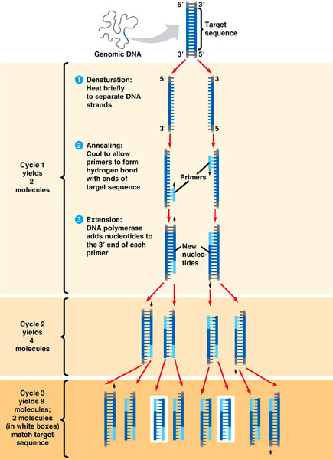
4.4.1 Outline the use of polymerase chain reaction (PCR) to copy and amplify minute quantities of DNA.
PCR stands for polymerase chain reaction. When researchers want to study a particular sequence of DNA, they need many (identical) copies of it. The traditional method of cloning (using plasmids) takes a lot of time and work.
Instead, a ‘photocopier for DNA’ is used, which is essentially what the PCR does. It uses enzymes to replicate DNA so no living organisms (e.g. bacteria or yeast) are required. The process for PCR was developed in 1983 by Kary Mullis who received a Nobel prize in 1993 for his work.

Slide 4
4.4.1 Outline the use of polymerase chain reaction (PCR) to copy and amplify minute quantities of DNA.
The principle of PCR
The desired DNA is heated which breaks the hydrogen bonds between the strands of the double helix so that they separate.
Primers are added to start the process of DNA replication.
As the mixture is cooled, the primers bond to the original, but now single stranded, DNA molecules (through hydrogen bonding between complementary base pairs).
Nucleotides and a thermo stable DNA polymerase are added.
The nucleotides will bond with the ‘exposed’ organic bases of the single stranded DNA (again through hydrogen bonding between complementary base pairs) and the DNA polymerase will then join them into a DNA strand.
This way, each of the original strands has formed a new complementary strand. These strands can be heated and separated and will function as a template for more DNA strands to be formed. A large amount of identical copies of the original DNA can therefore be made quickly.
The DNA is exponentially amplified.
Lets go to the website to do a virtual lab session

Slide 5
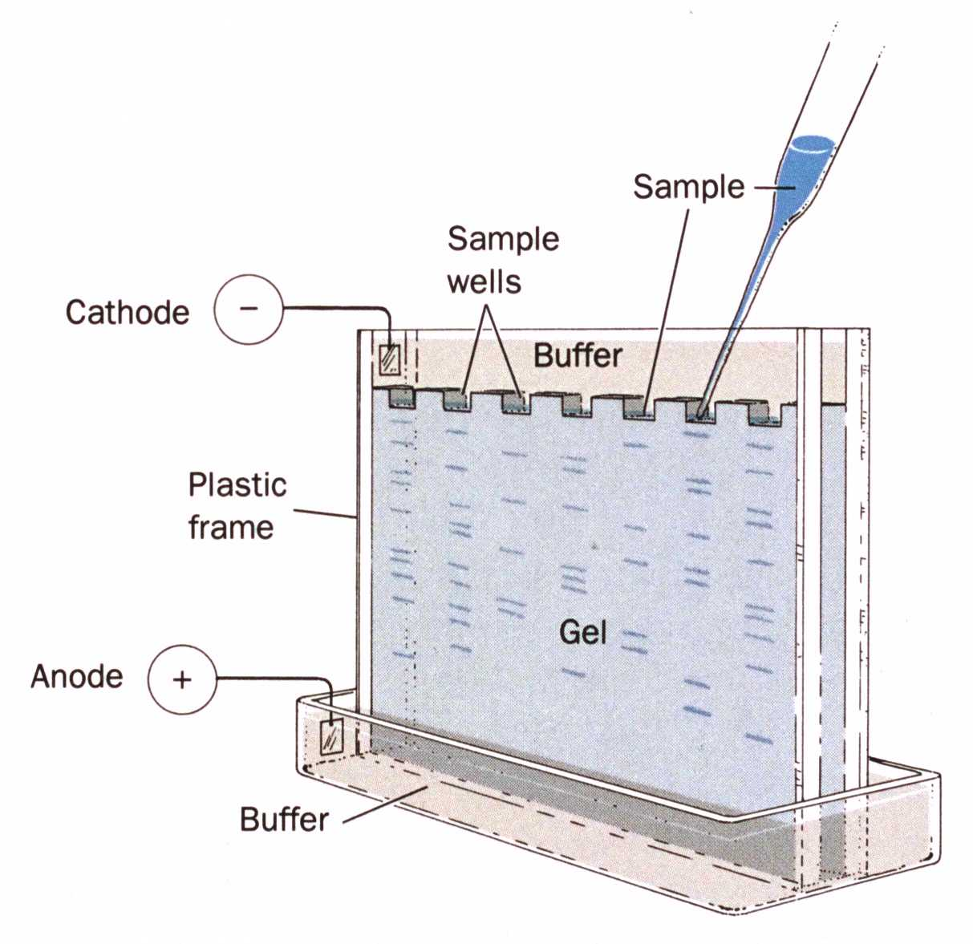
4.4.2 State that, in gel electrophoresis, fragments of DNA move in an electric field and are separated according to their size.
Gel electrophoresis is a process commonly used in biochemistry. Electrophoresis is a technique used to separate large molecules (nucleic acids or proteins) based on their different rates of movement in an electric field caused by a combination of their charge and their size.
A gel is prepared into a thin layer and placed in the container. Then some holes are made on one side where the molecular biologist will place the samples. Often at least one of them will be an unknown sample. The others can contain (mixtures of) known molecules. Then the equipment is connected to a source of electricity. The gel will conduct electricity.
Depending on the charge of the molecules, they will be attracted more or less to the other side. DNA fragments are slightly negative and will move towards the positive electrode (anode). So they will start to move through the gel. The speed with which they move will depend on how strong the attraction force is, but also on the size of the molecule. Larger molecules will move more slowly through the gel than smaller molecules

Slide 6
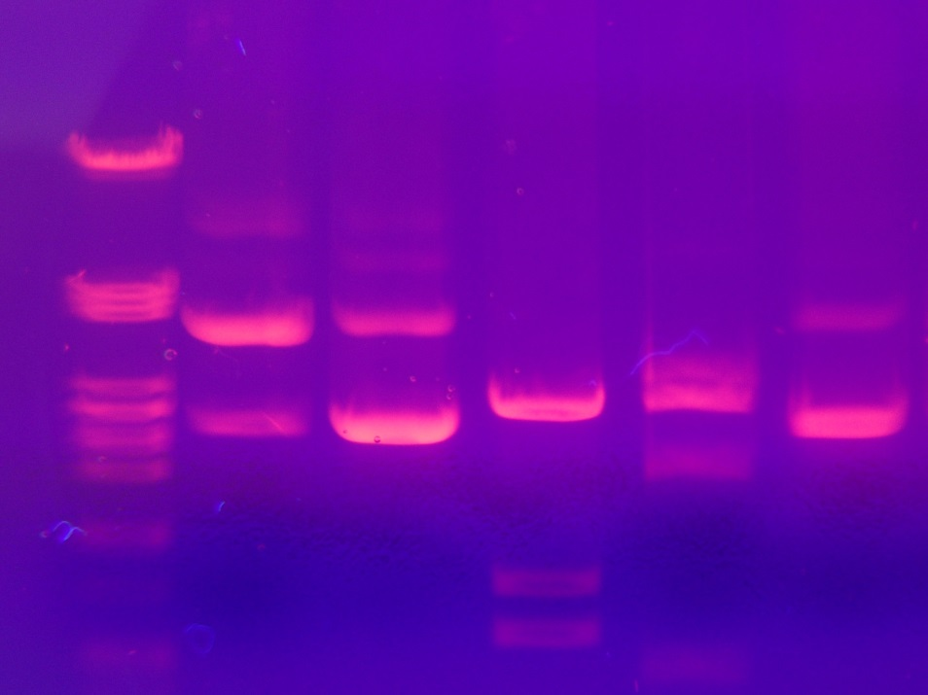
4.4.2 State that, in gel electrophoresis, fragments of DNA move in an electric field and are separated according to their size.
When the molecules have moved through the gel, the equipment is turned off and the gel removed. Sometimes the gel then needs to be stained to show the spots to where the molecules have travelled. If a spot of the unknown sample has travelled exactly the same distance as one of the known molecules, they are likely to be the same.
PCR can be used to increase the size of a sample and then gel electrophoresis can be used to compare the sections of DNA with the DNA of various suspects in an investigation.
Lets go to the website to do a virtual lab session

Slide 7
4.4.4 Describe the application of DNA profiling to determine paternity and also in forensic investigations.
DNA profiling is also known as DNA fingerprinting. It is a technique that compares DNA from different sources without mapping the entire genome since that would take a long time.
DNA profiling is used to compare the DNA of a suspect with, for example, blood found at a crime scene or to compare the DNA of a child with that of an adult who could be the parent.
When a small amount of DNA is found, for example, in a spot of blood on a crime scene, the polymerase chain reaction (PCR) can be used to increase the amount of DNA. The two strands of the DNA double helix are separated. Restriction enzymes (or endonucleases, see Topic 4.4.8), which will cut between specific sequences of organic bases, are used to cut the DNA into sections. The sections will differ in size and charge and are separated using gel electrophoresis. The same treatment is used on every sample.
The gel electrophoresis will separate the sections of DNA according to size and charge. This creates a pattern of stripes and bands, determined by the sequence of the organic bases. As every person’s DNA is unique (except monozygotic or identical twins), it would be highly unlikely that two different people would produce the exact same pattern of DNA sections on the gel.

Slide 8
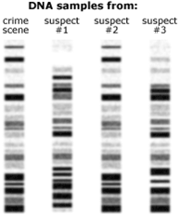
4.4.4 Describe the application of DNA profiling to determine paternity and also in forensic investigations.
4.4.5 Analyse DNA profiles to draw conclusions about paternity or forensic investigations.
Crime scene investigation
Lets do a virtual lab!!

Slide 9
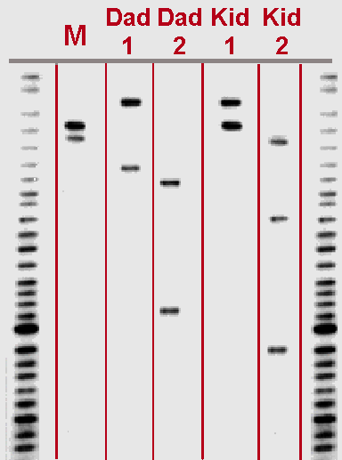
4.4.4 Describe the application of DNA profiling to determine paternity and also in forensic investigations.
4.4.5 Analyse DNA profiles to draw conclusions about paternity or forensic investigations.
Paternity test

Slide 10
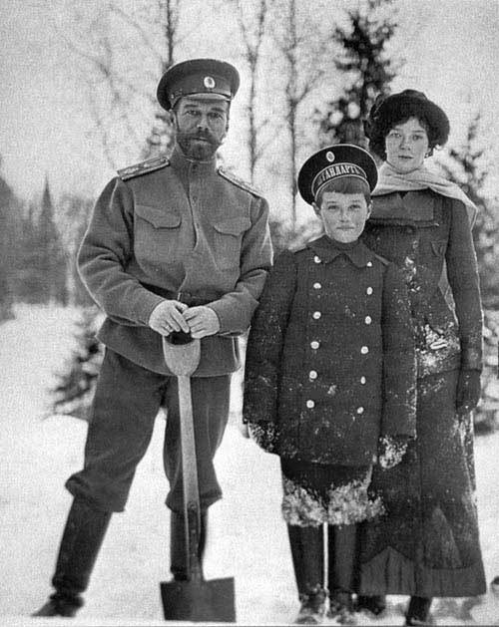
4.4.4 Describe the application of DNA profiling to determine paternity and also in forensic investigations.
Use a relative’s DNA to determine the identity of a victim
This technique has also been used to try to determine the identity of the remains of dead people. For example, there were people claimed that the Tsar of Russia and his family were shot during the Russian Revolution and bodies were shown to prove this. However, not everyone believed that they were really the remains of the Romanovs. The identity of these bodies could not be proven until DNA fingerprinting was brought in. By taking blood samples of (distant) relatives of the Romanovs, DNA patterns could be established. Samples from the bodies showed similar DNA patterns and the conclusion was that the bodies were likely to be the Romanov family.

Slide 11
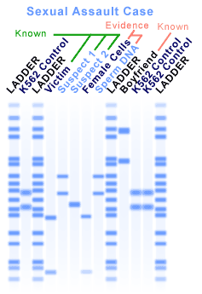
Who is the guilty suspect?

Slide 12
4.4.6 Outline three outcomes of the sequencing of the complete human genome.
The Human Genome Project was a commitment undertaken by the scientific community across the world to determine the location and structure of all genes in the human chromosomes. Groups of scientists sequenced the
genes of a particular (section of) a chromosome and all the information was pooled. It is part of the international Human Genome Organisation and an excellent example of how collaboration of scientists across the world can
benefit all of us.
Mapping the human genome was first suggested in 1985 and the expected financial and time investment was staggering. Finally, in 1990, the project of sequencing all (approximately 3 x 109) base pairs in the human DNA was started. It was expected to take 15 years. Some new developments in DNA sequencing and software made the process faster and cheaper than originally expected and a “rough draft” was finished in 2000. In 2003, 50 years
after Watson and Crick described the DNA double helix structure, the sequencing of the human DNA was 99.9% complete.
LINK
LINK

Slide 13
4.4.6 Outline three outcomes of the sequencing of the complete human genome.
Having a map of the sequence of the nucleotides of the human DNA then lead to mapping the genes, i.e. listing and finding the locus of each human gene. They are not the same thing: knowing the sequence of A, T, C and G does not tell you if you are looking at a gene for eye colour or the ability to roll your tongue.
Outcomes of having sequenced the entire human genome are:
an improved understanding of many genetic diseases: now many more genes causing disease are known than before the Human Genome Project;
the production of medicines (based on DNA sequences) to cure diseases and/or genetic engineering to remove the genes which cause the disease;
to determine fully which genetic diseases any individual is prone to (Prediction) (genetic screening leading to preventive medicine);
research into a particular disease can now focus on only the gene(s) that are relevant to the disease;
it can provide more information about evolutionary paths by comparing similarities and differences in genes between species.
This information could be valuable, but it could also be abused (e.g. by insurance companies or prospective employers) and society faces the challenge of coming to terms with these ethical issues.

Slide 14
4.4.7 State that, when genes are transferred between species, the amino acid sequence of polypeptides translated from them is unchanged because the genetic code is universal.
Genetic engineering refers to the deliberate manipulation of genetic material. It is possible to move genetic material between species because the genetic code is universal. This means that, for every organism, the same RNA codon codes for the same amino acid in an mRNA strand, UUU and UUC both code for the amino acid phenylalanine while CUU, CUC, CUA and CUG all code for leucine, regardless of the species.
Since the genetic code is universal, it is possible to transfer genetic material from one species to another. Because the code is universal, it is possible to introduce a human gene for making insulin into a bacterium. The bacterium will then produce the human protein hormone insulin, which is responsible for making cells take up more glucose and convert it to glycogen.

Slide 15
4.4.8 Outline a basic technique used for gene transfer involving plasmids, a host cell (bacterium, yeast or other cell), restriction enzymes (endonucleases) and DNA ligase.
Gene transfer involves the following elements:
a vector
a host cell
restriction enzymes
DNA ligase.
The vector is what is needed to carry the gene into the host cell. Plasmids are often used as vectors. Bacteria carry all the required genetic information on one large circular DNA. However, most bacteria also possess extra DNA in the form of plasmids. Plasmids are circular bits of genetic material carrying 2-30 genes. Plasmids may replicate at the time the chromosome replicates, or at other times. It is therefore possible for a cell to possess several identical plasmids.
Plasmids are used to clone a desired gene. First, you splice or introduce the desired gene into a plasmid and transfer it into a bacterial cell. Then, culture these bacteria; many of them will have a plasmid with the desired gene. Use a section of nucleotides, complementary to the desired gene, but also attached to a (e.g. radioactive) label to find out which plasmids have the gene and which do not.
Use restriction enzymes to cut the desired gene out of the plasmids and purify the gene using gel electrophoresis
LINK

Slide 16
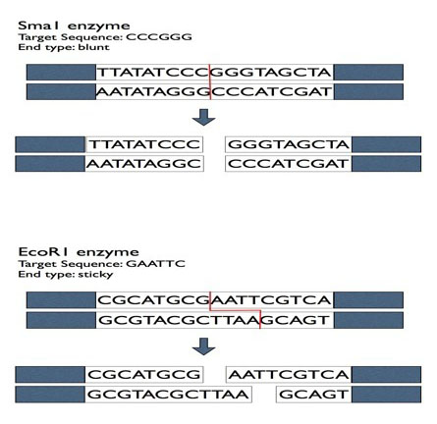
4.4.8 Outline a basic technique used for gene transfer involving plasmids, a host cell (bacterium, yeast or other cell), restriction enzymes (endonucleases) and DNA ligase.
The host cell is the cell which is to receive the genetic material. A bacterium may be the host cell and produce a protein desired by humans.
Restriction enzymes(endonucleases) are used to cut a desired section of the DNA. Bacteria produce these enzymes naturally as a defence against invading viruses.
When preparing to transfer DNA, the same restriction enzyme is used for the host and the donor so the cuts are made in the same way. This way, the same ‘sticky ends’ are created so that the donor DNA can fit in between the host DNA. To attach the two cut sections of DNA, the enzyme DNA ligase is used to create the required covalent bonds.
LINK
Restriction enzyme lab!

Slide 17
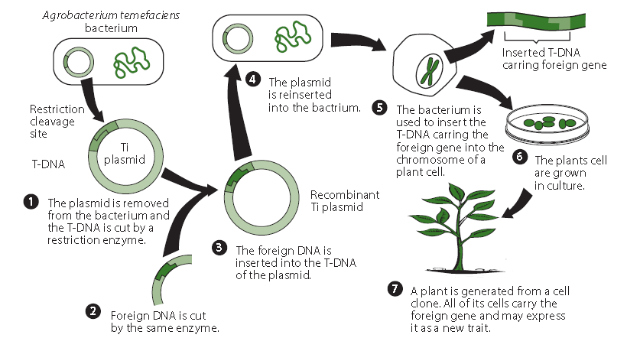
SUMMARY

Slide 18
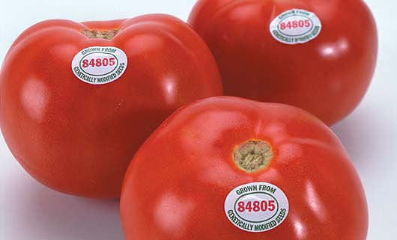
4.4.9 State two examples of the current uses of genetically modified crops or animals.
GM crops and GM animals are referred to as Genetically Manipulated organisms (GMO’s), also known as transgenic organisms. Their genetic material has been changed to include specific genes, usually from another species.
In 1994, the first genetically modified food sold commercially was introduced. It was the ‘Flavr Savr’, a tomato that was genetically altered to stay fresh longer. This was achieved by adding another gene that blocked
the gene for the production of an enzyme which caused rotting. Due to various commercial problems, the tomatoes are no longer available.
Bt corn is genetically modified maize. A gene from Bacillus thuringiensis (Bt) has been incorporated into the maize DNA. As a result, the plants produce a toxin that makes them resistant to insects. Bt corn crops are grown in the US.

Slide 19
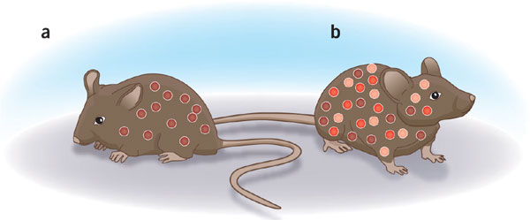
4.4.9 State two examples of the current uses of genetically modified crops or animals.
There are also examples of genetically modified mice. Normally, mice do not contract polio because they do not have the receptor in their cell membranes that allows the polio virus to infect their cells. Adding this receptor, means that mice can be infected with polio and used for laboratory experiments in order to study the disease and its possible treatment and prevention. GM mice infected with polio will develop symptoms similar to humans with the disease.
LINK

Slide 20
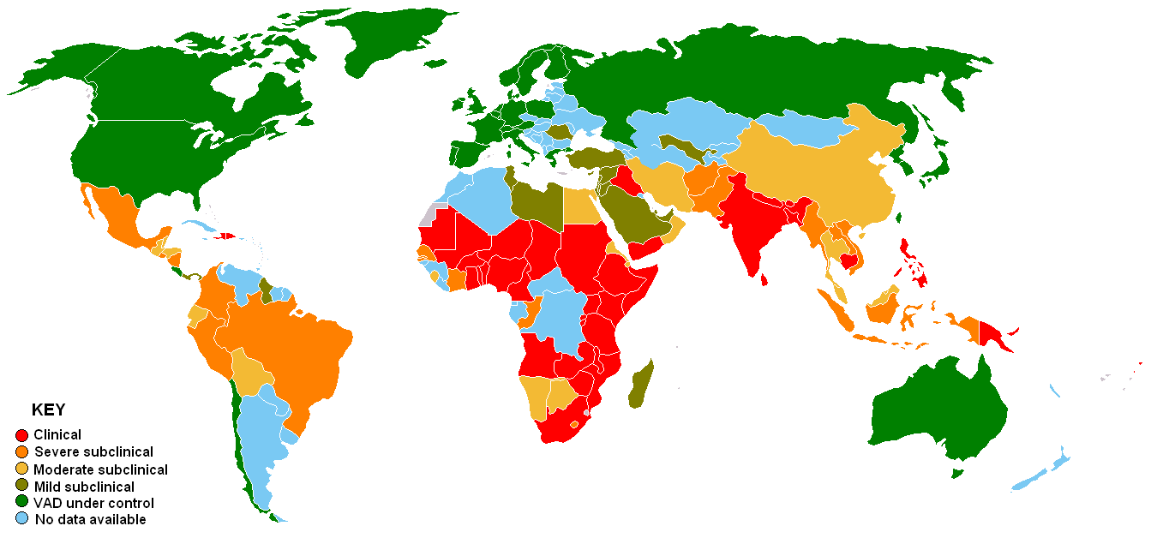
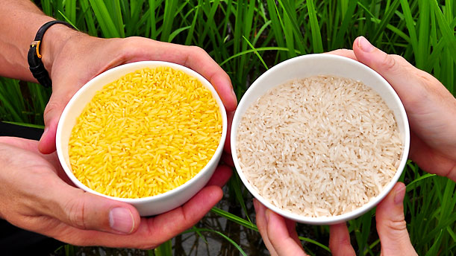
4.4.9 State two examples of the current uses of genetically modified crops or animals.
Many people in the world who have rice as a very major part of their diet, suffer from vitamin A deficiency (VAD) which can lead to blindness. Countries most affected are in Africa and South America. Rice plants store vitamin A in their leaves but not in the rice grains. Golden rice is genetically modified by adding genes from daffodils and from a bacterium. This allows
the plant to store beta carotene, a precursor of vitamin A, in the grains, which causes the yellow colour. A new kind of Golden Rice has now been produced, using one gene from maize and a bacterium, which contains more than 20 times the amount of beta carotene compared to the first
kind of Golden Rice.

Slide 21
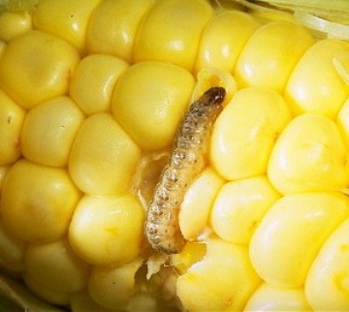
4.4.10 Discuss the potential benefits and possible harmful effects of one example of genetic modification.
Bt Corn
Bt corn contains a gene from the Bacillus thuringiensus which produces a protein that is toxic to specific insects, in particular the European corn borer (ECB), which, despite its name, is also found
in the US.
The ECB eats its way through stems and leaves of the corn plant and will damage vascular bundles and disrupt the transport of water and nutrients through the plant. It can also weaken the stems and leaves so that the plant or leaves may break. Only a small part of the damage is caused by the ECB eating the corn directly.

Slide 22
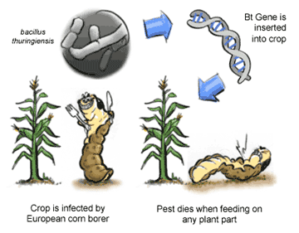
4.4.10 Discuss the potential benefits and possible harmful effects of one example of genetic modification.
Benefits of Bt corn
The damage caused by the ECB is much reduced.
Bt corn is slightly more expensive, but the difference is less than one extra application of insecticide.
Non-Bt corn needs to be checked often for signs of ECB - less checking needed for Bt corn.
Less insecticide needed means less impact on the environment and lower health risks for the worker(s).
Seems to reduce the infection with fungus so mycotoxin(poisons produced by fungi) levels are lowered. Mycotoxins are difficult to remove by cooking/freezing and may go into the food chain and be found in meat of animals which ate the infected corn. Mycotoxins can be a hazard to human and animal health.

Slide 23
4.4.10 Discuss the potential benefits and possible harmful effects of one example of genetic modification.
Harmful effects of Bt corn
Will also kill some other insects (though many are not affected).
Insects may develop resistance to Bt toxin because they are exposed to it all the time.
Resistant insects also make Bt spray useless as insecticide (Bt spray is considered to be relatively safe for humans and the environment).
It is difficult to prevent pollen (with the Bt gene) from travelling outside the field where the Bt corn is grown.
- it may fertilise non-Bt corn e.g. organically grown corn which can then no longer be sold as organic corn.
- it may fertilise wild relatives and make them more resistant to insects and have them dominate the niche they live in. This would result in loss of biodiversity.
LINK

Slide 24
4.4.11 Define clone.
A clone is a group of genetically identical organisms or a group of cells derived from a single parent cell.

Slide 25
4.4.12 Outline a technique for cloning using differentiated animal cells.
Cloning is a controversial issue. The technique for cloning using differentiated cells is mostly somatic cell nuclear transfer (SCNT) but the use made of the produced cells can be quite different. Generally reproductive cloning and therapeutic cloning are discussed separately.
Reproductive cloning
Reproductive cloning creates a new individual. The best known example is Dolly the sheep. The technique used to create Dolly is known as SCNT. The concept is relatively simple.
First you take a nucleus from a somatic (body) cell. In the case
of Dolly, it was the nucleus from a cell in the udder of her “mother”. The rest of the cell is no longer needed.
The nucleus is then removed from an egg cell and replaced with the nucleus from the somatic cell.
A small and brief electric shock is used to make the cell start dividing. Once it has grown into a group of cells, it can be implanted into a uterus where it will grow into a new individual, having the same genetic material in its nuclei as the individual who donated the nucleus. The mitochondrial DNA will come from the donor of the egg cell.
LINK

Slide 26
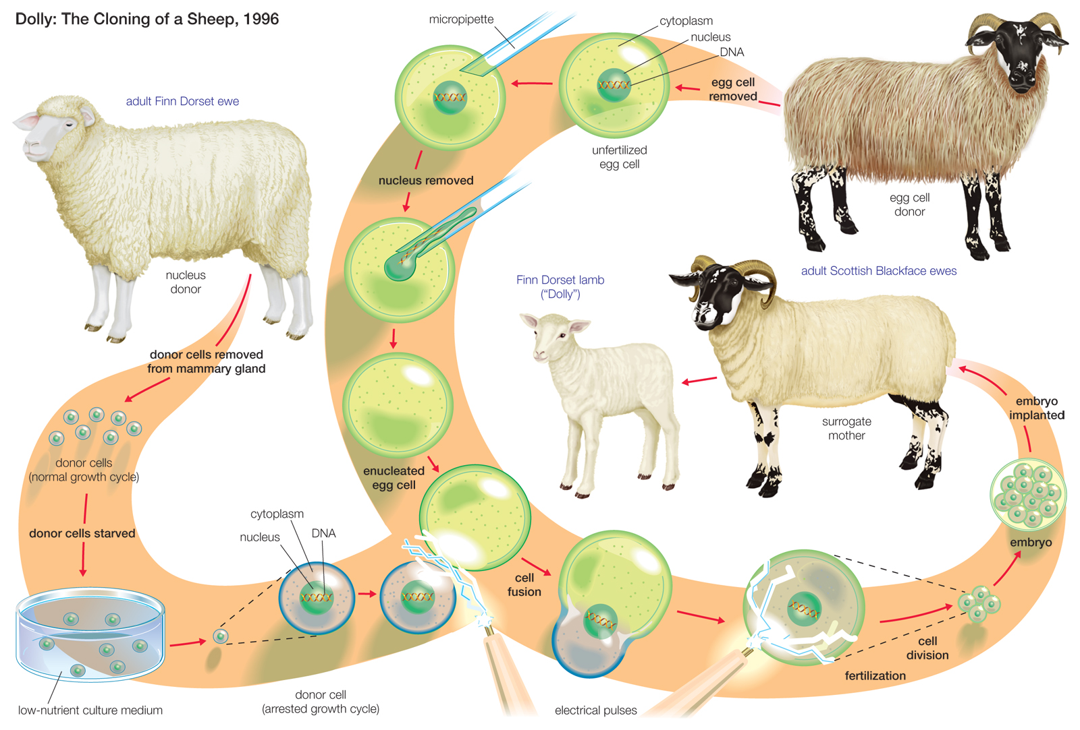

Slide 27
4.4.12 Outline a technique for cloning using differentiated animal cells.
Therapeutic cloning
Therapeutic cloning involves stem cell research. In therapeutic cloning, human embryos are produced and allowed to grow for a few days into a small ball of cells. These cells are not yet specialised (totipotent or pluripotent) and when SCNT is used, the cells can grow into any of a large number different specialised tissues. Other sources of stem cells are cells from the umbilical cord or cells from aborted foetuses.
Therapeutic cloning often aims at cell therapy where diseased cells are replaced with healthy ones. Cell therapy is used for people suffering from Parkinson‘s disease but may also be possible when a patient has spinal cord injury. Bone marrow transplants for patients with leukaemia, new skin cells for burn victims and to grow new corneas for some forms of visual impairments are examples of therapeutic cloning already in use.

Slide 28
4.4.13 Discuss the ethical issues of therapeutic cloning in humans.
A large number of websites can be found on the ethical issues of cloning.
Arguments in favour of therapeutic cloning focus on:
the ability to cure serious diseases with cell therapy: currently leukaemia and in the future possibly cancer and diabetes.
Some of the concerns raised about therapeutic cloning relate to :
fears of it leading to reproductive cloning;
use of embryonic stem cells involves the creation and destruction of human embryos (although it is possible to use embryos left over from IVF treatment which would be destroyed anyway);
embryonic stem cells are capable of many divisions and may turn into tumours.
Ethical aspects of cloning are difficult to discuss since a lot of the benefits are currently not yet realised. They are potential benefits. Likewise, some of the disadvantages are still unknown because we are not (yet?) cloning at a large
scale. This could be an argument for carefully monitoring and regularly evaluating the results of any technological advances.
Please remember all the discussions we had in class, the IB accepts any other valid example)

Slide 29
Topic 4: Genetics
4.4 Genetic Engineering and Biotechnology

