Slide 1
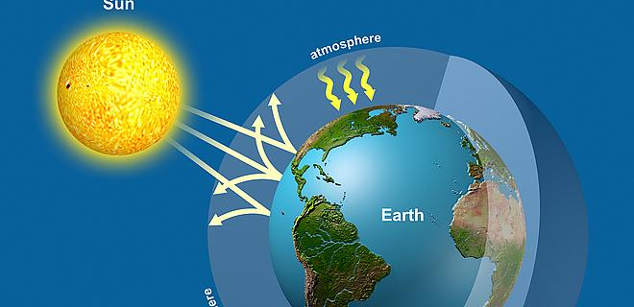
Topic 5: Ecology and evolution
5.3 Populations

Slide 2
ASSESSMENT STATEMENTS
5.3.1Outline how population size is affected by natality, immigration, mortality and emigration.
5.3.2 Draw and label a graph showing a sigmoid (S-shaped) population growth curve.
5.3.3 Explain the reasons for the exponential growth phase, the plateau phase and the transitional phase between these two phases.
5.3.4 List three factors that set limits to population increase.

Slide 3
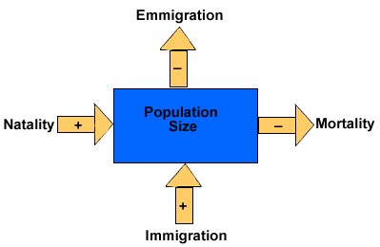
5.3.1 Outline how population size is affected by natality, immigration, mortality and emigration.
Four factors exist which influence the size of a population:
natality (birth rate)
mortality (death rate)
immigration (‘moving in’)
emigration (‘moving out’)
LINK
LINK

Slide 4
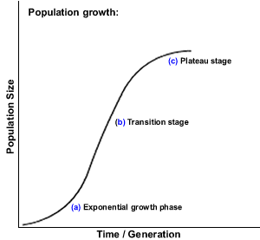
5.3.2 Draw and label a graph showing a sigmoid (S-shaped) population growth curve.
Carrying capacity (K)
Normally populations will be prevented from undergoing uncontrolled exponential growth by limiting factors. Most populations will adhere to a sigmoid growth curve.

Slide 5
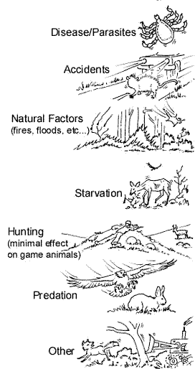
5.3.3 Explain the reasons for the exponential growth phase, the plateau phase and the transitional phase between these two phases.
Any population has the potential to increase its numbers quickly. In most natural situations, this increase in numbers is controlled by limiting factors. Limiting factors are factors that will place restrictions on the amount a population can grow.
In a typical sigmoidal curve, three stages are indicated:
1. Exponential growth phase.
2. Transitional phase.
3. Plateau phase.

Slide 6
5.3.3 Explain the reasons for the exponential growth phase, the plateau phase and the transitional phase between these two phases.
EXPONENTIAL GROWTH PHASE
In this stage, there is unlimited growth of the population due to the absence of limiting factors. The growth could follow the pattern 1, 2, 4, 8, 16, 32 etc if we talk about bacteria where each bacterium divides into two every twenty minutes.
TRANSITIONAL PHASE
In this stage, limiting factors start influencing the rate of increase of the population. The number of individuals is still increasing but no longer at an exponential rate. It is the transition from exponential growth to no growth.
PLATEAU PHASE
In this stage, the number of individuals of the population no longer increases, due to limiting factors.
Natality + immigration = mortality + emigration.
Natural selection (survival of the fittest) is taking place. The population has reached the carrying capacity of the environment.
Carrying capacity refers to the maximum number of individuals of a species that can be sustainably supported by the environment. This is shown by ‘K’.

Slide 7
5.3.4 List three factors that set limits to population increase.
Limiting factors are those factors that control a process such as population growth.
Examples of limiting factors for animal populations are:
amount of food available
presence of parasites and/or disease
amount of predation
available nesting sites
Examples of limiting factors for plant populations are:
amount of light available
temperature
amount of carbon dioxide
amount of water available
LINK

Slide 8
Topic 5: Ecology and evolution
5.3 Populations

