Slide 1
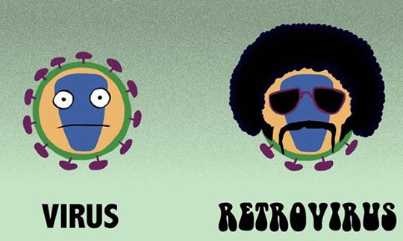
Topic 6: Human Health and Physiology
6.3 Defence against
Infectious Disease

Slide 2
ASSESSMENT STATEMENTS
6.3.1 Define pathogen.
6.3.2 Explain why antibiotics are effective against bacteria but not against viruses.
6.3.3 Outline the role of skin and mucous membranes in defence against pathogens.
6.3.4 Outline how phagocytic leucocytes ingest pathogens in the blood and in body tissues.
6.3.5 Distinguish between antigens and antibodies.
6.3.6 Explain antibody production.
6.3.7 Outline the effects of HIV on the immune system.
6.3.8 Discuss the cause, transmission and social implications of AIDS.

Slide 3
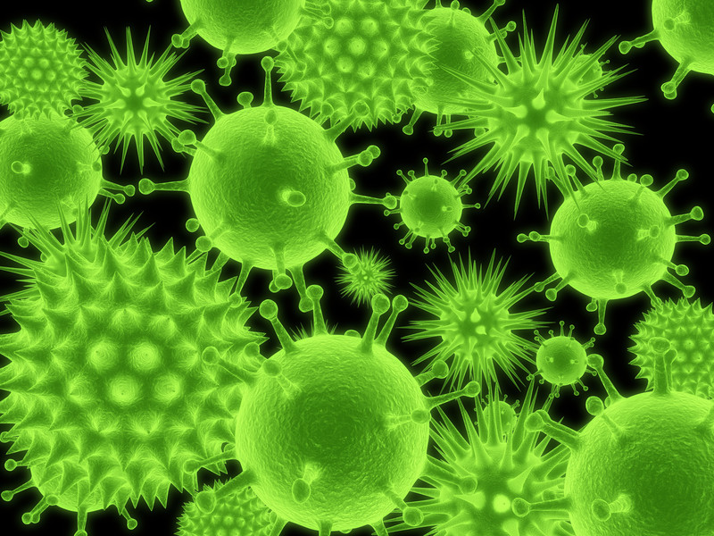
6.3.1 Define pathogen.
A pathogen is an organism or virus that causes a disease in any other organism.
Common pathogens include bacteria, fungi and viruses.

Slide 4
6.3.2 Explain why antibiotics are effective against bacteria but not against viruses.
Antibiotics, block protein synthesis in bacteria but not in eukaryotic cells. Bacteria and animal cells synthesise proteins in a similar manner, though the proteins involved are not the same. Those antibiotics that
are useful as antibacterial agents use these differences to bind to or inhibit the function of the bacterial proteins. In this way, they prevent the synthesis of new proteins and new bacterial cells without damaging the ‘patient’.
Most bacteria have a cell wall. Antibiotics may disrupt this cell wall which will interfere with the life cycle of the bacteria. Eukaryotic animal cells do not have cell walls so are not affected by the antibiotic. Viruses do not have a cell wall so are also not affected by antibiotics.
Viruses invade a cell and get this host cell to produce the protein and DNA that the virus needs to reproduce. As the virus uses it host’s processes, antibiotics do not hurt them. If they did, the antibiotic would also disrupt the process of protein synthesis in the host (which would be a serious problem). Many anti-viral drugs focus on disrupting the protein coat of a virus and will therefore not usually cause harm to the host.
LINK

Slide 5
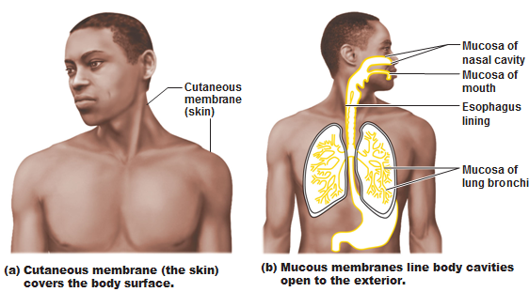
6.3.3 Outline the role of skin and mucous membranes in defence against pathogens.
The best way to prevent disease is to prevent the pathogens from entering the body. The skin plays a major role in this. When unbroken, it is almost impossible for any microorganism to penetrate the skin. Weak points are those where we are not protected by skin. Most of these areas have defences of their own. Mucus is an often-used barrier. It traps micro-organisms and prevents further entry.
Lungs are protected by mucus and cilia which transport the mucus to the throat.
The stomach contains a very acidic environment.
Glands above the eyes produce tears that contain lysozymes (enzymes which destroy bacterial cell walls).
The vagina produces mucus and has an acidic environment.

Slide 6
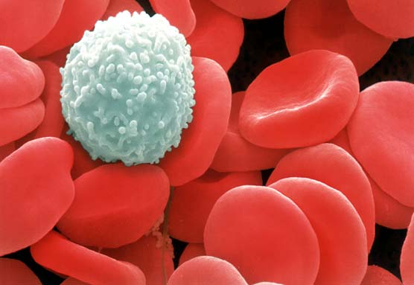
6.3.4 Outline how phagocytic leucocytes ingest pathogens in the blood and in body tissues.
Despite all of the measures to keep pathogens out of the body, many do manage to get in. This is called infection (a successful invasion of the body by pathogens) but does not always lead to disease. Leucocytes (white
blood cells) are the body’s defence against pathogens after they have entered. They can be found in the blood but also in the body’s tissues, e.g. lungs. Several different kinds of leucocytes exist, some of which are phagocytic, i.e. they simply will ‘eat’ (phagocytosis) any cell which is not recognised as ‘body own’ (determined by the ‘code’ on the outside of the cell surface membrane). Red blood cells (erythrocytes) lack a nucleus, while leucocytes have a nucleus.
LINK
LINK

Slide 7
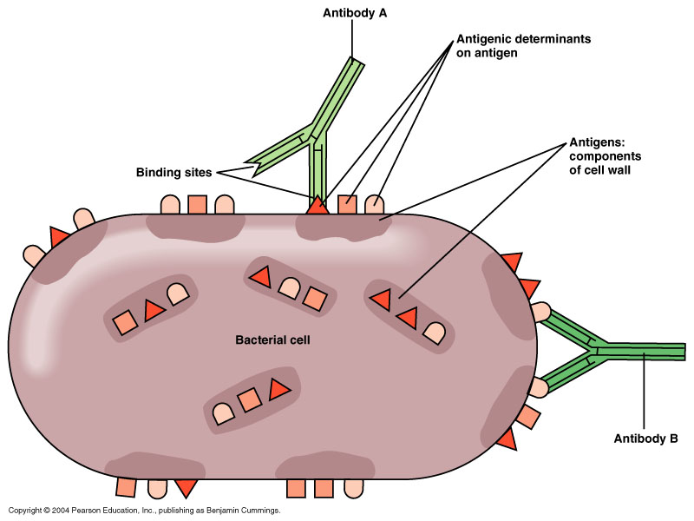
6.3.5 Distinguish between antigens and antibodies.
An antigen is a molecule that is recognised by the organism as foreign. It will cause an immune response. An antibody, also known as “immunoglobulin”, is a soluble protein produced by a plasma cell. It is produced by the immune system as a response to the presence of an antigen. An antibody will recognise an antigen and neutralise it.

Slide 8
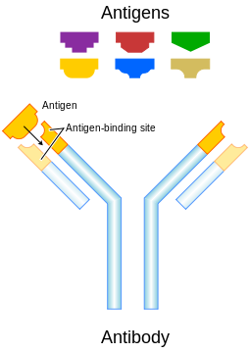
6.3.6 Explain antibody production.
There are many different kinds of antibodies. They are produced by different kinds of lymphocytes. Each different lymphocyte will recognise a particular kind of antigen and produce antibodies that work against that kind of antigen.
When an antigen enters the organism, the lymphocyte that produces the right kind of antibody will recognise the antigen. The lymphocyte will divide many times, forming a clone. This clone is a group of lymphocytes, all producing the same kind of antibody. They will produce a lot of this antibody which will attach itself to the antigen that has entered the organism and make it harmless.
LINK

Slide 9
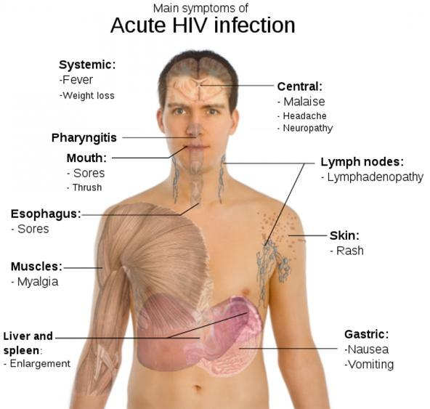
6.3.7 Outline the effects of HIV on the immune system.
The Human Immunodeficiency Virus (HIV), is a virus that infects cells of the immune system. It reduces the number of lymphocytes that are actively involved in the production of antibodies. As a result, the infected person makes a much lower number of antibodies and is therefore much more likely to develop a disease. These diseases are called opportunistic diseases and they are the major cause of death of people who have been infected with HIV and developed AIDS.
LINK
LINK

Slide 10
6.3.8 Discuss the cause, transmission and social implications of AIDS.
AIDS is an acronym for ‘Acquired Immune Deficiency Syndrome’. AIDS is not a disease but rather a collection of symptoms and/or opportunistic diseases. AIDS is caused by the weakening of the immune system by the HIV virus. A person is diagnosed with AIDS when s/he shows one or more “indicator illnesses” or based on the results of a blood test in which the number of certain lymphocytes are counted.
Transmission of the HIV virus can take place via:
blood
semen
vaginal secretions
breast milk
Blood and semen contain the highest concentration of the HIV virus.
The most common transmission of the HIV virus occurs during:
unprotected sexual contact (no condom), either vaginal or anal contact
sharing injection needles (usually by people addicted to intravenously-used drugs)
mother to child during birth or breastfeeding
LINK

Slide 11
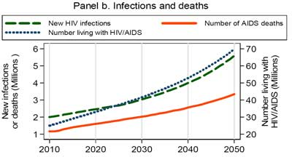
6.3.8 Discuss the cause, transmission and social implications of AIDS.
Some statistical information shows the extent of the problem.
In 2006, nearly 40 million people were estimated to be living with HIV/AIDS, of whom 4.3 million had been newly infected. More than 60% of the people infected with HIV/AIDS were living in Sub-Saharan Africa. Nearly 3 million people died in 2006 of AIDS-related diseases and 2 million of these lived in Sub-Saharan Africa.
Source: Nature magazine

Slide 12
6.3.8 Discuss the cause, transmission and social implications of AIDS.
In North America and Western Europe, the number of new infections has remained the same. In many other countries, the decrease in the number of new infections has slowed or in other countries the number of new infections has increased. It is believed that this is caused by a reduction in HIV prevention programmes.
The social implications of AIDS are many and can be found on any of numerous websites. Some of these implications are listed below:
People with HIV/AIDS can suffer from stigma and discrimination.
Women are more likely to contract HIV from sex with an infected partner than men. This further increases the inequality between men and women in some countries.
People who die as a result of HIV/AIDS are often at an age where they are the most productive members of society. In countries were AIDS causes many deaths, a relatively large proportion of the work force may be removed, delaying economic growth.
If both parents die because of AIDS, the country will need to spend resources on caring for the orphans.

Slide 13
6.3.8 Discuss the cause, transmission and social implications of AIDS.
If one adult in a household suffers from HIV/AIDS, s/he may face unemployment and not be able to earn an income. This may push the entire household into poverty, further reducing the chances of obtaining anti-viral drugs.
Poverty in itself increases the chances of contracting HIV/AIDS due to a lack of information (no school) and/or being forced to have sex in exchange for food/ money. Also the incidence of rape may increase, which is also a factor in spreading HIV/AIDS.
It is expensive to treat people with HIV/AIDS so obtaining insurance might be a problem.
Use of condoms increases.
LINK

Slide 14
Topic 6: Human Health and Physiology
6.3 Defence against
Infectious Disease

