Slide 1
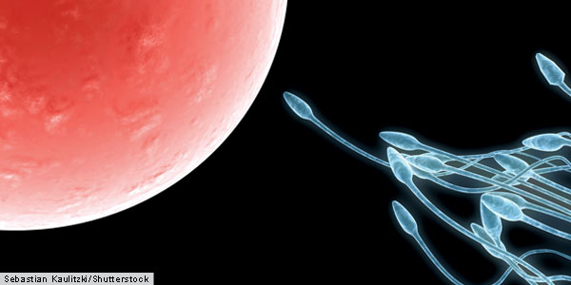
Topic 6: Human Health and Physiology
6.6 Reproduction

Slide 2
ASSESSMENT STATEMENTS
6.6.1 Draw and label diagrams of the adult male and female reproductive systems.
6.6.2 Outline the role of hormones in the menstrual cycle, including FSH (follicle stimulating hormone), LH (luteinizing hormone), oestrogen and progesterone.
6.6.3 Annotate a graph showing hormone levels in the menstrual cycle, illustrating the relationship between changes in hormone levels and ovulation, menstruation and thickening of the endometrium.
6.6.4 List three roles of testosterone in males.
6.6.5 Outline the process of in vitro fertilization (IVF).
6.6.6 Discuss the ethical issues associated with IVF.

Slide 3
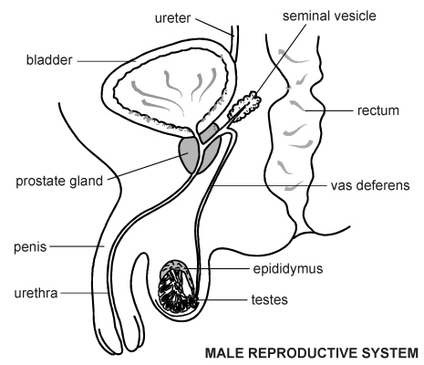
6.6.1 Draw and label diagrams of the adult male and female reproductive systems.

Slide 4
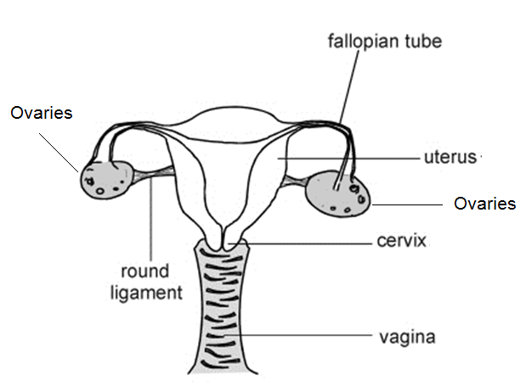
6.6.1 Draw and label diagrams of the adult male and female reproductive systems.

Slide 5
6.6.2 Outline the role of hormones in the menstrual cycle, including FSH (follicle stimulating hormone), LH (luteinizing hormone), oestrogen and progesterone.
In the female, there are four hormones involved in the control of the monthly cycle. They are:
Follicle Stimulating Hormone (FSH)
Luteinizing Hormone (LH)
Oestrogen
Progesterone
FSH and LH are produced by the anterior lobe of the pituitary gland in the brain. Oestrogen and progesterone are produced in the ovaries.
The cycle starts with the release of FSH from the pituitary gland, which is about the size of a pea and deep within the brain. As its name suggests FSH stimulates the ripening of a follicle.
The growing follicle releases oestrogen. Oestrogen increases the thickness of the endometrium and inhibits the production of FSH, but stimulates the production of LH.
LH stimulates ovulation and the formation of the corpus luteum.
The corpus luteum produces progesterone which keeps the endometrium intact and inhibits both FSH and LH. If fertilisation does not occur, the corpus luteum degenerates and the pituitary will start producing FSH again to stimulate another follicle.

Slide 6
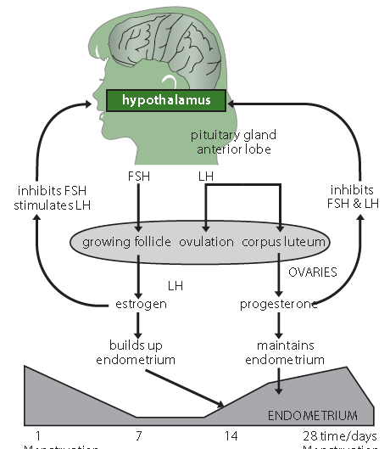
LINK

Slide 7
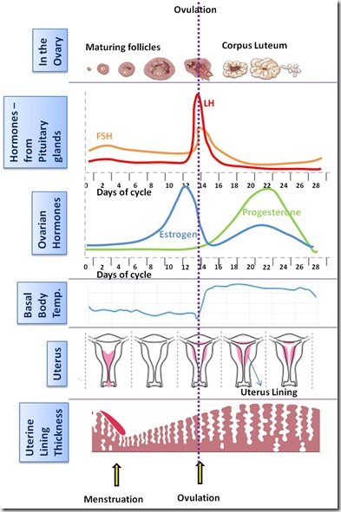
6.6.3 Annotate a graph showing hormone levels in the menstrual cycle, illustrating the relationship between changes in hormone levels and ovulation, menstruation and thickening of the endometrium.

Slide 8
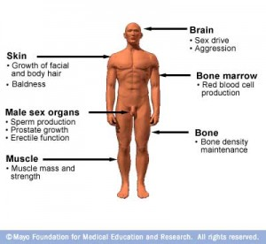
6.6.4 List three roles of testosterone in males.
Testosterone is a hormone produced by the testes. It has a variety of functions in the male body, these include:
promotion of male secondary sexual characteristics, e.g. facial and chest hair, extra muscles, deeper voice growth and activity of the male reproductive organs
spermatogenesis
enhanced sexual desire (libido)
enhances immune function
protection against osteoporosis

Slide 9
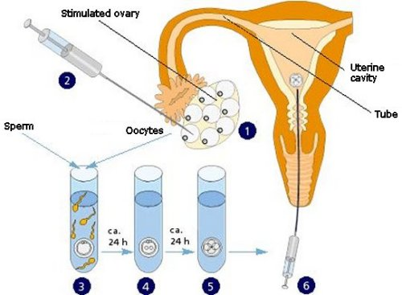
6.6.5 Outline the process of in vitro fertilization (IVF).
IVF is in vitro fertilization (‘in vitro’ - ‘in glass’). In this procedure, the egg and sperm cells ‘meet’ outside the female’s body. A successful procedure results in a so-called ‘test tube baby’. The first test tube baby was Louise Brown, born in 1978.
IVF is used for women who have blocked fallopian tubes (oviducts), usually due to an earlier infection, or who cannot sustain a pregnancy. Depending on the reasons for the IVF procedure, it may be possible to use the egg cells of the woman who wants to get pregnant. If not, donor egg cells can be used. In either case, the woman generating the egg cells is treated with hormones so that more than one follicle will ripen. A needle is placed in the follicle and the egg cell is carefully removed. This is repeated until all egg cells are harvested.

Slide 10
6.6.5 Outline the process of in vitro fertilization (IVF).
The egg cells are then mixed with sperm cells. This can be supplied by the woman’s husband or, if he is not fertile, by a sperm donor.
If the quality of the sperm is poor, a sperm cell may be injected into the egg cell. The fertilised egg cells are cultivated and either placed inside the uterus or frozen so that they can be used later. The number of embryos placed in the uterus depends on several factors and policies about this depend on the country and even the opinion of the doctor involved. It is important to consider that, if all embryos were to implant successfully, that a multiple pregnancy may result in a premature delivery and a reduced chance of survival for the babies.
LINK

Slide 11
6.6.6 Discuss the ethical issues associated with IVF.
There are a lot of ethical issues associated with IVF. A search on the Internet will provide many sites explaining arguments for and against.
When looking for information on the Internet, make sure you check when the information was posted and the nature of the organisation managing the website. This is particularly important for something like IVF where information, such as the statistics, have changed considerably over the past few years.
Some issues with IVF are:
the creation of life in a laboratory
freezing embryos and keeping them in case they are needed
discarding surplus embryos or using them for (stem cell) research
the possibility of creating embryos for research
the possibility of selecting embryos
the potential possibility to modify embryos
the birth mother may not be genetic mother
elderly women can have babies (using egg cell donors)

Slide 12
Topic 6: Human Health and Physiology
6.6 Reproduction

