Slide 1
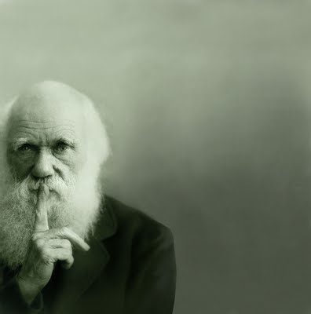
Option D: Evolution
D1 Origin of life on Earth

Slide 2
ASSESSMENT STATEMENTS
D.1.1 Describe four processes needed for the spontaneous origin of life on Earth.
D.1.2 Outline the experiments of Miller and Urey into the origin of organic compounds.
D.1.3 State that comets may have delivered organic compounds to Earth.
D.1.4 Discuss possible locations where conditions would have allowed the synthesis of organic compounds.
D.1.5 Outline two properties of RNA that would have allowed it to play a role in the origin of life.
D.1.6 State that living cells may have been preceded by protobionts, with an internal chemical environment different from their surroundings.
D.1.7 Outline the contribution of prokaryotes to the creation of an oxygen-rich atmosphere.
D.1.8 Discuss the endosymbiotic theory for the origin of eukaryotes.

Slide 3
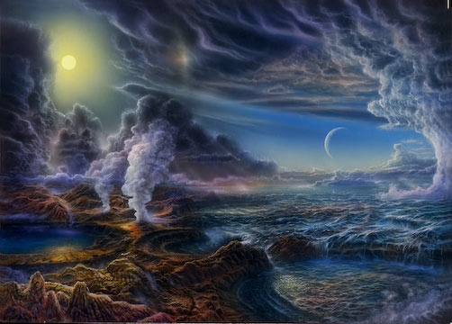
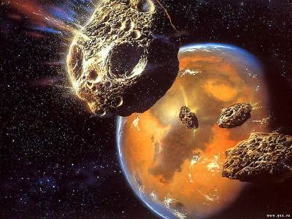
D.1.1 Describe four processes needed for the spontaneous origin of life on Earth.
1. The non-living synthesis of simple organic molecules
The early Earth is presumed to have provided all of the elements and chemical compounds needed for life to begin.
It was believed that the early oceans contained a mixture of simple inorganic molecules that were converted into simple organic molecules. The organic
chemicals may have been generated on the Earth (see Topic D.1.2) or introduced from space (see Topics D.1.3 and D.1.4).

Slide 4
D.1.1 Describe four processes needed for the spontaneous origin of life on Earth.
2. The assembly of these molecules into polymers
The simple organic molecules present in the oceans would have needed to undergo a process of polymerisation to form the larger more complex organic chemicals needed by cells. A variety of different environments, both hot and cold, have been proposed where this may have occurred (see Topic D.1.4).

Slide 5
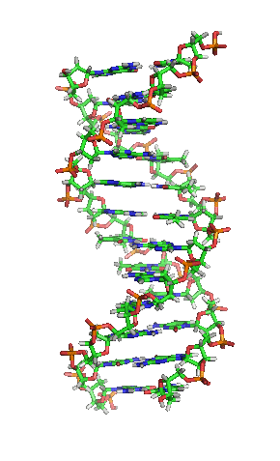
D.1.1 Describe four processes needed for the spontaneous origin of life on Earth.
3. The origin of self-replicating molecules made inheritance possible
Self-replicating molecules are molecules that are able to undergo replication, that is, act as a template for copies of themselves to be made. The only biological molecules capable of self-replication are DNA and RNA.
DNA can only replicate in the presence of protein enzymes, but certain RNA sequences are capable of self-replication: it can catalyse its formation from nucleotides in the absence of proteins. This is an example of an RNA-based catalyst or ribozyme (see Topic D.1.5.).
Only self replicating molecules are capable of undergoing evolution by natural selection (see Topic D.1.5).

Slide 6
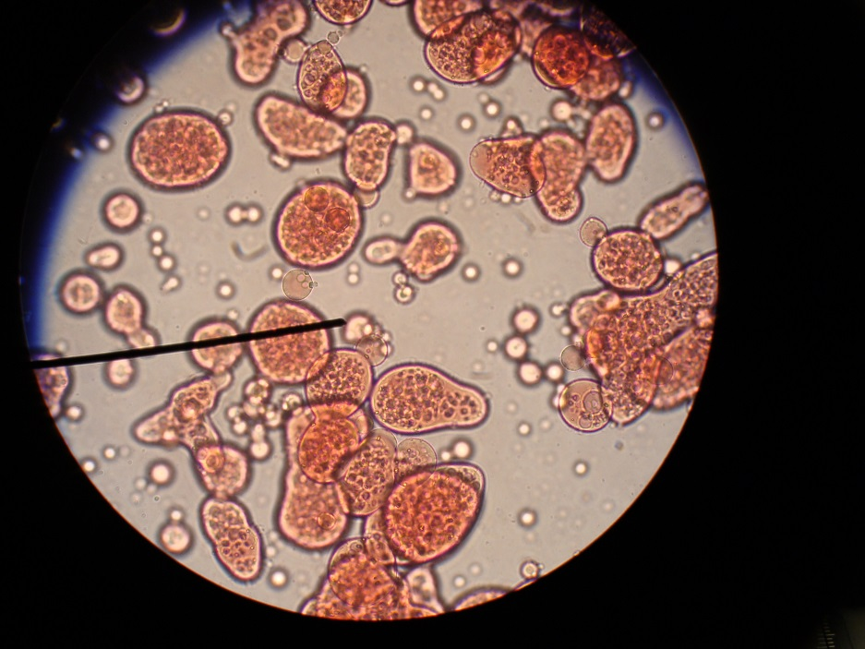
D.1.1 Describe four processes needed for the spontaneous origin of life on Earth.
4. The packaging of these molecules into membranes with an internal chemistry different from their surroundings
The formation of closed membranes is believed to be an early and important event in the origin of cellular life. Closed membrane vesicles form spontaneously from lipids and can maintain different chemical compositions between the intracellular compartment and the extra cellular compartment (surroundings). This allowed for the development of an internal cellular metabolism (seeTopic D.1.6).

Slide 7
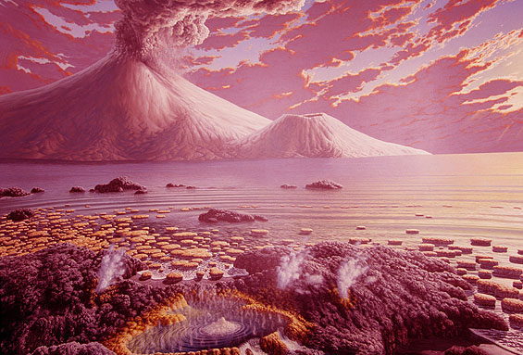
D.1.2 Outline the experiments of Miller and Urey into the origin of organic compounds.
A variety of Scientific evidence strongly suggests that the Earth was formed about five thousand million years ago from a cloud of dust particles surrounding the Sun. As the mass of the developing planet increased, heat generated by the force of gravity and radioactive decay caused the interior to melt.
During the cooling of the crust gases from the hot interior escaped through volcanoes, forming an atmosphere that probably contained hydrogen, water vapour, methane, ammonia, nitrogen and hydrogen sulfide.
This mixture of gases lacked oxygen and was termed a reducing atmosphere.

Slide 8
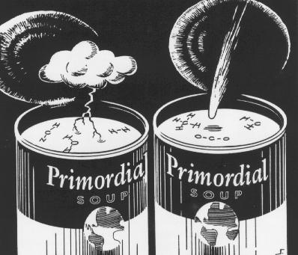
D.1.2 Outline the experiments of Miller and Urey into the origin of organic compounds.
Many of the chemicals needed as monomers for the synthesis of biological molecules are thought to have been formed in the shallow waters of the oceans as the products of chemical reactions between simple inorganic
compounds present in the atmosphere and water.
This mixture of chemicals believed to be present in the oceans is known as primordial soup or simply ‘chemical soup’.
LINK

Slide 9
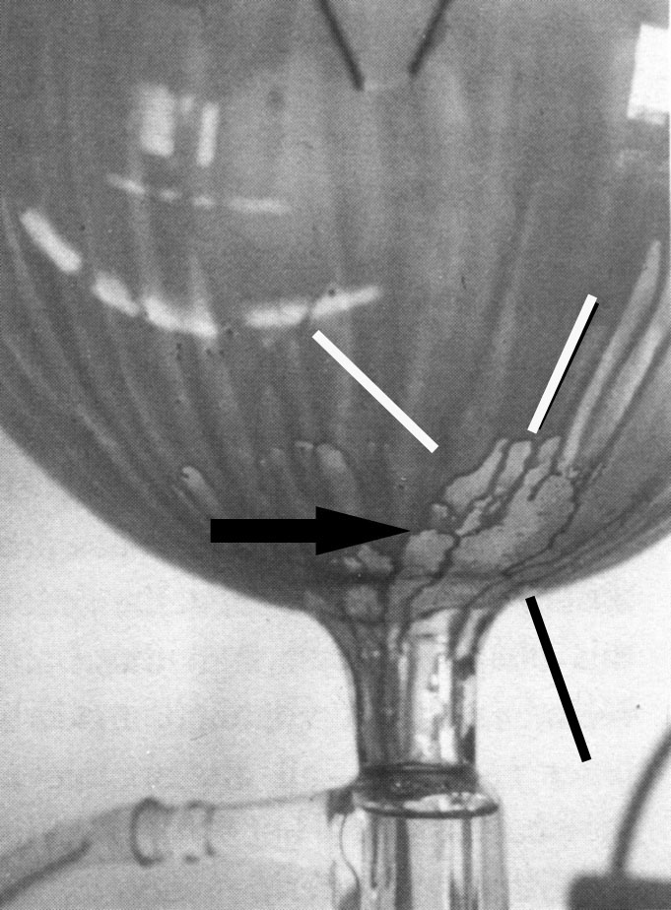
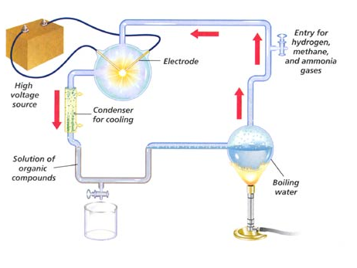
D.1.2 Outline the experiments of Miller and Urey into the origin of organic compounds.
Miller and Urey’s experiments conducted in 1953 simulated the conditions, believed at the time, to be present on the early Earth. They attempted to establish whether chemical evolution could occur in primeval soup. Chemical evolution refers to the pre-biological changes that transformed simple atoms and molecules into the more
complex chemicals needed for the origin of life.

Slide 10
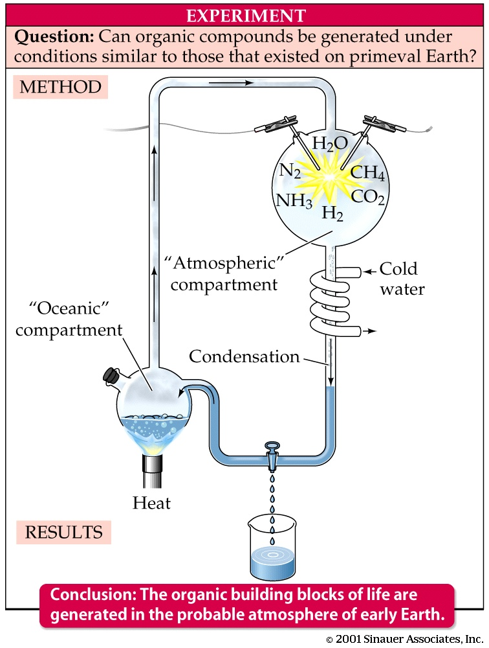
D.1.2 Outline the experiments of Miller and Urey into the origin of organic compounds.
The experiments used water, H2O, methane, CH4, ammonia, NH3 and hydrogen, H2.
The chemicals were sealed inside sterile glass tubes and flasks connected together in a loop, with one flask containing water and another with a pair of electrodes.
The water was heated to produce steam and sparks were produced between the electrodes to simulate lightning.
The mixture was cooled so that the water could condense and trickle back into the first flask in a continuous cycle.
At the end of a week of continuous operation Miller and Urey observed that up to fifteen percent of the carbon was present in the form of organic compounds. Thirteen of the twenty naturally occurring amino acids were detected.

Slide 11
D.1.3 State that comets may have delivered organic compounds to Earth.
Panspermia Pan (everywhere) Sperm (seed)
LINK
Panspermia is the hypothesis that life on Earth may have originated by the introduction of complex organic chemicals or even bacteria via comets.
Recent evidence suggests that some bacteria and archaebacteria are very resistance to extreme conditions and may be able to survive for long periods of time, even perhaps in deep space.
Semi-dormant bacteria found in ice cores deep beneath Antarctica suggest that bacterial endospores might survive on the surface of icy comets.
Cosmic radiation in deep space may provide the energy to form complex organic molecules.
A shower of comets about four thousand million years ago could have introduced complex organic molecules and water to the Earth and initiated chemical evolution.

Slide 12
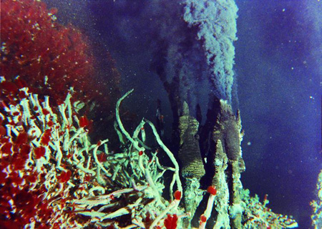
D.1.4 Discuss possible locations where conditions would have allowed the synthesis of organic compounds.
One of the difficulties faced by the chemical soup theory is to explain how amino acids and nucleotides polymerised to form proteins and nucleic acids.
Some researchers believe that the first cellular organisms evolved inside black smokers (oceanic vents) located on seafloors. They are a type of hydrothermal vent where superheated water from the Earth’s crust enters the ocean floor.
It is rich in dissolved sulfides which crystallise to form a black chimney around each vent. The vents may have provided a suitable environment for the formation and concentration of biological polymers.
LINK

Slide 13
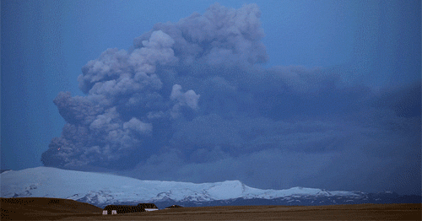
D.1.4 Discuss possible locations where conditions would have allowed the synthesis of organic compounds.
Volcanoes may have also played an important role in the origin of life by fixing nitrogen (see Topic F.2.1.). Researchers have measured the composition of gases above hot lava lakes and found that there was a higher than average level of fixed nitrogen. Volcanoes may have been as important as lightning in fixing nitrogen for use by the earliest bacteria.

Slide 14
D.1.4 Discuss possible locations where conditions would have allowed the synthesis of organic compounds.
An alternative to abiogenesis (generation of life from chemicals) on Earth is the hypothesis that primitive life may have originally formed extra terrestrially, either in space or on a nearby planet, for example, Mars. Organic compounds are relatively common in space, especially in the outer solar system where they are not evaporated by solar heating.
An alternative hypothesis is the suggestion that life originated on Mars. Due to its smaller size Mars cooled down more quickly which might have allowed prebiotic evolution to occur while the Earth was too hot. Evolution on Mars may have stopped when it lost its atmosphere due to low volcanic activity.
There is little direct evidence for this extra-terrestrial hypothesis, but Martian meteorites (possibly containing remains of fossilised bacteria) have been found in Antarctica.
The extraterrestrial hypothesis does not address the issue of how life first originated but shifts it to a planet or comet. However, the advantage is that primitive life or complex organic compounds are only required to have occurred once in a single location and then spread through the galaxy by comets or meteorite

Slide 15
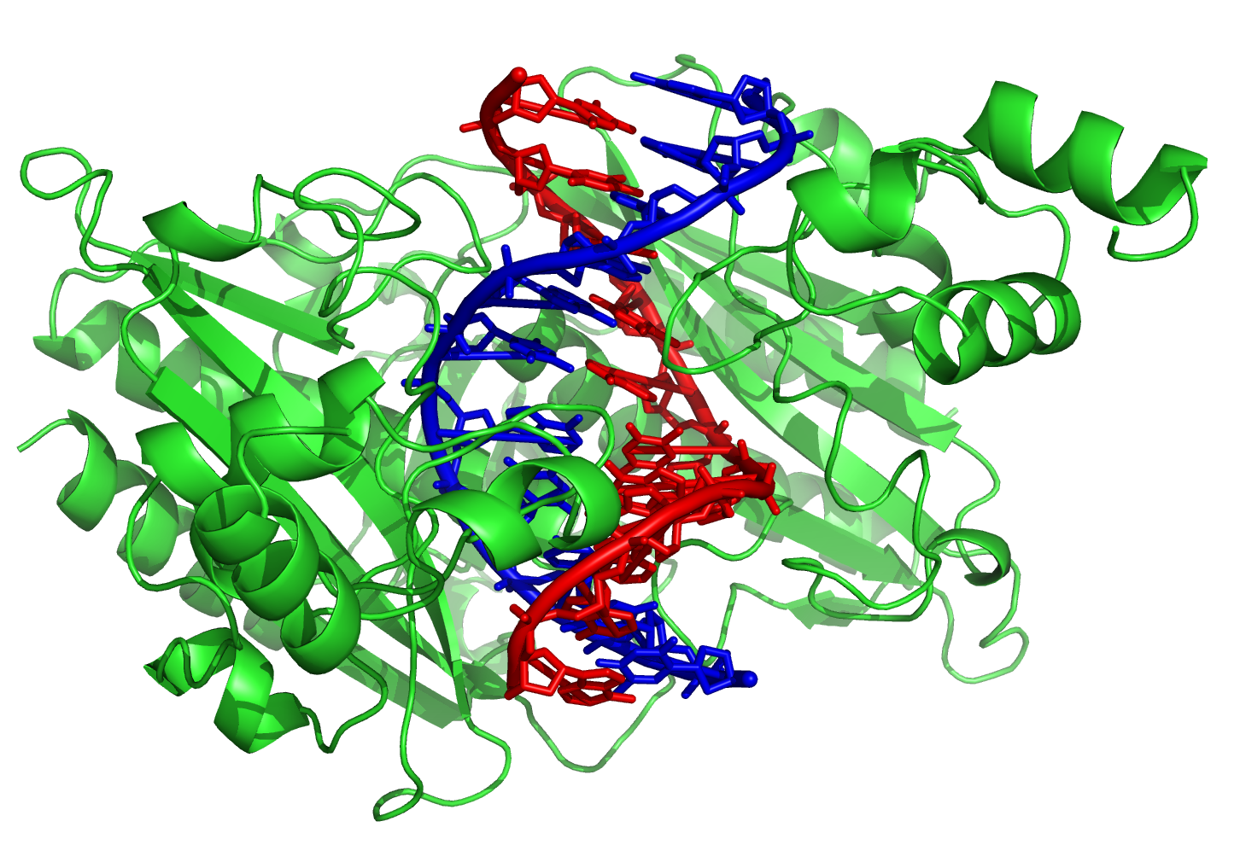
D.1.5 Outline two properties of RNA that would have allowed it to play a role in the origin of life.
A number of researchers believe that RNA may have played an important role in the origin of life by acting as the first molecule capable of replication. The RNA World hypothesis is supported by RNA’s ability to behave like DNA and Ribozymes are naturally occurring small sequences of RNA that can act as enzymes, either on themselves or other RNA molecules.
A range of artificial ribozymes have been chemically synthesised and some have been shown to perform some of the reactions of RNA replication such as polymerising nucleotides using ATP.

Slide 16
D.1.5 Outline two properties of RNA that would have allowed it to play a role in the origin of life.
RNA molecules were perhaps capable of generating the first proteins. Eventually RNA was replaced by DNA and enzymes to take over the storage of genetic information and enzymatic functions.
Evolution via natural selection can only occur on molecules that exhibit the properties of variation and heredity.

Slide 17
D.1.6 State that living cells may have been preceded by protobionts, with an internal chemical environment different from their surroundings.
Over millions of years, the complexity of organic compounds in the primeval soup gradually increased. In warm concentrated solutions the amino acids,
monosaccharides and nucleotides would have undergone a process of polymerisation.
When protein coacervates ( a small spherical droplet of organic molecules) are heated in water to 130 - 180 °C they form a boundary which resembles a cell membrane, although it lacks phospholipids. They can also grow by absorbing protein from the surrounding solution and then splitting when a certain size is reached.
The first precursors to cells, known as protobionts, may have evolved from coacervate droplets which contained polynucleotides (DNA or more likely RNA). RNA molecules may have evolved the ability to direct the assembly of amino acids into proteins. Once a simple genetic code was established this allowed the coacervate to perform the major processes of life. Presumably, a primitive process of enzyme-controlled binary fission evolved. The first true cells are believed to have been heterotrophic and anaerobic.

Slide 18
D.1.6 State that living cells may have been preceded by protobionts, with an internal chemical environment different from their surroundings.

Slide 19
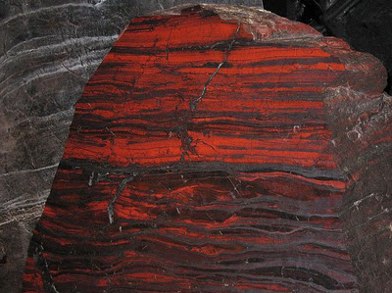
D.1.7 Outline the contribution of prokaryotes to the creation of an oxygen-rich atmosphere.
Small amounts of oxygen were first produced by the action of ultraviolet radiation on water vapour. Atmospheric oxygen is also indirectly damaging since it reacts with water to form traces of hydrogen peroxide. This is a strong oxidising agent and degrades lipids and nucleic acids. The
gradual accumulation of oxygen selected for organisms which synthesised protective enzymes, for example, catalase which converts hydrogen peroxide into water and oxygen.
A major transition in evolution occurred when bacteria evolved containing a form of chlorophyll that allowed a simple form of oxygenic photosynthesis to occur. There was then an explosive rise in oxygen levels known as the oxygen catastrophe.
Geological evidence suggests that oxygenic photosynthesis, such as that in cyanobacteria became important around two billion years ago.
Sudden bands of iron oxide appearing in ancient, 2 billion year old, rock

Slide 20
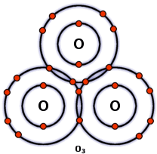
D.1.7 Outline the contribution of prokaryotes to the creation of an oxygen-rich atmosphere.
The release of oxygen by cyanobacteria had an irreversible effect on the subsequent evolution of life. The remaining organic chemicals in the ‘chemical soup’ in the oceans were broken down into carbon dioxide and oxidised sediments. In addition a layer of ozone, O₃, began to form in the upper atmosphere. This acted as a barrier to the penetration of ultra-violet radiation from the Sun. The production of new organic chemicals in the ‘chemical soup’ was thereby blocked.

Slide 21
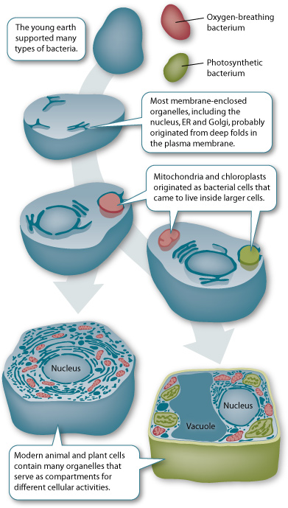
D.1.8 Discuss the endosymbiotic theory for the origin of eukaryotes.
Eukaryotes have a considerably more complex structure and appear much
later in the fossil record than prokaryotes. However, despite structural differences they share many biochemical pathways, for example, glycolysis and the light reactions of photosynthesis.
The endosymbiotic theory suggests that chloroplasts and mitochondria are derived from free living prokaryote ancestors. They were engulfed by larger prokaryotes but survived inside the cytoplasm and gradually evolved into
the chloroplast and mitochondrion.

Slide 22
D.1.8 Discuss the endosymbiotic theory for the origin of eukaryotes.
Mitochondria are believed to have evolved from proteobacteria and chloroplasts from cyanobacteria.
Listed below is the main evidence that supports the endosymbiotic theory (½):
Both organelles contain DNA that is different from the nucleus and is similar to bacteria.
Both organelles are surrounded by two membranes which resemble the composition of a prokaryote cell.
New organelles are formed by a process that resembles bacterial binary fission.
The internal structure and biochemistry of chloroplasts is very similar to that of cyanobacteria, indicating a common past. (Next page)

Slide 23
D.1.8 Discuss the endosymbiotic theory for the origin of eukaryotes.
Listed below is the main evidence that supports the endosymbiotic theory (²/₂):
DNA sequence analysis suggests that plant nuclear DNA contains genes that had previously been part of the chloroplast.
Some proteins encoded in the nucleus are transported to the two organelles. The two organelles have smaller genomes than bacteria. This is consistent with an increased dependence on the eukaryotic host after forming an endosymbiosis. The majority of genes on the genomes of the chloroplast and mitochondria have been lost or transferred to the nucleus. Most of the proteins that comprise these organelles are encoded by genes in the nucleus.
The ribosomes of the organelles closely resemble those found in bacteria (70S).

Slide 24
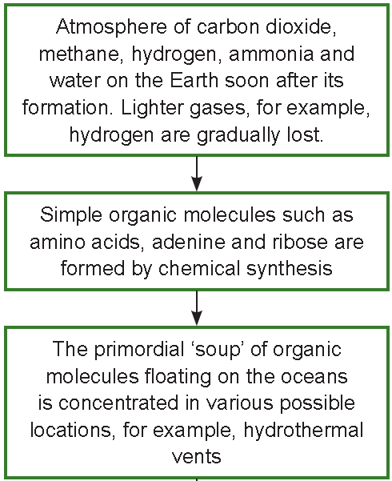
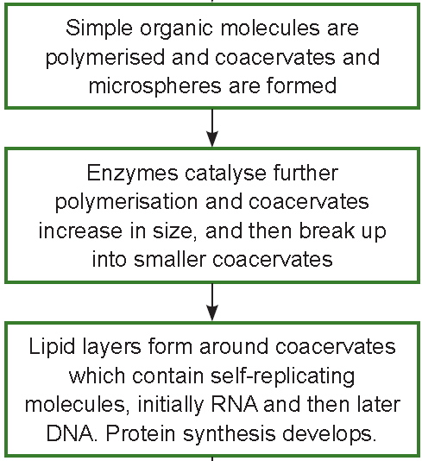
Summary of all processes

Slide 25
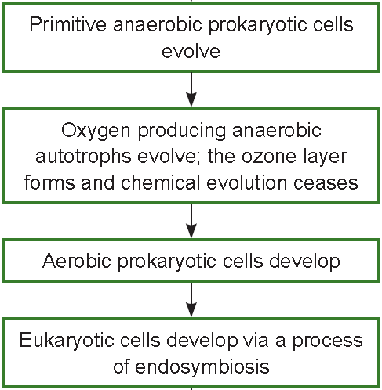
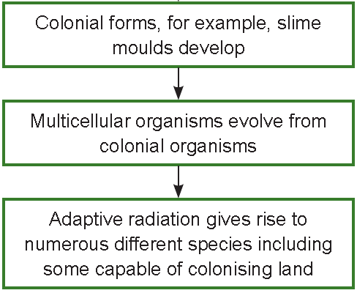
Summary of all processes

Slide 26
Option D: Evolution
D1 Origin of life on Earth

