Slide 1
Option F Biotechnology and Microbes
F 3 Microbes and Biotechnology

Slide 2
ASSESSMENT STATEMENTS
F.3.1 State that reverse transcriptase catalyses the production of DNA from RNA.
F.3.2 Explain how reverse transcriptase is used in molecular biology.
F.3.3 Distinguish between somatic and germ line therapy.
F.3.4 Outline the use of viral vectors in gene therapy.
F.3.5 Discuss the risks of gene therapy.

Slide 3
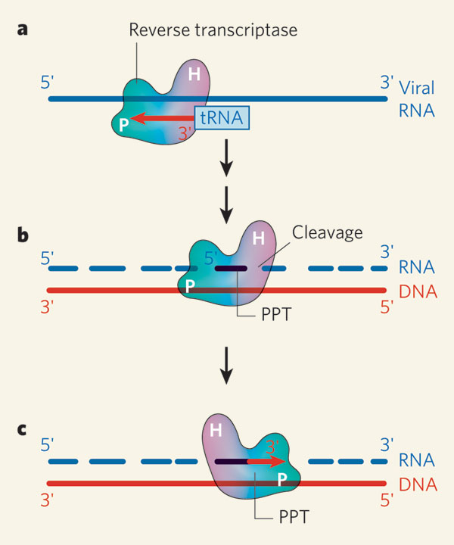
F.3.1 State that reverse transcriptase catalyses the production of DNA from RNA.
Reverse transcriptase is an enzyme that transcribes single-stranded RNA into double-stranded DNA.
Normal transcription involves the synthesis of RNA from DNA, hence reverse transcription is the reverse of this, as it synthesises DNA from RNA.
The gene encoding reverse transcriptase is present in HIV and other retroviruses.
LINK

Slide 4
F.3.2 Explain how reverse transcriptase is used in molecular biology.
Reverse transcriptase is commonly used in molecular biology to apply the polymerase chain reaction (PCR) (see Topic 4.4.1) is a technique to amplify a single or a few copies of a piece of DNA across several orders of magnitude, generating thousands to millions of copies of a particular DNA sequence.
A technique called reverse transcription polymerase chain reaction (RTPCR) is used to qualitatively detect gene expression through creation of complementary DNA (cDNA) transcripts from RNA.
PCR can only be applied to DNA strands, but with reverse transcriptase, RNA can be transcribed into DNA, thus making PCR analysis of RNA molecules possible.
Reverse transcription polymerase chain reaction is widely used in the diagnosis of genetic diseases and studying gene expression in cells or tissues.
LINK

Slide 5
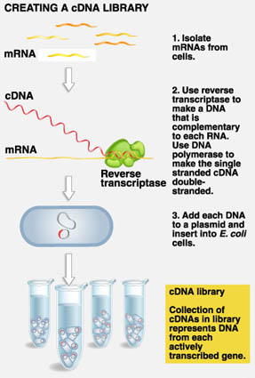
F.3.2 Explain how reverse transcriptase is used in molecular biology.
Reverse transcriptase is also used to create complementary DNA (cDNA) libraries from messenger RNA (mRNA). A cDNA library refers to a set of all the expressed genes found within a cell or organism.
Because working with messenger RNA is difficult (since messenger RNA is unstable and is easily degraded by RNAases), researchers use reverse transcriptase to produce a DNA copy of each mRNA strand.
Referred to as cDNA these reverse transcribed mRNAs are collectively known as a cDNA library.
LINK

Slide 6
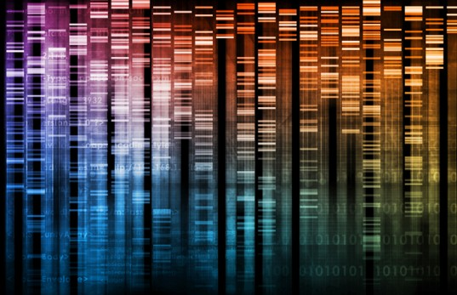
F.3.2 Explain how reverse transcriptase is used in molecular biology.
Such a DNA library has several uses. A cDNA of an organism can be cloned into a bacterium, and expressed (translated into the appropriate protein).
The complete cDNA library of an organism gives the total of the proteins it can possibly express. Comparison between the cDNA libraries from different species offers an opportunity to examine the evolutionary relationship between those species in terms of their encoded proteins
LINK

Slide 7
F.3.3 Distinguish between somatic and germ line therapy.
Gene therapy involves the replacement or modification of a gene to restore or enhance cellular function.
Somatic cell therapy involves human cells other than germ cells (gametes or cells that divide to form gametes) which are genetically altered and germ line therapy, in which a replacement gene is integrated into the genome of human gametes, resulting in transmission of the change to the next generation, and expression of the new gene in the patient’s children and their offspring.
The fundamental difference between germ line therapy and somatic cell therapy is that germ line therapy affects subsequent generations and may be associated with increased risk and the potential for unpredictable and irreversible consequences.
LINK

Slide 8
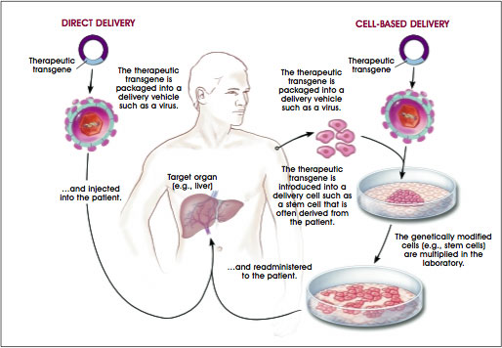
F.3.4 Outline the use of viral vectors in gene therapy.
Gene therapy is the introduction of genes into an individual’s cells and tissues to treat a genetic disorder or disease. Gene therapy aims to replace a defective mutant allele with a functional one.
In most gene therapy studies, a normal gene is inserted into the genome to replace a mutated disease-causing gene. A vector must be used to deliver the gene to the patient’s target cells.
LINK
LINK
LINK

Slide 9
F.3.4 Outline the use of viral vectors in gene therapy.
Currently, the most common vector is a virus that has been genetically altered to carry normal human DNA. Viruses have evolved a way of delivering their genes to human cells (see Topic F.1.8). Most viruses have specific cell-type targets. Molecular Biologists have taken advantage of this capability and manipulated the virus genome via use of restriction enzymes to remove disease-causing versions of genes with modified or repaired genes.
Adenoviruses (see Topic F.1.8) are commonly used viral vectors and their genomes are composed of double stranded DNA.
When these viruses infect a host cell, they introduce their DNA molecule into the host. The genome of the adenovirus is not incorporated into the host cell’s genetic material. The DNA molecule is left free in the nucleus of the host cell, and this extra DNA molecule can be transcribed.
LINK
Example of gene therapy

Slide 10
F.3.5 Discuss the risks of gene therapy.
Short-lived nature of gene therapy
The DNA introduced into target cells must remain functional and the cells containing the DNA must be long-lived and stable. Problems achieving the integration of modified DNA into the genome and the rapidly dividing nature of many cells may prevent gene therapy from achieving any long-term benefits. Patients may have to undergo multiple rounds of gene therapy.
LINK
Immune response
The risk of stimulating the immune system (due to the appearance of new (foreign) proteins)) in a way that reduces gene therapy effectiveness is a potential risk. In addition the immune system’s enhanced response to
antigens it has encountered before makes it difficult for
gene therapy to be repeated in patients.

Slide 11
F.3.5 Discuss the risks of gene therapy.
Problems with viral vectors
Viruses present a variety of potential problems to the patient - toxicity, immune and inflammatory responses, and gene control and targeting issues. In addition, there is always the possibility that a slightly modified viral vector, once inside the patient, may recover its ability to cause disease. Hence the need for removing all crucial viral genes related to pathogenicity.
Multigene disorders
Conditions or disorders that arise from mutations in a single gene are the best targets for gene therapy. However, some of the most commonly occurring disorders, such as heart disease, high blood pressure, Alzheimer’s disease, arthritis, and diabetes, are caused by the combined effects of variations in many genes. Multigene disorders such as these would be particularly difficult to treat effectively using gene therapy.

Slide 12
F.3.5 Discuss the risks of gene therapy.
Chance of inducing a tumour
If the DNA is integrated in a place in the genome, and disrupts genomic function, for example, if the insertion disrupts a tumour suppressor gene, it could induce a tumour.
TOK - What are the risks in gene therapy?
Do we have to ask ouselves if it is ethical?
Patients used for the trails are usually very ill and volunteer because it is their last resource.
At least one person has died as a result of a gene therapy trial.
Several kids with SCID (severe combined immunodeficiency disease) developed leukaemia after the therapy.
Are the benefits overruling the limitations?

Slide 13
Option F Biotechnology and Microbes
F 3 Microbes and Biotechnology

