Slide 1
Introduction to IB Biology SL
Notes:
Este Esta presentación, que se recomienda ver en modo de presentación, muestra las nuevas funciones de PowerPoint. Estas diapositivas están diseñadas para ofrecerle excelentes ideas para las presentaciones que creará en PowerPoint 2010.
Para obtener más plantillas de muestra, haga clic en la pestaña Archivo y después, en la ficha Nuevo, haga clic en Plantillas de muestra.

Slide 2
Aims of the course
1. provide opportunities for scientific study and creativity within a global context that will stimulate and challenge students
2. provide a body of knowledge, methods and techniques that characterize science and technology
3. enable students to apply and use a body of knowledge, methods and techniques that characterize science and technology
4. develop an ability to analyse, evaluate and synthesize scientific information
5. engender an awareness of the need for, and the value of, effective collaboration and communication during scientific activities
6. develop experimental and investigative scientific skills
7. develop and apply the students’ information and communication technology skills in the study of science
8. raise awareness of the moral, ethical, social, economic and environmental implications of using science and technology
9. develop an appreciation of the possibilities and limitations associated with science and scientists
10. encourage an understanding of the relationships between scientific disciplines and the overarching nature of the scientific method.

Slide 3
Objectives
1. Demonstrate an understanding of:
a. scientific facts and concepts
b. scientific methods and techniques
c. scientific terminology
d. methods of presenting scientific information.
2. Apply and use:
a. scientific facts and concepts
b. scientific methods and techniques
c. scientific terminology to communicate effectively
d. appropriate methods to present scientific information.
3. Construct, analyse and evaluate:
a. hypotheses, research questions and predictions
b. scientific methods and techniques
c. scientific explanations.
4. Demonstrate the personal skills of cooperation, perseverance and responsibility appropriate for effective scientific investigation and problem solving.
5. Demonstrate the manipulative skills necessary to carry out scientific investigations with precision and safety.

Slide 4
Command terms Objective 1
Define Give the precise meaning of a word, phrase or physical quantityDefine Give the precise meaning of a word, phrase or physical quantity
Draw Represent by means of pencil lines.
List Give a sequence of names or other brief answers with no explanation.
Label Add labels to a diagram
Measure Find a value for a quantity.
State Give a specific name, value or other brief answer without explanation or calculation.

Slide 5
Command terms Objective 2
Apply Use an idea, equation, principle, theory or law in a new situation.
Calculate Find a numerical answer showing the relevant stages in the working (unless instructed
not to do so).
Distinguish Give the differences between two or more different items.
Describe Give a detailed account.
Estimate Find an approximate value for an unknown quantity.
Identify Find an answer from a given number of possibilities.
Outline Give a brief account or summary.

Slide 6
Command terms Objective 3/1
Derive Manipulate a mathematical relationship(s) to give a new equation or relationship.
Deduce Reach a conclusion from the information given.
Construct Represent or develop in graphical form.
Compare Give an account of similarities and differences between two (or more) items, referring to both (all) of them throughout.
Analyse Interpret data to reach conclusions.
Comment Give a judgment based on a given statement or result of a calculation.

Slide 7
Command terms Objective 3/2
Show Give the steps in a calculation or derivation
Predict Give an expected result.
Explain Give a detailed account of causes, reasons or mechanisms.
Evaluate Assess the implications and limitations.
Determine Find the only possible answer.
Discuss Give an account including, where possible, a range of arguments for and against the relative importance of various factors, or comparisons of alternative hypotheses.
Sketch Represent by means of a graph showing a line and labelled but unscaled axes but with important features (for example, intercept) clearly indicated.

Slide 8
Command terms Objective 3/3
Solve Obtain an answer using algebraic and/or numerical methods.
Suggest Propose a hypothesis or other possible answer.

Slide 9
SL curriculum model
SL Total estimated teaching hours = 150
Theory 110
Core 80
Options 30
Practical work 40
Investigations 30
Group 4 project 10

Slide 10
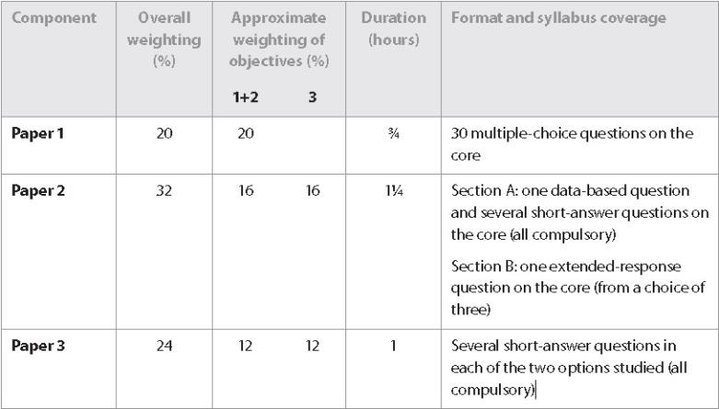
External assessment (76%)

Slide 11
External assessment
Paper 1
Paper 1 is made up of multiple-choice questions that test knowledge of the core only for students at SL and the core and AHL material for students at HL. The questions are designed to be short, one- or two-stage problems that address objectives 1 and 2 (see the “Objectives” section). No marks are deducted for incorrect responses. Calculators are not permitted, but students are expected to carry out simple calculations.

Slide 12
External assessment
Paper 2
Paper 2 tests knowledge of the core only for students at SL and the core and AHL material for students at HL.
The questions address objectives 1, 2 and 3 and the paper is divided into two sections:
In section A, there is a data-based question that requires students to analyse a given set of data. The remainder of section A is made up of short-answer questions.
In section B, students at SL are required to answer one question from a choice of three, and students at HL are required to answer two questions from a choice of four. These extended-response questions may involve writing a number of paragraphs, solving a substantial problem, or carrying out a substantial piece of analysis or evaluation. A calculator is required for this paper.

Slide 13
External assessment
Paper 3
Paper 3 tests knowledge of the options and addresses objectives 1, 2 and 3. Students at SL are required to answer several short-answer questions in each of the two options studied.

Slide 14
Internal assessment
This will be based mainly on the laboratory sessions
Laboratory: Assessed with the set of lab reports elaborated over the length of the course.
Criteria: D (Design), DCP (Data Collection and Processing) and CE (Conclusion and Evaluation) will be summatively assessed TWICE.
The criterion MP (Manipulative Skills) will be assessed each lab session (former criterion F)
The lab reports will be assessed internally by your teacher and two will be moderated by the IBO.
Group 4 project: A task performed during 10 hours together with other science students. Only the criterion; Personal Skills (PS) will be assesssed
The maximum mark for each criterion is 6
Design : 2 x 6=12
Data collection and Processing: 2 x 6=12
Conclusion and evaluation 2 x 6=12
Manupulative skills 1 x 6=6
Personal skills 1 x 6=6
TOTAL 48

Slide 15
Subject program
The subject Biology SL will be given 6 hours weekly of which 2 are dedicated to lab work. This lab work doesn’t necessarily have to be each week.
The criteria assessed will be:
Biology SL
A. Theory | 40%
B. Applied Theory | 30%
C. Experimentation | 20%
D. AIE | 10%
Criterion A: Will be evaluated with one or two tests per trimester and the evaluation exam. The format of these exams will be similar to the IBO Exams. They will have multiple choice questions (Paper 1) and short and long answer questions (like section B in Paper 2 and 3).
Criterion B: Will be evaluated with one or two tests per trimester and the evaluation exam. They will consist out of short answer questions based on the analysis of data (like section A in paper 2 and 3).
Criterion C: This mark will be established by the evaluation of your lab reports.

Slide 16
Subject program
Criterion D (AIE): This criterion will be evaluated by the opinion of your teacher. The mark will be established by taking into account the following aspects:
Your work on the online questions of each unit;
Your work on other tasks;
Handing in your work on time;
Having your materials complete;
Assistance and being on time;
Behaviour;
Participation and feedback on the subject.
(during the course, more criteria might be added)
Biology SL
A. Theory | 40%
B. Applied Theory | 30%
C. Experimentation | 20%
D. AIE | 10%

Slide 17
Group 4 project
This is a cooperative project in which students of different subjects work together on a scientific topic. It permits the interchange of concepts and perceptions from the different disciplines, like is described by aim nº 10: ‘encourage an understanding of the relationships between scientific disciplines and the overarching nature of the scientific method.’
The project permits students to value environmental, social and ethical implications of science and technology.

Slide 18
Group 4 project
Project stages
Planning
This stage is crucial to the whole exercise and should last about two hours.
• The planning stage could consist of a single session, or two or three shorter ones.
• This stage must involve all group 4 students meeting to “brainstorm” and discuss the central topic, sharing ideas and information.
• The topic can be chosen by the students themselves or selected by the teachers.
• Where large numbers of students are involved, it may be advisable to have more than one mixed
subject group.
After selecting a topic or issue, the activities to be carried out must be clearly defined before moving from the planning stage to the action and evaluation stages.
A possible strategy is that students define specific tasks for themselves, either individually or as members of groups, and investigate various aspects of the chosen topic. At this stage, if the project is to be experimentally based, apparatus should be specified so that there is no delay in carrying out the action stage. Contact with other schools, if a joint venture has been agreed, is an important consideration at this time.

Slide 19
Group 4 project
Action
This stage should last around six hours and may be carried out over one or two weeks in normal scheduled
class time. Alternatively, a whole day could be set aside if, for example, the project involves fieldwork.
• Students should investigate the topic in mixed subject groups or single subject groups.
• There should be collaboration during the action stage; findings of investigations should be shared
with other students within the mixed/single subject group. During this stage, in any practically based
activity, it is important to pay attention to safety, ethical and environmental considerations.
Note: Students studying two group 4 subjects are not required to do two separate action phases.

Slide 20
Group 4 project
Evaluation
The emphasis during this stage, for which two hours is probably necessary, is on students sharing their findings, both successes and failures, with other students. How this is achieved can be decided by the teachers, the students or jointly.
• One solution is to devote a morning, afternoon or evening to a symposium where all the students, as individuals or as groups, give brief presentations.
• Alternatively, the presentation could be more informal and take the form of a science fair where students circulate around displays summarizing the activities of each group.
The symposium or science fair could also be attended by parents, members of the school board and the press. This would be especially pertinent if some issue of local importance has been researched. Some of the findings might influence the way the school interacts with its environment or local community.

Slide 21
Assessment criteria
There are five assessment criteria that are used to assess the work of both SL and HL students.
• Design—D
• Data collection and processing—DCP
• Conclusion and evaluation—CE
• Manipulative skills—MS
• Personal skills—PS
The first three criteria—design (D), data collection and processing (DCP) and conclusion and evaluation (CE)—are each assessed twice.
Manipulative skills (MS) is assessed summatively over the whole course and the assessment should be based on a wide range of manipulative skills.
Personal skills (PS) is assessed once only and this will be during the group 4 project.

Slide 22
Assessment criteria
Each of the assessment criteria can be separated into three aspects as shown in the following sections.
Descriptions are provided to indicate what is expected in order to meet the requirements of a given aspect completely (c) and partially (p). A description is also given for circumstances in which the requirements are not satisfied, not at all (n).
A “complete” is awarded 2 marks, a “partial” 1 mark and a “not at all” 0 marks.
The maximum mark for each criterion is 6 (representing three “completes”).

Slide 23
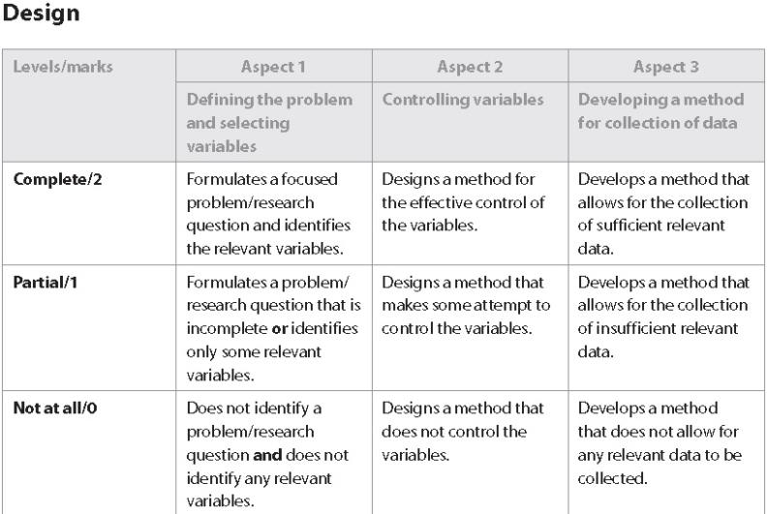
Design

Slide 24
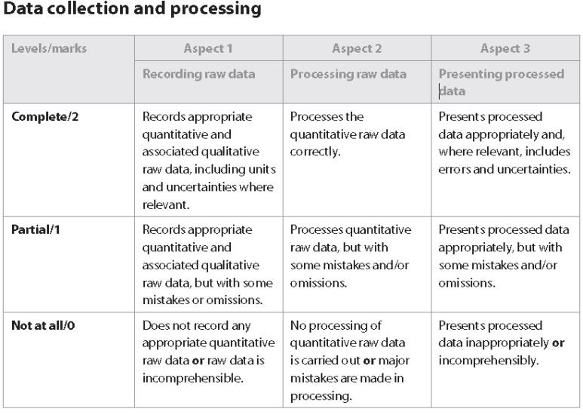
Data collection and processing

Slide 25
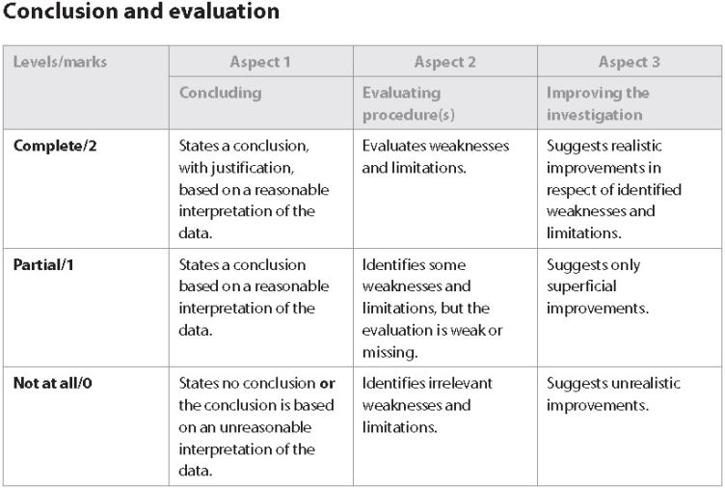
Conclusion and evaluation

Slide 26
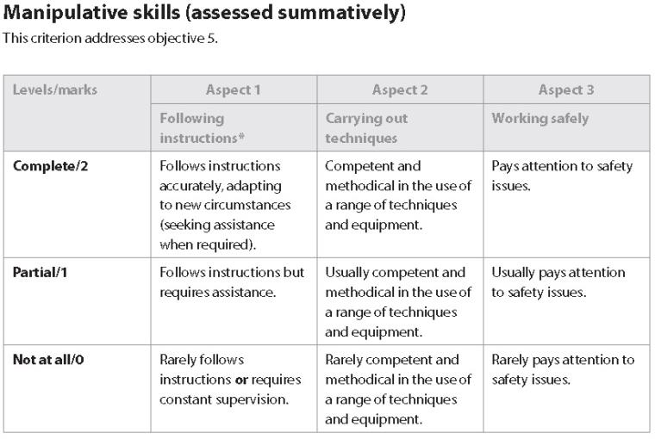
Manipulative skills

Slide 27
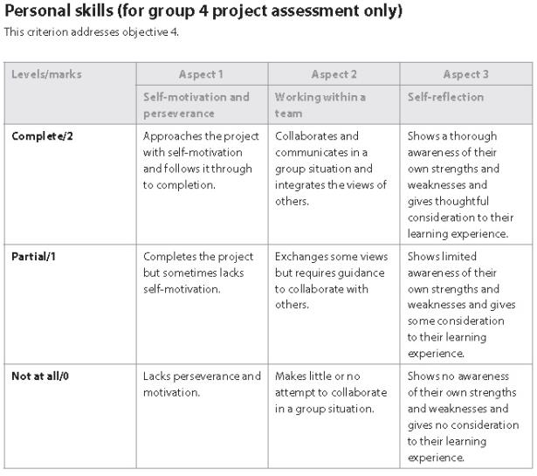
Personal skills

Slide 28
Syllabus view or download the complete content from the website (click here)
Core
Topic 2: Cells
Topic 3: The chemistry of life
Topic 4: Genetics
Topic 5: Ecology and evolution
Topic 6: Human health and physiology
Topic 1: Statistical analysis

Slide 29
Syllabus view or download the complete content from the website (click here)
Options
Option D: Evolution
Option F: Microbes and biotechnology

Slide 30
Calender (for now)
6h each week
Theory 110
Lab 40h (30 lab – 10 group 4)

Slide 31
Introduction to IB Biology SL
Notes:
Este Esta presentación, que se recomienda ver en modo de presentación, muestra las nuevas funciones de PowerPoint. Estas diapositivas están diseñadas para ofrecerle excelentes ideas para las presentaciones que creará en PowerPoint 2010.
Para obtener más plantillas de muestra, haga clic en la pestaña Archivo y después, en la ficha Nuevo, haga clic en Plantillas de muestra.

