Slide 2
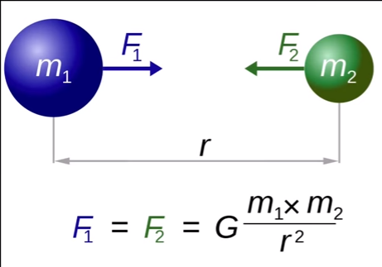
Gravational force calculations
Gravational force animation
Gravational force is equal to the mass of object 1(m1) multiplied by the mass of object 2 (m2) multiplied by the constant (G) devided by the distance between the centres of the objects squared (r2).

Slide 3
What is the gravational force between an object of 100kg and an object of 200kg with a distance of 4m between them?
Data
G: 6,67 x 10-11 (Nm2/kg2)
m1= 100kg
m2= 200kg
r= 4m
F=.......N
Formula
Calculations

Slide 6
