Slide 1

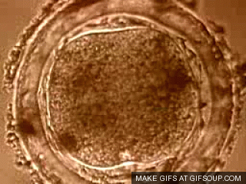
Topic 1 EXTRA
Calculate magnifications

Slide 2
Cells and sizes
2.1.4 Compare the relative sizes of molecules, cell membranes thickness, viruses, bacteria, organelles and cells, using the appropriate SI unit.
When we talk about cells we need to use units probably unfamiliar to you because of their, and especially their organelles’, extremely small sizes.
As you know, a millimetre is a thousand of a meter, so 1 m=1000 mm
When we refer to cell and organelle sizes we use micrometres (µm)
µ is called ‘Micro sign’ in Office
1 millimetre (mm) = 1000 micrometres (µm)
1 micrometre (µm) = 1000 nanometres (nm)
Most cells are up to 100 micrometres
Organelles are up to 10 micrometres
Bacteria are up to 1 micrometre
Viruses are up to 100 nanometres
Membranes are 10 nanometres thick
Molecules are near 1 nanometre

Slide 3
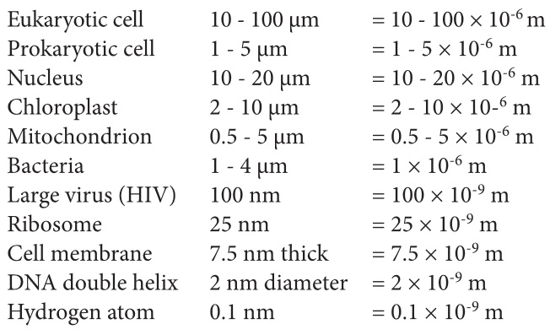
Some examples

Slide 4
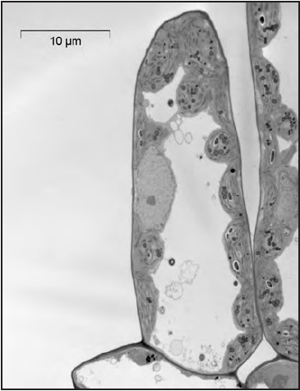
2.1.5 Calculate the linear magnification drawings and the actual size of specimens in images of known magnification.
Diagrams and photographs can be shown larger or smaller than reality. To indicate the real size of the object, the magnification can be indicated next to the diagram or picture or a scale bar can be given.
Magnification 2x
The size of the bar is 10µm, so 10x10⁻⁶m.
How large is the cell?

Slide 5
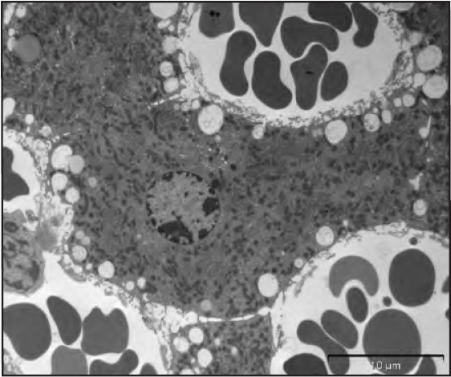
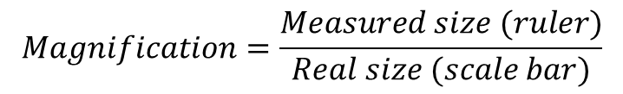
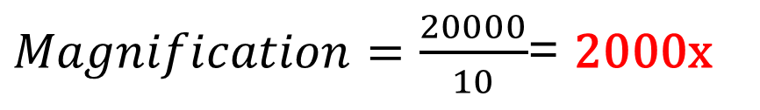
Calculating the magnification
To calculate the magnification used to establish the image on the right you need to apply a very simple formula;
$$Magnification=\frac{Measured size (ruler)}{Real size (scale bar)}$$
The real size of the scale bar is 10 µm.
The measured size with a ruler would be 20 mm.
$Magnification=\frac{20000}{10}$= 2000x
10 µm

Slide 6
Off course you use the same procedure to calculate the size of organelles you observe on the image.
If you want to calculate the size of the nucleus of the liver cell you see on the image, you use the same magnification you just calculated.
So real size: = 14 mm or 14000 µm
= 14000 µm/2000
= 7 µm
10 µm

Slide 7
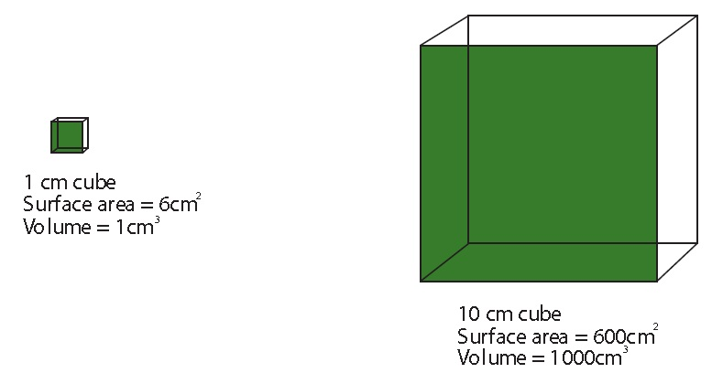
2.1.6 Explain the importance of the surface area to volume ratio as a factor of limiting cell size.
The size of a cell is limited by its need to exchange materials with its environment. If a cell becomes too large, its diffusion distance becomes too long to be efficient and its surface to volume ratio becomes too small to allow the necessary exchange.
The surface area is larger than the volume.
Surface to volume ratio = 6:1
The surface are is smaller than the volume.
Surface to volume ratio = 0,6:1

Slide 8
The rate with which a cell produces heat/waste and consumes resources (food/oxygen) is directly proportional to its volume. However, since the uptake of resources and the removal of heat/waste goes via the cell membrane, the rate of uptake/removal is proportional to its surface area.
The surface area is larger than the volume.
Surface to volume ratio = 6:1
The surface are is smaller than the volume.
Surface to volume ratio = 0,6:1
So a volume of 1cm³ has a surface area of 6 cm² in the small cube, and a volume of 1cm³ in the big cube only of 0.6cm², so a tenth the amount.

Slide 9
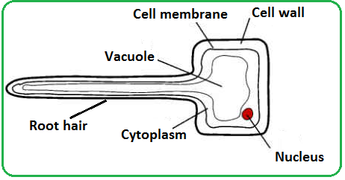
Some statements regarding surface area to volume ratio:
as size increases both surface area and volume increase, but volume increases more
ratio of surface area to volume decreases as size of cell increases
rate of metabolism is a function of its mass to volume ratio
surface area limits/affects the rate at which substances can enter (or leave) the cell.
volume determines the rate at which material is produced/used
oxygen/nutrients/substances will take too long to diffuse into/out of the centre of the cell if it is too big
excretory products would take too long to be eliminated
heat will take too long to be eliminated
example of cell adaptation to increase the ratio of surface area:volume e.g. root hair cell;

Slide 10
Check out this animation to understand the concept a bit better
LINK

Slide 11
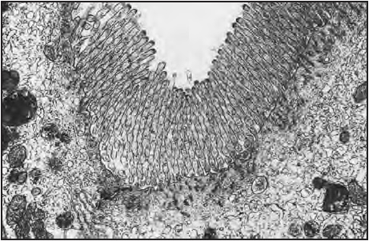
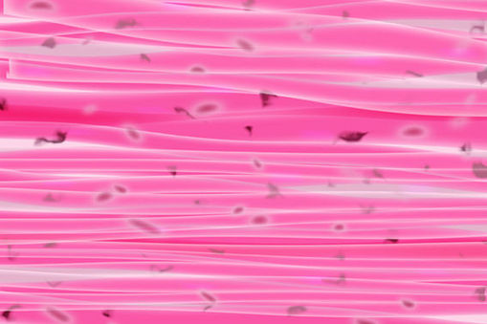
Ways of dealing with volume surface area ratios.
Increasing the surface area is the best way to facilitate a proper diffusion of substances through the cell membrane. Cells do that by:
Having protruding extensions
For example the epithelium of the gut has small extensions to increase the surface area and facilitate the absorption of substances in the blood.
Flattening the cells.
This makes the diffusion distance much smaller, like the muscle cells on the image.
Link to image

Slide 12
Topic 1 EXTRA
Calculate magnifications

