Slide 1
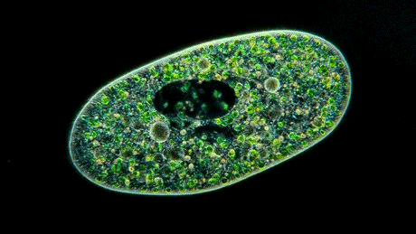
Topic 1 Cells
1.2 Ultrastructure of cells

Slide 2
Nature of science
Developments in scientific research follow improvements in apparatus: the invention of electron microscopes led to greater understanding of the cell structure.
Understandings:
Prokaryotes have a simple cell structure without compartments
Eukaryotes have a compartmentalised cell structure
Prokaryotes divide by binary fission
Electron microscopes have a much higher resolution than light microscopes

Slide 3
Applications and skills
Application: The structure and function of organelles within exocrine gland cells of the pancreas
Skill: Drawing the ultrastructure of prokaryotic cells based on electron micrographs (EM)
Application: the structure and function of organelles within palisade mesophyll cells of the leaf
Skill: Drawing the ultrastructure of eukaryotic cells based on electron micrographs (EM)
Skill: Interpretation of electron micrographs to identify organelles and deduce the function of specialised cells.
Essential idea: Eukaryotes have a much more complex cell structure than prokaryotes.

Slide 4
The electron microscope
Light microscopes, like the ones in the lab, cannot produce images oof structures smaller than 0,2 micrometers (µm). This is a problem becuase most structures within a cell are smaller than that. For example the membrane of the cell is about 0.001 µm thick. The invention of the electron microscope changed this.
This first electron microscope was developed in Germany during the 1930’s to be used in the 40’s and 50’s in laboratories. Things up to 0.001 µm became visible (200x smaller than with the light microscope).
Lots of discoveries were made with the EM, like the membranes of organelles and the ultracellular structures like the intricate internal membrane of the mitochondria.
Nowadays there are even electron tomography pictures made, producing 3D images.
LINK

Slide 5
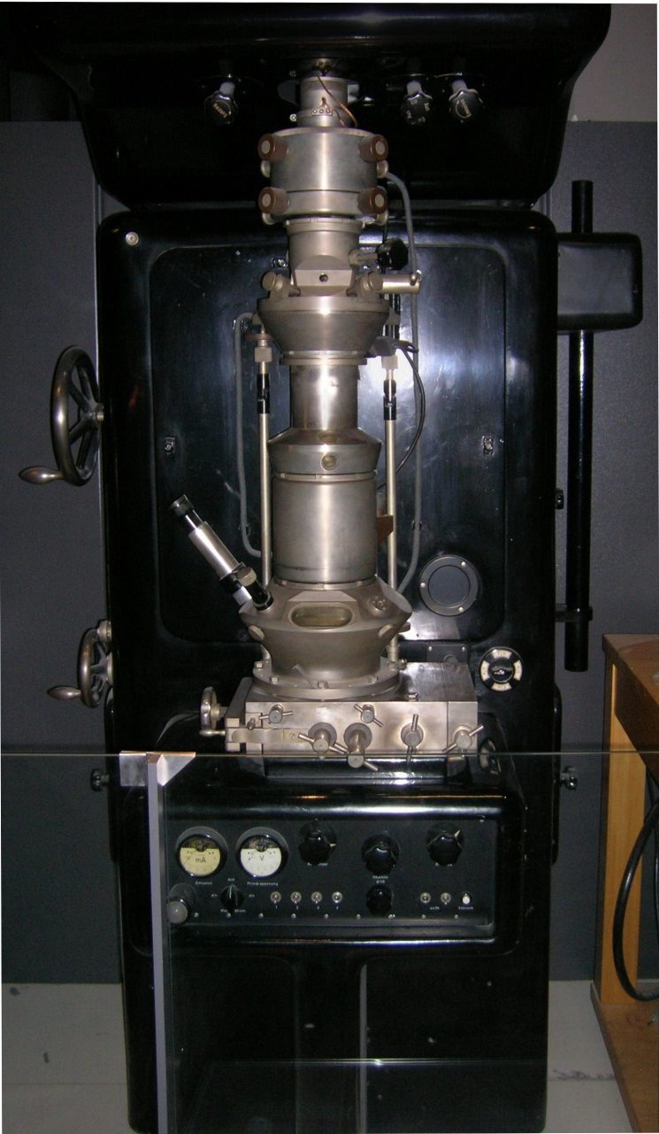
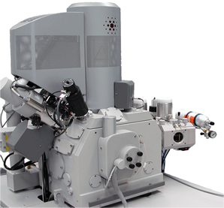
The electron microscope
Modern electron tomograph
First EM

Slide 6
The electron microscope
The maximum resolution we can see with our naked eye is of 0.1mm, or 100µm. With a light microscope we can see up to 0.2 µm, this makes it possible to distinguish cells. This can’t be more because the wavelength of light is between 400 and 700 nm.
Beams of electron have a much smaller wavelength, so the resolution of an EM is much higher, up to 0.001 µm, or 1 nm.
Read the orange box on the left of pg 18. What do you think is the reason?

Slide 7
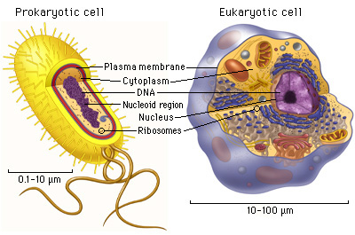
The prokaryotic cell
As you remember from previous years we can divide cells in two major groups, prokaryotic and eukaryotic cells. The main characteristics are very similar but there are various structural differences between the two types of cells. (the differences on the next slide don’t need to be studied see pg 18-19)
Link to image

Slide 8
 | Eukaryotic Cell | Prokaryotic Cell
Nucleus: | Present | Absent
Number of chromosomes: | More than one | One--but not true chromosome:Plasmids
Cell Type: | Usually multicellular | Usually unicellular (some cyanobacteria may be multicellular)
True Membrane bound Nucleus: | Present | Absent
Example: | Animals and Plants | Bacteria and Archaea
Genetic Recombination: | Meiosis and fusion of gametes | Partial, undirectional transfers DNA
Lysosomes and peroxisomes: | Present | Absent
Microtubules: | Present | Absent or rare
Endoplasmic reticulum: | Present | Absent
Mitochondria: | Present | Absent
Cytoskeleton: | Present | May be absent
DNA wrapping on proteins.: | Eukaryotes wrap their DNA around proteins called histones. | Multiple proteins act together to fold and condense prokaryotic DNA. Folded DNA is then organized into a variety of conformations that are supercoiled and wound around tetramers of the HU protein.
Ribosomes: | larger | smaller
Golgi apparatus: | Present | Absent
Chloroplasts: | Present (in plants) | Absent; chlorophyll scattered in the cytoplasm
Flagella: | Microscopic in size; membrane bound; usually arranged as nine doublets surrounding two singlets | Submicroscopic in size, composed of only one fiber
Permeability of Nuclear Membrane: | Selective | not present
Plasma membrane with steriod: | Yes | Usually no
Cell wall: | Only in plant cells and fungi (chemically simpler) | Usually chemically complexed
Cell size: | 10-100um | 1-10um

Slide 9
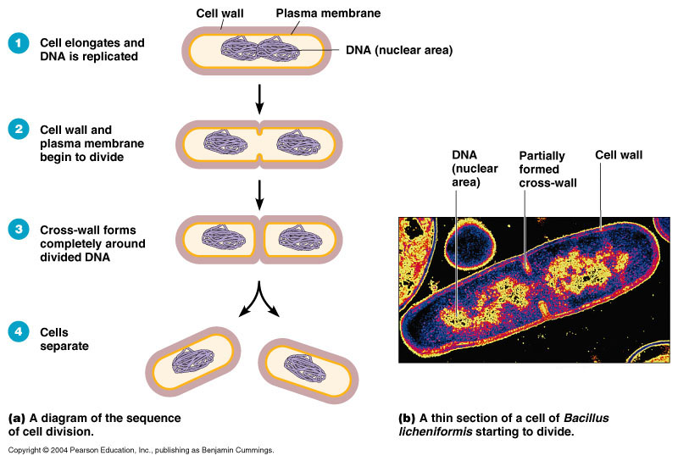
Cell division in prokaryotes
Prokaryotic cells divide by binary fission.
The process of binary fission starts with DNA replication which is followed by the separation of the two circular strands of DNA to either side of the cell.
Then cytokinesis occurs, where the cell divides into two.
Each new cell receives about half of the cytoplasm.
Subsequent growth will restore each cell to full size.
Link to animation

Slide 10
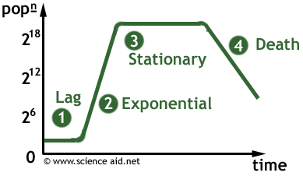
Cell division in prokaryotes

Slide 11
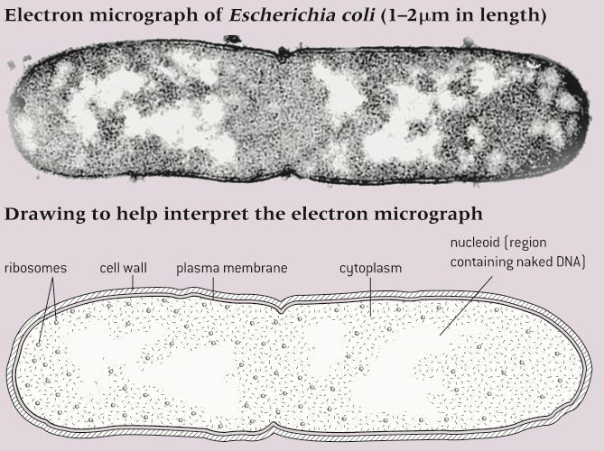
Drawing the ultrastructure of prokaryotic cells based on EM
Let’s take a pen and a paper and try this yourself!

Slide 12
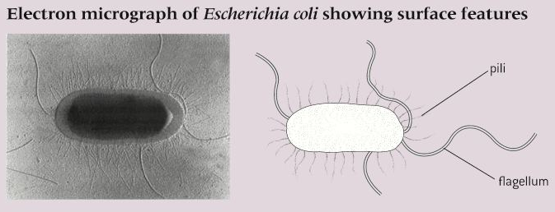
Drawing the ultrastructure of prokaryotic cells based on EM
Let’s take a pen and a paper and try this yourself!

Slide 13
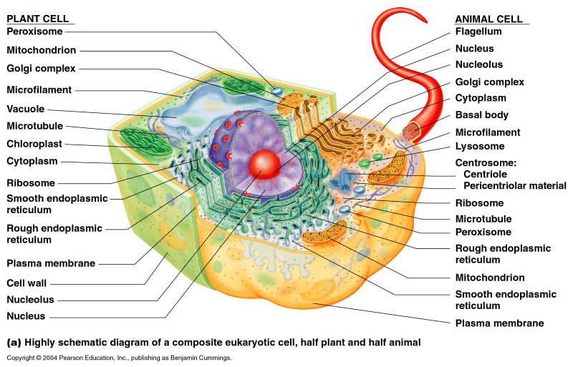
Eukaryotic cells
Eukaryotic cells have a much more complex internal structure than prokaryotic cells. Eukaryotic cells have their cytoplasms compartmentalised, this means that it is divided into compartments with single or double membranes. The most iportant compartment is the nucleus where you can find the chromosomes. Sp each compartment is called a organelle.
Note that the image on the left is a highly schematic illustration. It compares some possible structures of both animal and plant cells.

Slide 14
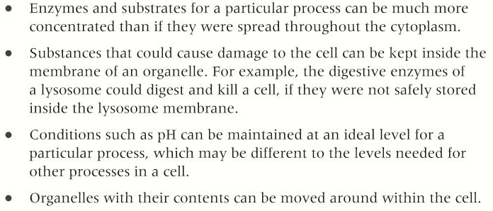
Eukaryotic cells
There are several advantages to being compartmentalised:

Slide 15
Drawing the structure of eukaryotic cells
It is best to draw only parts of the eukaryotic cell as they are very difficult to draw. Lest’s practice to draw each ultrastructure!
First…..the nucleus!

Slide 16
Drawing the structure of eukaryotic cells
Second…..the RER
Third…..the golgi apparatus

Slide 17
Drawing the structure of eukaryotic cells
Third…..the lysosome
Fifth…..the mitochondrion

Slide 18
Drawing the structure of eukaryotic cells
Sixth…..the free ribosomes
Seventh…..the chloroplast

Slide 19
Drawing the structure of eukaryotic cells
Eight…..the vacuoles and vesicles
Ninth…..the microtubules and centrioles

Slide 20
Drawing the structure of eukaryotic cells
And last but not least…..the cilia and flagella
This is a cross section!

Slide 21
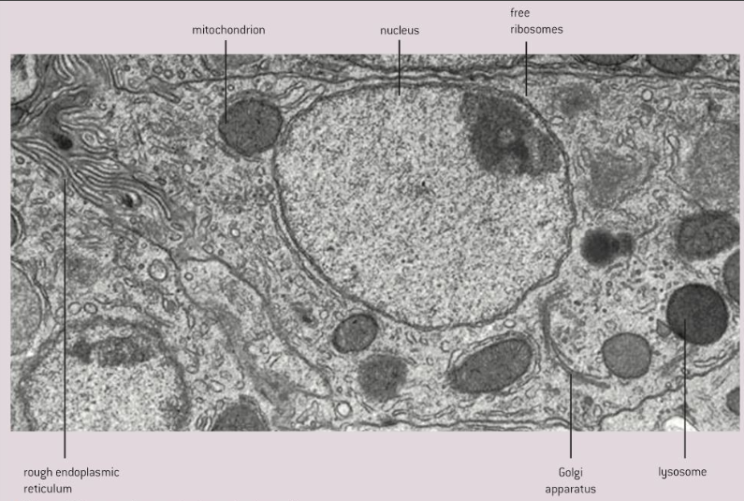
Drawing the structure of eukaryotic cells
An EM image of the entire cell would look like this:

Slide 22
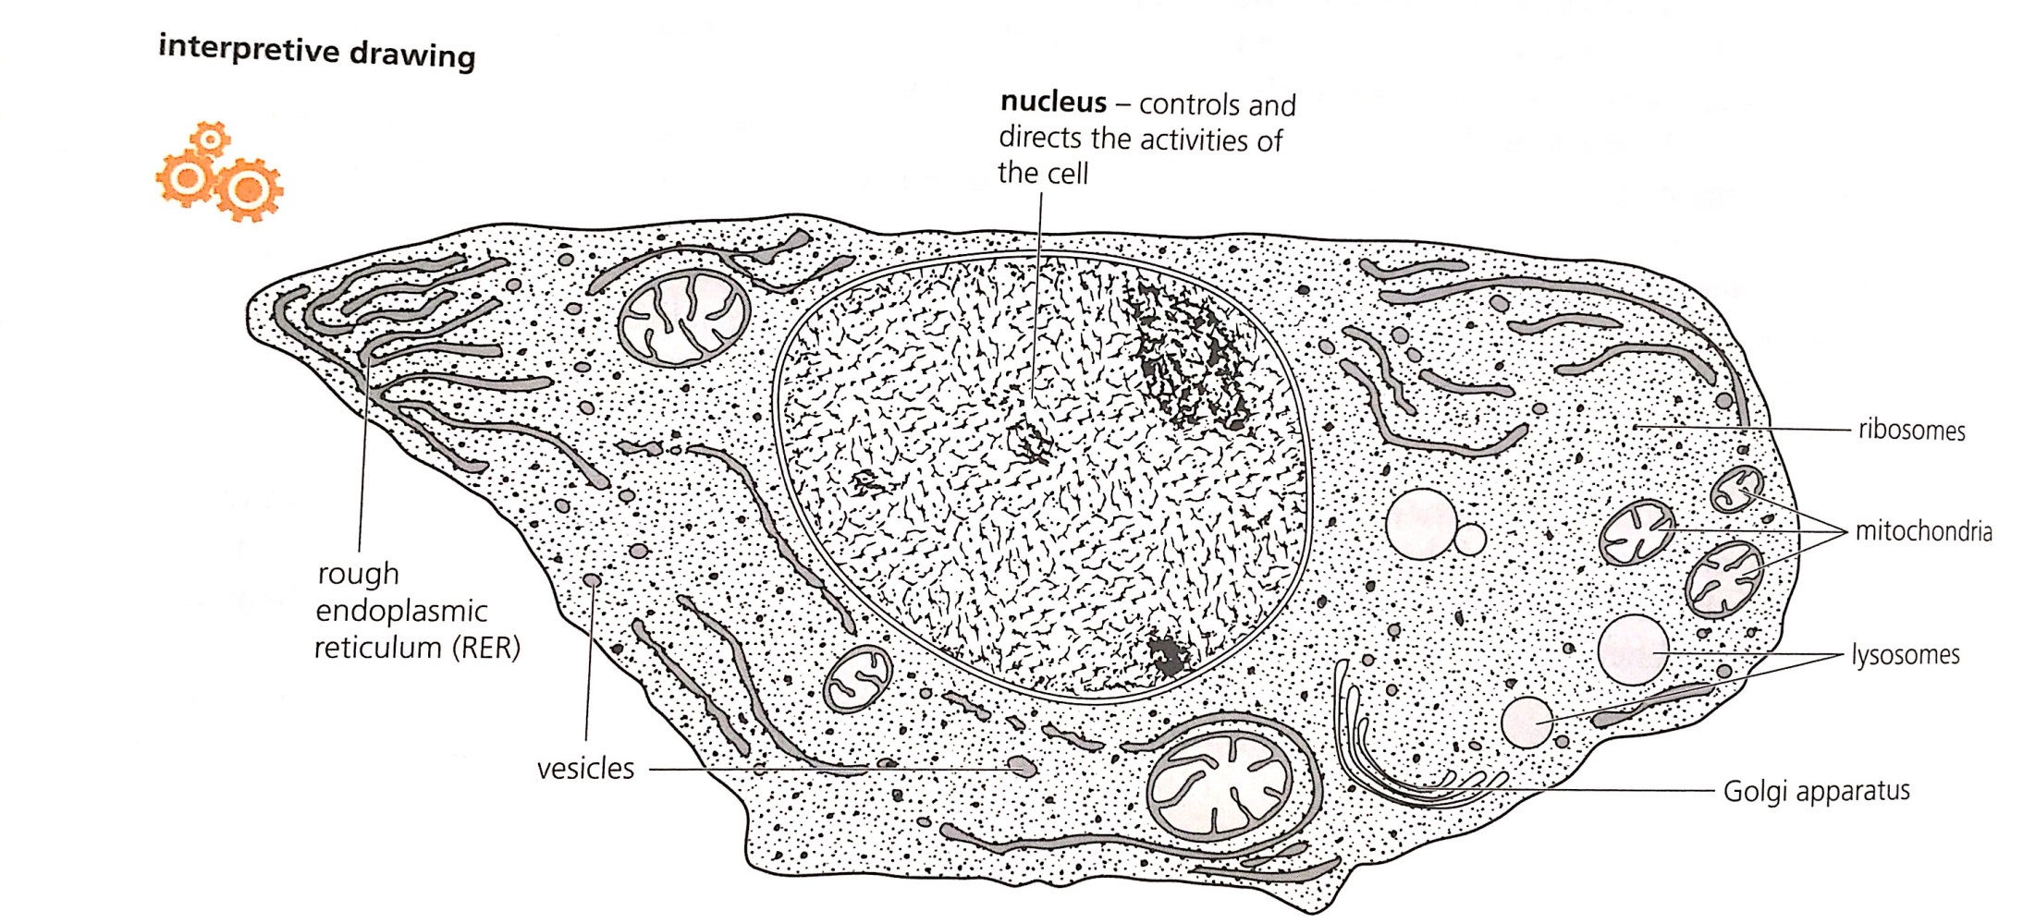
Drawing the structure of eukaryotic cells
But you would draw it like this:

Slide 23
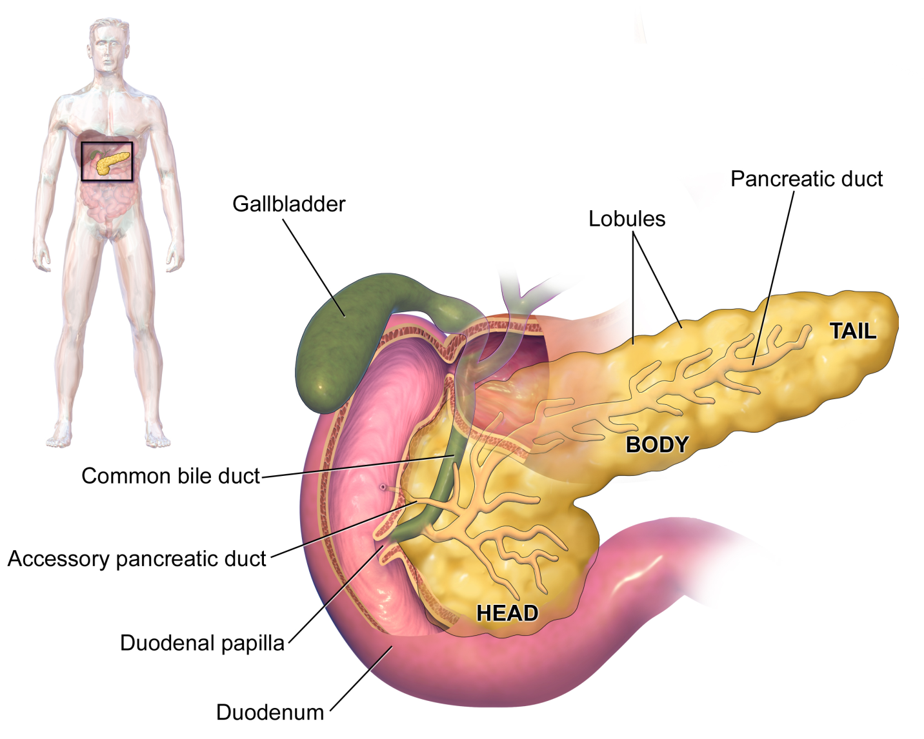
Exocrine glands of the pancreas
Gland cells secrete chemical substances like hormones and enzymes. There are many glands in your body like the pituitary gland, the thyroid gland, the adrenal gland etc. The gland cells secrete these chemicals through their plasma membranes.
In the pancreas there are two types of gland cells, endocrine and exocrine glands.
Exocrine cells in the pancreas secrete digestive enzymes into a duct which carries them to the small intenstine to digest food.

Slide 24
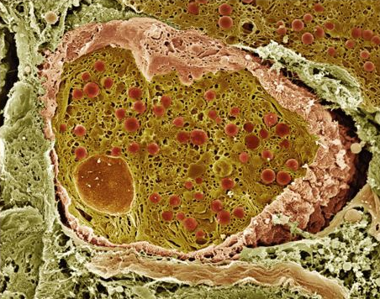
Exocrine glands of the pancreas
Enzymes are proteins, so these cells need to have organelles to synthesise these substances, them process them and then transport the to the plasme membrane. Here is an EM from your book of those organellles involved in these processes.

Slide 25
Topic 1 Cells
1.2 Ultrastructure of cells

