Slide 1
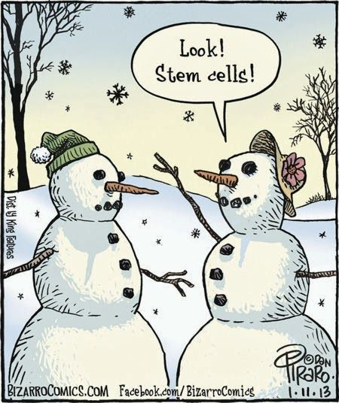
Topic 1 Cells
1.5 The origin of cells

Slide 2
Design an investigation
Tomorrow we will do some first trials if possible!
Some tips before you start your investigation:
Make sure the topic is related to the content of the course
Make sure the experiment can be performed in the school lab (check materials)
Make sure you can obtain quantitative data
Make sure you can obtain sufficient relevant data (5x5 of 15x2)
Make sure some statistics can be done with the data
Make sure your experiment is of good quality (you are in bachillerato, not in the ESO anymore!)
Make sure you estimate the time you need for the experiment properly and discuss the possibilities with your teacher
Do some trials before you really start to see if what you want to do is possible
Do some good background investigation before starting
Have the objective very clear before you start
Always check with your teacher before you invest too much time in vane!

Slide 3
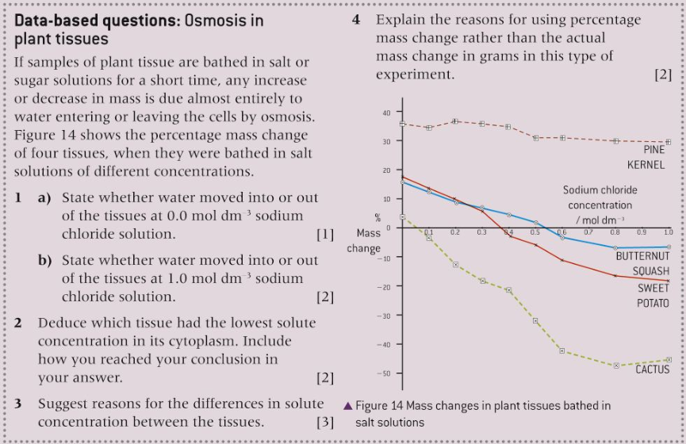
Revision questions

Slide 4
Nature of science
Testing the general principles that underlie the natural world—the principle that cells only come from pre-existing cells needs to be verified. (1.9)
Understandings:
Cells can only be formed by division of pre-existing cells.
The first cells must have arisen from non-living material.
The origin of eukaryotic cells can be explained by the endosymbiotic theory

Slide 5
Applications and skills
Application: Evidence from Pasteur’s experiments that spontaneous generation of cells and organisms does not now occur on Earth.
ToK
Biology is the study of life, yet life is an emergent property. Under what circumstances is a systems approach productive in biology and under what circumstances is a reductionist approach more appropriate? How do scientists decide between competing approaches?
Essential idea: There is an unbroken chain of life from the first cells on Earth to all cells in organisms alive today.

Slide 6
Cell division and the origin of cells
Cells can only be formed by division of preexisting cells
The idea that cells can be only produced from pre-existing cells stems from 1880. the implications have been huge. This means that all the diversity we have of life must have started with only one cell.
Have a look at your own body, an egg cells was fertilized by a sperm cell forming a one-cell zygote. This one cell has become your body with all the different tissues and systems, with a brain and blood flowing through it.
So if cells only come from pre-existing cells, the information for the construction of your entire body must have all already been present in that first zygote.
But where do humans come from? If cells come from pre-existing cells, species must come from pre-existing species. So there must have been a common ancestor to all life on Earth.

Slide 7
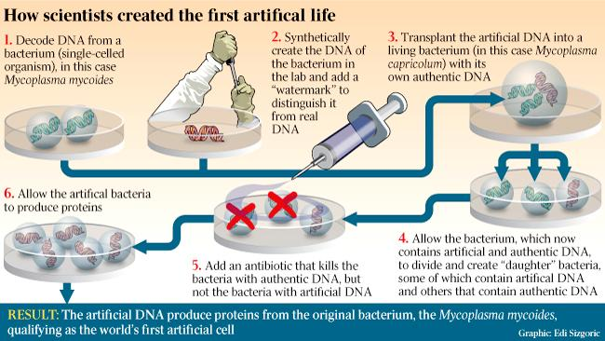
Cell division and the origin of cells
Cells can only be formed by division of preexisting cells
ToK
Artificial life, future or present? LINK

Slide 8
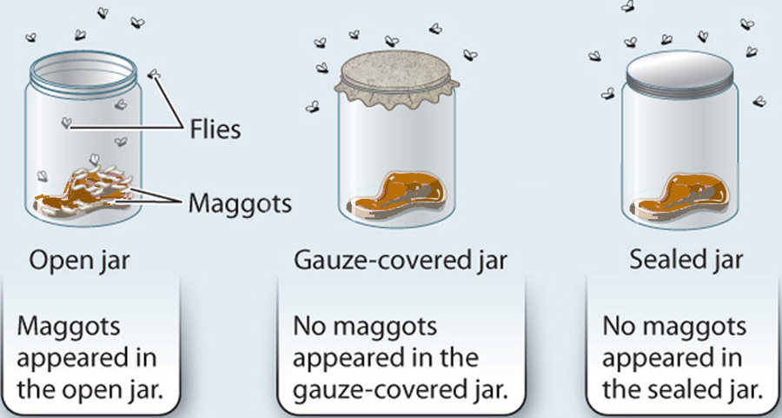
Spontaneous generation
and the origin of life
LINK
Spontaneous generation is the formation of living organisms from non-living matter. When the cell and microscopic life was not yet discovered, scientist were of pinion that life could originate from non-living matter. Plants could sprout from bare soil, mice could be generated from old pieces of clothes and maggots from rotting meat. They based this on observations, clearly maggots were initially not there but after a few days suddenly appearing, nobody saw them crawling towards the meat so they must have been created from it.
Soon experiments were carried out to prove these theories false. Francesco Redi for example showed that the maggots on the meat only developed if the meat had been in contact with flies.
LINK

Slide 9
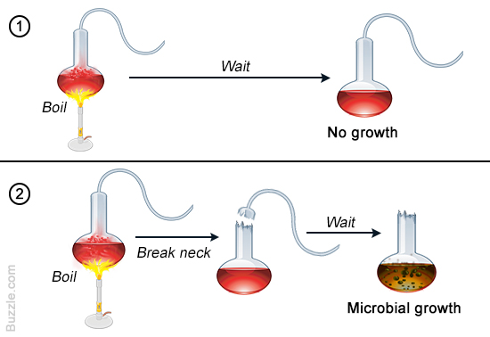
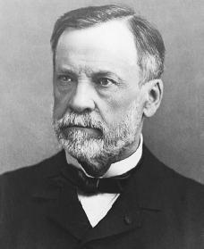
Spontaneous generation
and the origin of life
Rafael Spallanzani boiled four containers with soup, left four open and closed the other four. After boiling the microorganisms died so the eight containers were sterilised, but the four unsealed containers started to rot again soon. Clearly microorganisms came from the air and were not spontaneously generated.
LINK
But the scientific world really became convinced when Louise Pasteur did his experiments and published his findings.
Read about Louise Pasteur’s experiments on page 47 and 48 and discuss them in class.

Slide 10
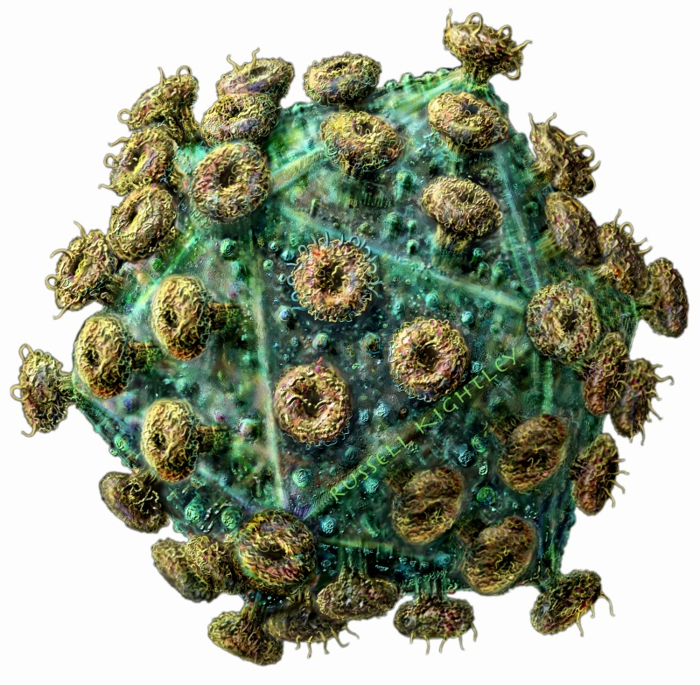
Spontaneous generation
and the origin of life
Apart from the evidence from these experiments there are more reasons why cells must come from pre-existing cells:
A cell is a highly complex structure and no natural mechanisms has been yet suggested for producing cells from simpler units than other cells.
No example is know for increase of cells in a populations, organism or tissue without cell division taking place.
Viruses are produced from simpler units but they are not composed out of cells. They can only reproduce inside a host cell.

Slide 11
Origin of the first cells
The first cells must have arisen from non-living matter
Life has been proven to have existed for about approximately 3.8 billion years ago. The first living being must have been very simple in structure, but already have fulfilled all the functions of life, among which reproduction.
There are several theories, most accepted is the chemical evolution where organic compounds were synthesised from inorganic compounds. Later those organic molecules became more and more complex until they started to work together and a membrane formed around them, separating the internal from the external environment. These so called ‘coacervates’ still exist nowadays.
There are also many which believe that live, or at least biomolecules, must have their origin somewhere else in space. This theory is called the panspermia theory.
LINK

Slide 12
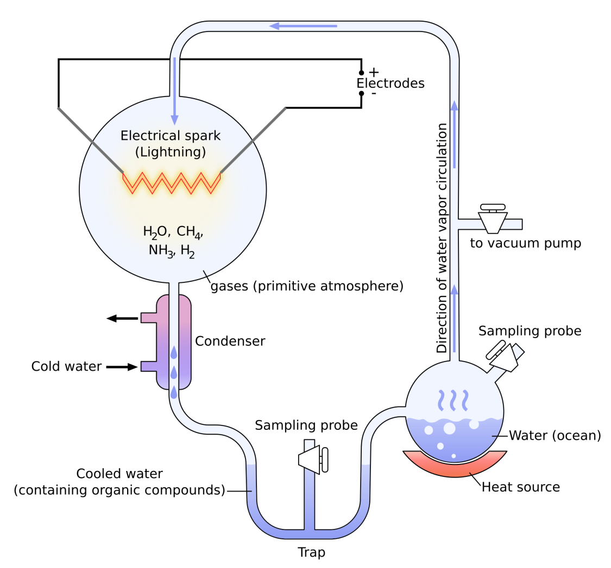
Origin of the first cells
The first cells must have arisen from non-living matter
Clearly the first cell wasn’t created at once. This must have been a step by step process. Lets have a look at how it most likely went.
Step 1 - The production of carbon compounds such as sugars and amino acids.
Lets see what Carl Sagan has to say about this
Miller and Urey reconstructed the early atmosphere in the lab in 1953 and were able to create amino acids from inorganic substances. Amino acids are the building blocks of proteins, so life.

Slide 13
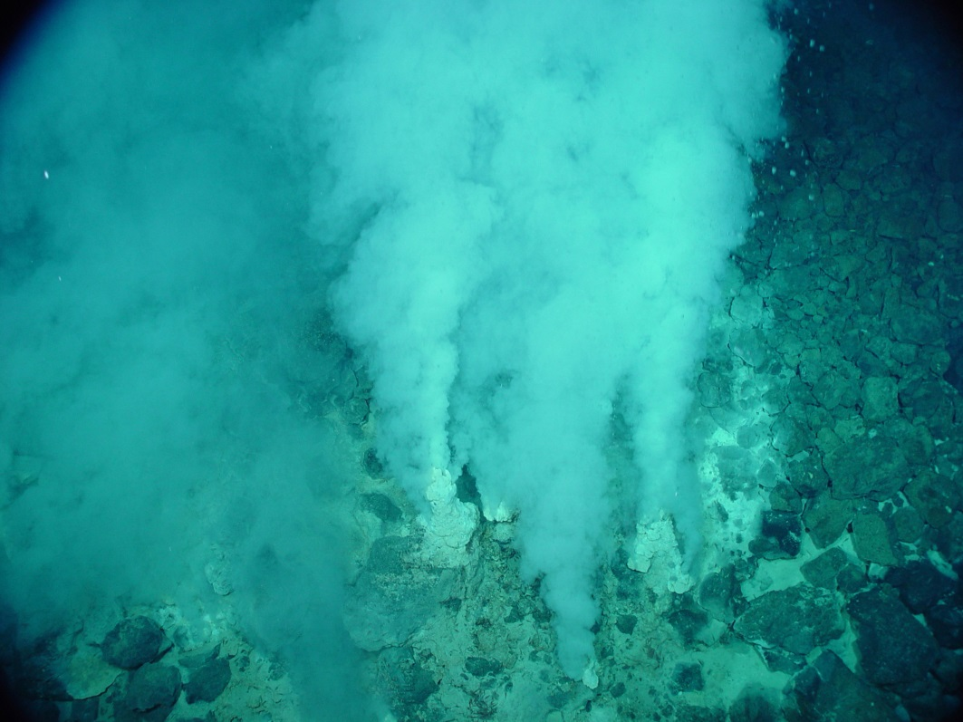
Origin of the first cells
The first cells must have arisen from non-living matter
Step 2 - Assembly of carbon compounds into polymers
One of the most likely sites for the first carbon compounds are deep sea oceanic vents. Hot water rushes out of these vents with several chemical substances like Iron sulphides. Iron sulphide has readily accessible energy which could have very well be the energy needed for the formation of carbon compounds.
Let’s see this video

Slide 14
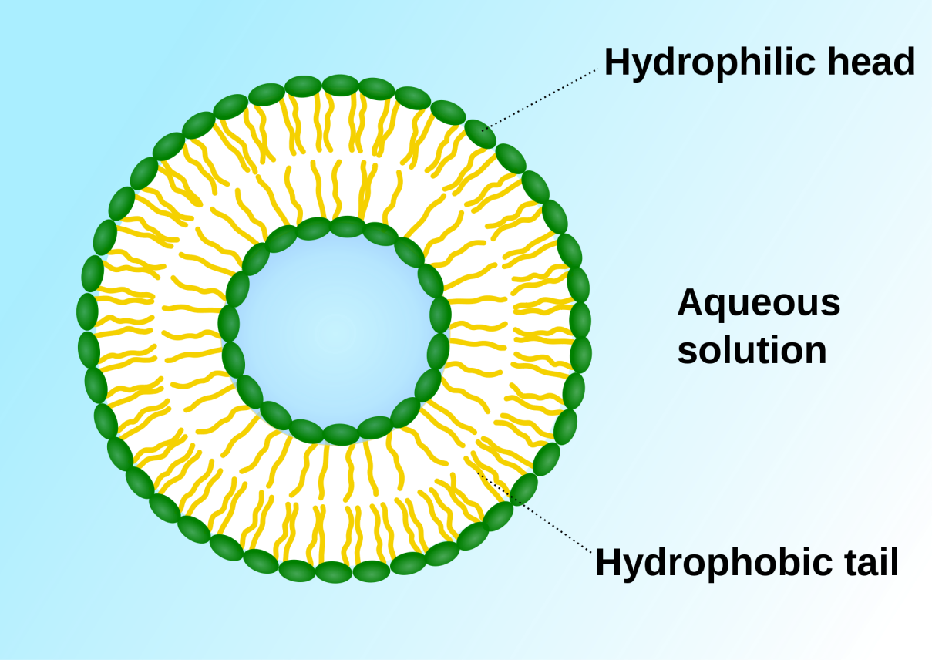
Origin of the first cells
The first cells must have arisen from non-living matter
Step 3 - Formation of membranes
If phospholipids or other amphipathic carbon compounds were among the first carbon compounds they would have naturally formed a bilayer (you can explain already why!). These membranes can right away form vesicles and would have separated the internal from the external environment of the fist ‘cell’.

Slide 15
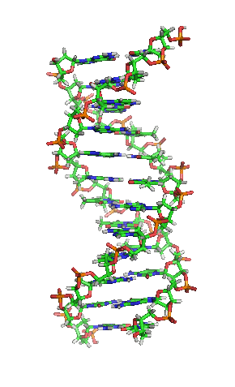
Origin of the first cells
The first cells must have arisen from non-living matter
Step 4 – Development of mechanisms of inheritance
All living organisms have genes made of DNA and enzymes to catalyse chemical reactions. To replicate DNA and to pass it on to offspring enzymes are needed, but for enzymes to exist genes are needed…
The answer to this enigma lies probably in the fact that the first organisms used RNA as genetic material. RNA stores information in genes just like DNA but has also the capacity to self-replicate.

Slide 16
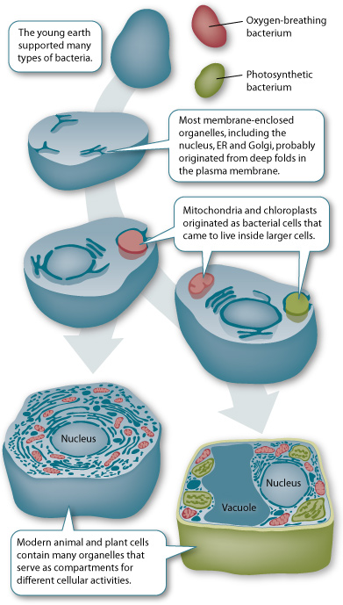
Endosymbiosis and the eukaryotic cell
The origin of eukaryotic cells can be explained with the endosymbiotic theory
INTRODUCTION VIDEO
Eukaryotes have a considerably more complex structure and appear much
later in the fossil record than prokaryotes. However, despite structural differences they share many biochemical pathways, for example, glycolysis and the light reactions of photosynthesis.
The endosymbiotic theory suggests that chloroplasts and mitochondria are derived from free living prokaryote ancestors. They were engulfed by larger prokaryotes but survived inside the cytoplasm and gradually evolved into
the chloroplast and mitochondrion.

Slide 17
Endosymbiosis and the eukaryotic cell
The origin of eukaryotic cells can be explained with the endosymbiotic theory
Mitochondria are believed to have evolved from proteobacteria and chloroplasts from cyanobacteria.
Listed below is the main evidence that supports the endosymbiotic theory (½):
Both organelles contain DNA that is different from the nucleus and is similar to bacteria.
Both organelles are surrounded by two membranes which resemble the composition of a prokaryote cell.
New organelles are formed by a process that resembles bacterial binary fission.
The internal structure and biochemistry of chloroplasts is very similar to that of cyanobacteria, indicating a common past. (Next page)

Slide 18
Endosymbiosis and the eukaryotic cell
The origin of eukaryotic cells can be explained with the endosymbiotic theory
Listed below is the main evidence that supports the endosymbiotic theory (²/₂):
DNA sequence analysis suggests that plant nuclear DNA contains genes that had previously been part of the chloroplast.
Some proteins encoded in the nucleus are transported to the two organelles. The two organelles have smaller genomes than bacteria. This is consistent with an increased dependence on the eukaryotic host after forming an endosymbiosis. The majority of genes on the genomes of the chloroplast and mitochondria have been lost or transferred to the nucleus. Most of the proteins that comprise these organelles are encoded by genes in the nucleus.
The ribosomes of the organelles closely resemble those found in bacteria (70S).

Slide 19
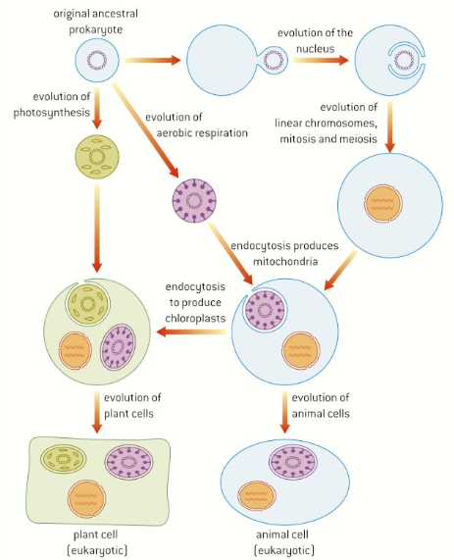
Endosymbiosis and the eukaryotic cell
The origin of eukaryotic cells can be explained with the endosymbiotic theory

Slide 20
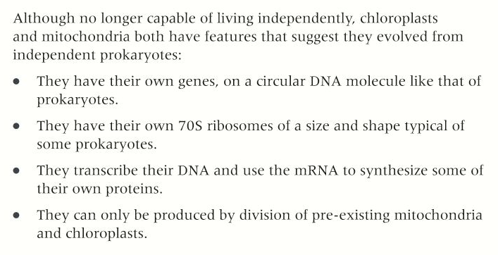
Endosymbiosis and the eukaryotic cell
The origin of eukaryotic cells can be explained with the endosymbiotic theory
So in short (from your book):

Slide 21
Topic 1 Cells
1.5 The origin of cells

