Slide 1
Topic 2 Molecular biology
2.5 Enzymes

Slide 2
Nature of science
Experimental design—accurate, quantitative measurements in enzyme experiments require replicates to ensure reliability. (3.2)
Understandings:
Enzymes have an active site to which specific substrates bind.
Enzyme catalysis involves molecular motion and the collision of substrates with the active site.
Temperature, pH and substrate concentration affect the rate of activity of enzymes.
Enzymes can be denatured.
Immobilized enzymes are widely used in industry.

Slide 3
Applications and skills
Application: Methods of production of lactose-free milk and its advantages.
Skill: Design of experiments to test the effect of temperature, pH and substrate concentration on the activity of enzymes.
Skill: Experimental investigation of a factor affecting enzyme activity. (Practical 3)
ToK
Development of some techniques benefits particular human populations more than others. For example, the development of lactose-free milk available in Europe and North America would have greater benefit in Africa/Asia where lactose intolerance is more prevalent. The development of techniques requires financial investment. Should knowledge be shared when techniques developed in one part of the world are more applicable in another?
Essential idea: Enzymes control the metabolism of the cell.

Slide 4
Some important notes
Lactase can be immobilized in alginate beads and experiments can then be carried out in which the lactose in milk is hydrolysed.
Students should be able to sketch graphs to show the expected effects of temperature, pH and substrate concentration on the activity of enzymes.
They should be able to explain the patterns or trends apparent in these graphs.

Slide 5
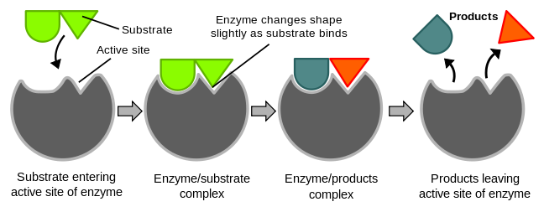
Active sites and enzymes
Enzymes have an active site to which enzymes bind
An enzyme is defined as a globular protein molecule that accelerates a specific chemical reaction. Enzymes are biological catalysts. A catalyst speeds up a reaction without changing it in any other way. Adding an enzyme to a reaction does not create different products and does not alter the reaction’s equilibrium. It only helps to reach this equilibrium faster.
Enzymes are also not used up in the reactions they catalyse. After the product has formed, the enzyme may be used again and again.
The active site is the region of an enzyme’s surface that binds the substrate (reacting substance) during the reaction catalysed by the enzyme.
LINK

Slide 6
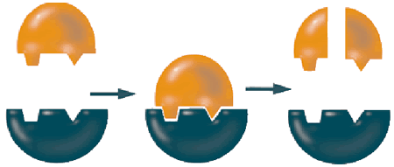
Active sites and enzymes
Enzymes have an active site to which enzymes bind
The substrate will bind to a special area of the enzyme called the active site.
The substrate fits into the active site of the enzyme as a key fits into a lock. This is called the lock and key model of enzyme action.
LINK
The three dimensional structure of the protein (remember, enzymes are proteins) determines the shape of the active site. The substrate fits into the active site and the reaction proceeds. Another molecules with a different shape will not fit into the active site will not react with the enzyme.
So, an enzyme only works with a specific substrate and only catalyses a specific reaction.

Slide 7
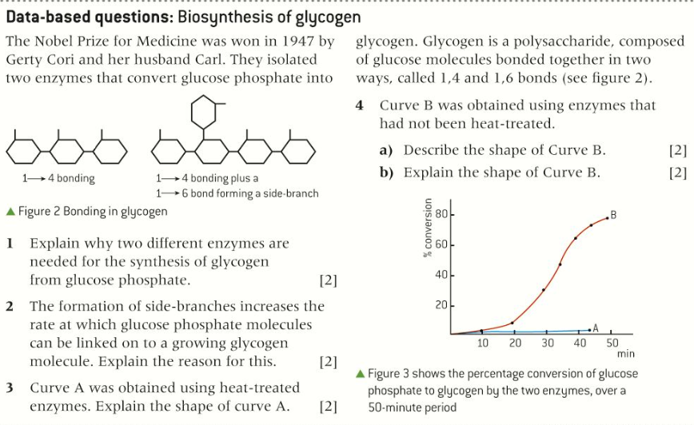
Active sites and enzymes
Enzymes have an active site to which enzymes bind

Slide 8
Enzyme activity
Enzyme catalysis involves molecular motion and the collision of substrates with the active site
Enzyme activity is the catalysis of a reaction by an enzyme. There are three stages:
The substrate binds to the active site of the enzyme. Some enzymes have two substrates binding to different sites.
While the substrates are bound to the active site they change into different chemical substances, the product of the reaction.
The products separate from the active site leaving it vacant for substrates to bind again.
The molecule can only bind to the active site when it moves very close to it, this is called substrate-enzyme collision. Most enzymes and substrates are dissolved in an aqueous solution. As liquids are constantly moving the collision of substrates and enzymes becomes more likely. These movements are random, so the substrate might collide with the active site in any way. Only when the active site is hit in the right way the reaction occurs.
One molecule of catalase can breakdown approx.. 5 million H₂O₂ molecules per second!

Slide 9
Factors affecting enzyme activity
Temperature, pH and substrate concentration affect enzyme activity
As you know from the lab the speed of a reaction can be measured in two ways:
how fast does the substrate disappear
how fast is the product formed
There is much more information in your book on pages 98 and 99
Generally, biological reactions are extremely slow at room temperature without the help of enzymes. Therefore the speed of reaction is a measurement of the enzyme activity.
A number of factors affect enzyme activity.
Temperature - every enzyme has an optimum temperature where its activity is highest. The optimum temperature of our enzymes is mostly around 37°C.
Almost every enzyme will be denatured above 60°C although some bacteria live in hot springs at 80°C and have enzymes suitable for this environment.
pH - every enzyme works best at a certain pH. Pepsin (in the stomach) works best at approximately pH 2 but trypsin (secreted from the walls of the small intestine) works best at approximately pH 8.
Concentration of substrate - using a given amount of enzyme, the reaction will go faster if the substrate is more concentrated.
LINK

Slide 10
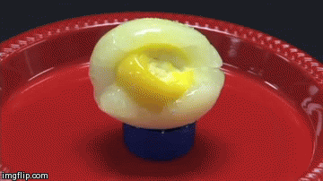
Denaturation
Enzymes can be denatured
Denaturation refers to a structural change in a protein that results in a loss (usually permanent) of its biological properties.
High temperatures and extreme pH can denature a protein.
If you think of a raw egg as an example of several proteins, you can think of a boiled egg as an example of denatured proteins. The fact that denaturation is permanent is shown by cooling down a boiled egg: it becomes a cold, boiled egg but does not change back to being a raw egg.

Slide 11
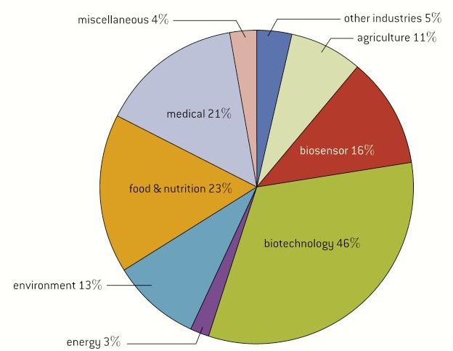
Inmobilized enzymes
Inmobilized enzymes are widely used in industry
Since 1897 when the Buchner brother first showed that with an extract from yeast they were able to convert sucrose into alcohol enzymes started to be used in the industry.
Before this happened scientist, like Louise Pasteur, thought that organic molecules like alcohol could only be synthesis inside a living cell (hence: vitalism). So apart from the synthesising of Urea also the alcohol creation of the Buchner brothers helped to falsify the theory of vitalism.
More than 500 enzymes are now used in industry.

Slide 12
Immobilized enzymes
Immobilized enzymes are widely used in industry
The enzymes used in industry are usually immobilized. Tis is done by attaching the enzymes to other materials or into aggregations so that the movement is minimized. Then can be stuck to glass, trapped in a gel or bound together in aggregates.
There are several advantages:
The enzyme can be easily separated from the product of the reaction stopping the reaction at the ideal time and preventing contamination.
The enzyme can be recycled after having been retrieved. Which is very cost saving, as enzymes are usually rather expensive.
Immobilization increases the stability of enzymes to changes in temperature and pH reducing the rate at which they are degraded and need to be replaced.
Substrates can be exposed to higher substrate concentrations than dissolved enzymes, speeding up the reaction rates.
Example of uses in the industry

Slide 13
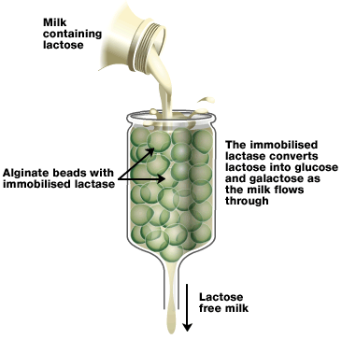
Immobilized enzymes
Immobilized enzymes are widely used in industry

Slide 14
Lactose free milk
Methods of production of lactose free milk
Overall, around 70% of adult humans in the world are lactose intolerant. This means that they have lost the ability to produce lactase after early childhood. This commonly happens to mammals after weaning. The incidence of lactose intolerance is not evenly distributed: only 2% of Swedes but 75% of African Americans and nearly 100% of American Indians are lactose intolerant.
When a lactose intolerant person consumes a reasonable amount of milk (or ice cream), s/he will suffer from excess gas production and diarrhoea.
The food industry has found that it is possible to produce milk and milk products that contain (almost) no lactose. They do this by attaching the enzyme lactase to a large molecule and then bringing it into contact with milk.
LINK
Any lactose present will be broken down into glucose and galactose by the lactase. It allows lactose intolerant people to drink milk and consume products that contain milk, such as cheese and ice-cream.

Slide 15
Topic 2 Molecular biology
2.5 Enzymes

