Slide 1
Topic 3: The chemistry of life
3.6 Enzymes

Slide 2
ASSESSMENT STATEMENTS
3.6.1 Define enzyme and active site.
3.6.2 Explain enzyme–substrate specificity.
3.6.3 Explain the effects of temperature, pH and substrate concentration on enzyme activity.
3.6.4 Define denaturation.
3.6.5 Explain the use of lactase in the production of lactose-free milk.

Slide 3
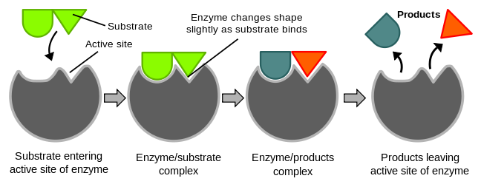
3.6.1 Define enzyme and active site.
An enzyme is defined as a globular protein molecule that accelerates a specific chemical reaction. Enzymes are biological catalysts. A catalyst speeds up a reaction without changing it in any other way. Adding an enzyme to a reaction does not create different products and does not alter the reaction’s equilibrium. It only helps to reach this equilibrium faster.
Enzymes are also not used up in the reactions they catalyse. After the product has formed, the enzyme may be used again and again.
The active site is the region of an enzyme’s surface that binds the substrate (reacting substance) during the reaction catalysed by the enzyme.
LINK

Slide 4
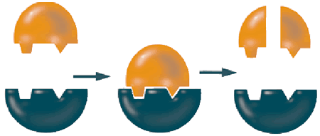
3.6.2 Explain enzyme–substrate specificity.
The substrate will bind to a special area of the enzyme called the active site.
The substrate fits into the active site of the enzyme as a key fits into a lock. This is called the lock and key model of enzyme action.
LINK
The three dimensional structure of the protein (remember, enzymes are proteins) determines the shape of the active site. The substrate fits into the active site and the reaction proceeds. Another molecules with a different shape will not fit into the active site will not react with the enzyme.
So, an enzyme only works with a specific substrate and only catalyses a specific reaction.

Slide 5
3.6.3 Explain the effects of temperature, pH and substrate concentration on enzyme activity.
As you know from the lab the speed of a reaction can be measured in two ways:
how fast does the substrate disappear
how fast is the product formed?
Generally, biological reactions are extremely slow at room temperature without the help of enzymes. Therefore the speed of reaction is a measurement of the enzyme activity.
A number of factors affect enzyme activity.
Temperature - every enzyme has an optimum temperature where its activity is highest. The optimum temperature of our enzymes is mostly around 37°C.
Almost every enzyme will be denatured above 60°C although some bacteria live in hot springs at 80°C and have enzymes suitable for this environment.
pH - every enzyme works best at a certain pH. Pepsin (in the stomach) works best at approximately pH 2 but trypsin (secreted from the walls of the small intestine) works best at approximately pH 8.
Concentration of substrate - using a given amount of enzyme, the reaction will go faster if the substrate is more concentrated.
LINK

Slide 6
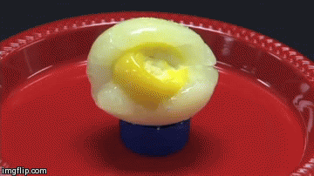
3.6.4 Define denaturation.
Denaturation refers to a structural change in a protein that results in a loss (usually permanent) of its biological properties.
High temperatures and extreme pH can denature a protein.
If you think of a raw egg as an example of several proteins, you can think of a boiled egg as an example of denatured proteins. The fact that denaturation is permanent is shown by cooling down a boiled egg: it becomes a cold, boiled egg but does not change back to being a raw egg.

Slide 7
3.6.5 Explain the use of lactase in the production of lactose-free milk.
Overall, around 70% of adult humans in the world are lactose intolerant. This means that they have lost the ability to produce lactase after early childhood. This commonly happens to mammals after weaning. The incidence of lactose intolerance is not evenly distributed: only 2% of Swedes but 75% of African Americans and nearly 100% of American Indians are lactose intolerant.
When a lactose intolerant person consumes a reasonable amount of milk (or ice cream), s/he will suffer from excess gas production and diarrhoea.
The food industry has found that it is possible to produce milk and milk products that contain (almost) no lactose. They do this by attaching the enzyme lactase to a large molecule and then bringing it into contact with milk.
LINK
Any lactose present will be broken down into glucose and galactose by the lactase. It allows lactose intolerant people to drink milk and consume products that contain milk, such as cheese and ice-cream.

Slide 8
Topic 3: The chemistry of life
3.6 Enzymes

