Slide 1
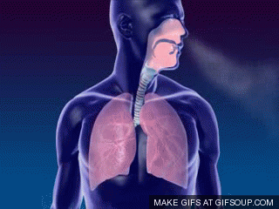
Topic 3: The chemistry of life
3.7 Cellular respiration

Slide 2
ASSESSMENT STATEMENTS
3.7.1 Define cell respiration.
3.7.2 State that, in cell respiration, glucose in the cytoplasm is broken down by glycolysis into pyruvate, with a small yield of ATP.
3.7.3 Explain that, during anaerobic cell respiration, pyruvate can be converted in the cytoplasm into lactate, or ethanol and carbon dioxide, with no further yield of ATP.
3.7.4 Explain that, during aerobic cell respiration, pyruvate can be broken down in the mitochondrion into carbon dioxide and water with a large yield of ATP.

Slide 3
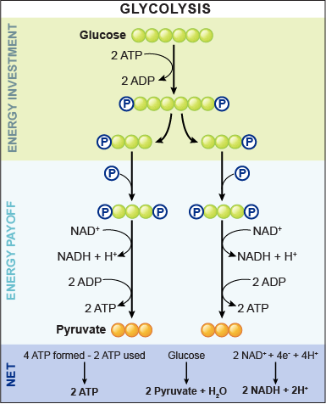
3.7.1 Define cell respiration.
3.7.2 State that, in cell respiration, glucose in the cytoplasm is broken down by glycolysis into pyruvate, with a small yield of ATP.
Cell respiration is the controlled release of energy from organic compounds in cells to form ATP.
The process of cell respiration can take place in the presence or in the absence of oxygen. In either case, the first stage of cell respiration is glycolysis.
LINK
Glycolysis: glucose → 2 pyruvate + ATP
Glycolysis is the breakdown of one molecule of glucose (a six carbon compound) into two molecules of pyruvate (a three carbon compound), with a small net yield of ATP.
This process takes place in the cytoplasm and does NOT require the presence of oxygen.

Slide 4
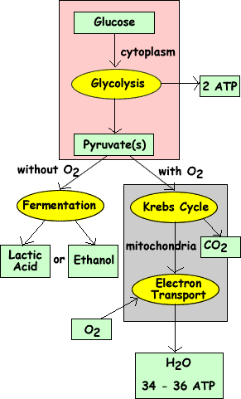
3.7.3 Explain that, during anaerobic cell respiration, pyruvate can be converted in the cytoplasm into lactate, or ethanol and carbon dioxide, with no further yield of ATP.
If there is no oxygen present, the cell needs to use the process of anaerobic cell respiration to obtain its energy. It will carry out glycolysis.
In order to be able to continue with glycolysis which produces a small amount of ATP, the cell needs to change the pyruvate into another substance.
Yeast cells will convert pyruvate (a three carbon compound) into ethanol (a two carbon compound) and carbon dioxide (a one carbon compound). Human cells will change pyruvate (a three carbon compound) into lactate (another three carbon compound). Neither of these equations requires the presence of oxygen. That is why they are part of anaerobic cell respiration.

Slide 5
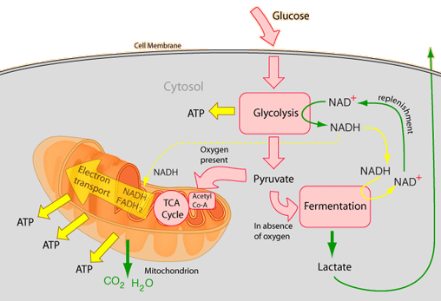
3.7.3 Explain that, during anaerobic cell respiration, pyruvate can be converted in the cytoplasm into lactate, or ethanol and carbon dioxide, with no further yield of ATP.
We use the process of anaerobic cell respiration in our bodies when, for example, we run a sprint. The muscles suddenly require a lot of energy.
The body can only supply a limited amount of oxygen to the muscles and there can only be a limited amount of aerobic respiration. This does not produce enough energy to contract the muscles at the rate required. So, in addition to aerobic respiration, the cells in the muscles will use anaerobic respiration to release the remaining amount of energy. This produces lactate which, under certain conditions, may cause muscle cramps.
Anaerobic respiration is also used with yeast in bread making so that the dough will rise. The carbon dioxide produced will create bubbles in the dough which makes it rise. The alcohol produced will evaporate during baking.

Slide 6
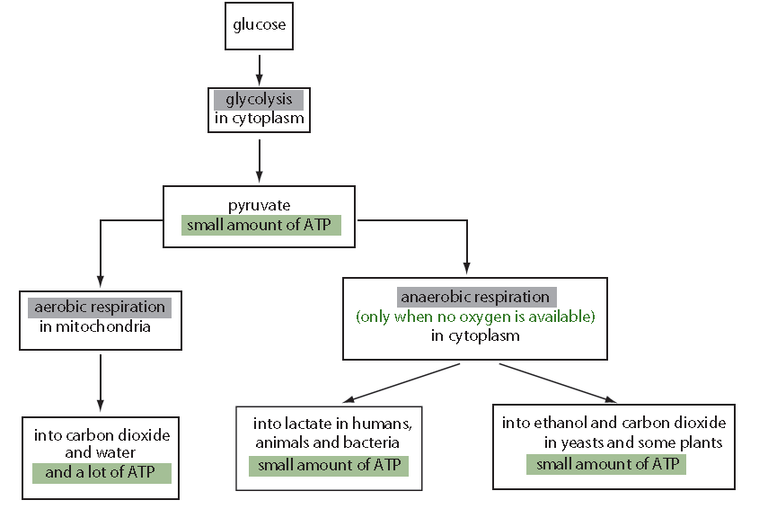
3.7.4 Explain that, during aerobic cell respiration, pyruvate can be broken down in the mitochondrion into carbon dioxide and water with a large yield of ATP.
If oxygen is present, the pyruvate produced in the cytoplasm during glycolysis will move into the mitochondria. Inside the mitochondria, pyruvate will be broken down to carbon dioxide and water. This process yields much more ATP than glycolysis or anaerobic respiration.
LINK

Slide 7
Topic 3: The chemistry of life
3.7 Cellular respiration

