Slide 1
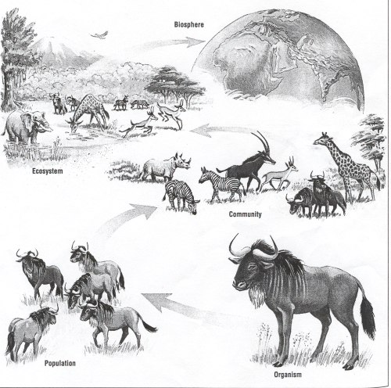
Option C Ecology and Conservation
C1 Species and communities

Slide 2
Nature of science
Use models as representations of the real world—zones of stress and limits of tolerance graphs are models of the real world that have predictive power and explain community structure. (1.10)
Understandings:
The distribution of species is affected by limiting factors.
Community structure can be strongly affected by keystone species.
Each species plays a unique role within a community because of the unique combination of its spatial habitat and interactions with other species.
Interactions between species in a community can be classified according to their effect.
Two species cannot survive indefinitely in the same habitat if their niches are identical.

Slide 3
Applications and skills
Application: Distribution of one animal and one plant species to illustrate limits of tolerance and zones of stress.
Application: Local examples to illustrate the range of ways in which species can interact within a community.
Application: The symbiotic relationship between Zooxanthellae and reef-building coral reef species.
Skill: Analysis of a data set that illustrates the distinction between fundamental and realized niche.
Skill: Use of a transect to correlate the distribution of plant or animal species with an abiotic variable.
ToK
Random samples are taken in studies involving large geographical areas or if limited time is available. Is random sampling a useful tool for scientists despite the potential for sampling bias?
Essential idea: Community structure is an emergent property of an ecosystem.

Slide 4
Ecology
Link to video

Slide 5
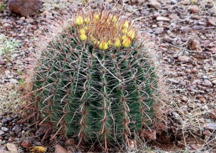
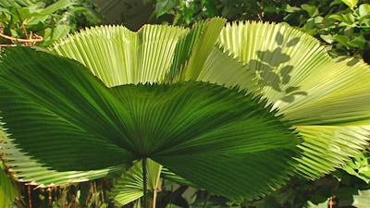
Limiting factors
The distribution of species is affected by limiting factors
A limiting factor is a factor which is most scarce in relation to an organisms needs. These needs vary a lot among different species, even if they are closely related.
Plants are perfectly adapted to the environment they live in, the light intensity, humidity, minerals in the soil, and the plants, insects, birds herbivores etc. present in the community. If any of these factors changes becomes available in too little amount which has an effect on the life of the plant then they become limiting factors.
These limiting factors are different for each species. Tropical plants need lots of water, desert plants very little. Plants growing on the beach need mineral poor soil and plants growing in a forest soil very rich in minerals
VIDEO

Slide 6
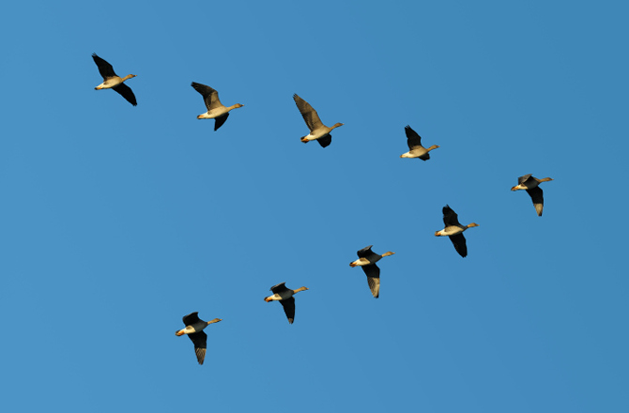
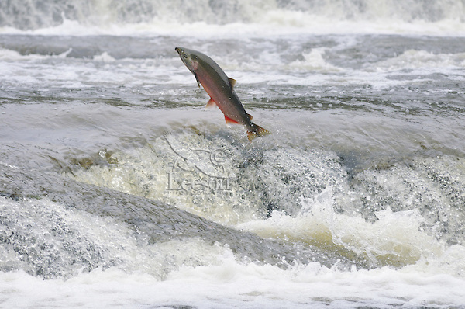
Limiting factors
The distribution of species is affected by limiting factors
Animal populations are limited very much by food supply, shelter, temperature, water, breeding sites etc. Animals, just like plants have adaptations for them to survive in the areas they live, with those adaptations they overcome the limiting factors of those areas.
Some examples: Aye aye, Tree frog, Pebble Toad
The migration of certain animals also overcomes limiting factors of the environment, birds fly up to twice around the world in one year to search for feeding and breeding places. Also salmons migrate back to their birth place, from the sea back up rivers, to mate, release their eggs and die.
VIDEO

Slide 7
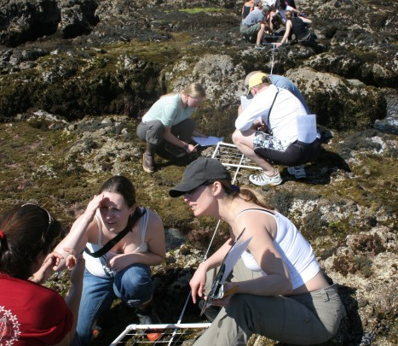
Use of transects
The use of transects to correlate the distribution of plant or animal species with an abiotic variable
A sample is random if every member of the population has the same chance to be selected. A transect is a method to ensure a student does this random selection and it is used to correlate the distribution of a plant or animal species with an abiotic variable.
For example, if a mountain slope changes from a very rocky area into an area with more plants and soil a transect would reveal a change in humidity, temperature, mineral compositions, and life forms.

Slide 8
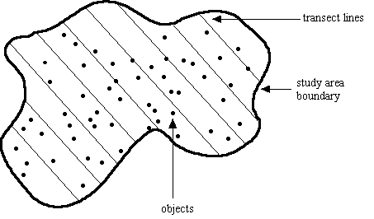
Use of transects
The use of transects to correlate the distribution of plant or animal species with an abiotic variable

Slide 9
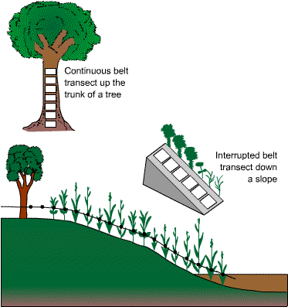
Use of transects
The use of transects to correlate the distribution of plant or animal species with an abiotic variable

Slide 10
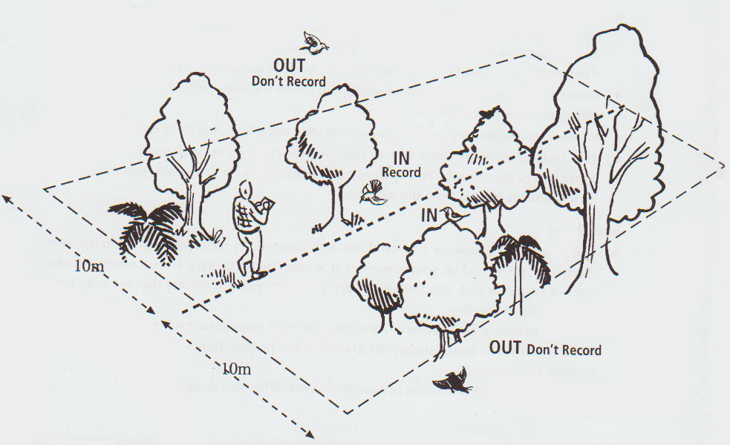
Use of transects
The use of transects to correlate the distribution of plant or animal species with an abiotic variable

Slide 11
Use of transects
The use of transects to correlate the distribution of plant or animal species with an abiotic variable
Lets take 15 minutes to do the data based questions on page 605-606
Later we discuss your conclusions as a group

Slide 12
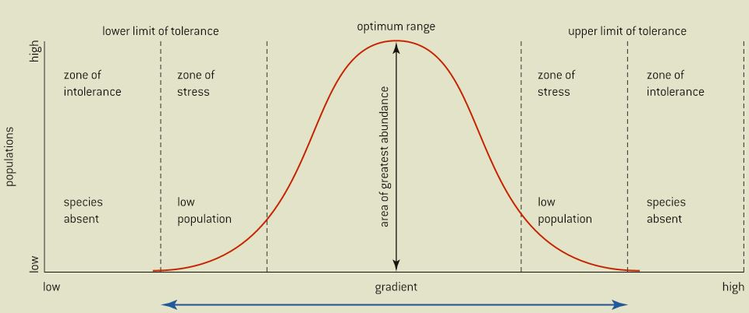
Ecological models
Use models as representations of the real world: zones of stress and limits of tolerance graphs are models of the real word that have predictive power and explain community structure.
Figure 4 of your book is a model of how environmental gradient affect population levels of a species. The range of values of a biotic or abiotic factor that is tolerated is a characteristic of a species but within a population there is variability.
Some members of a population are more tolerant of extreme conditions than others and the limits of tolerance and where the zone of stress starts is sometimes difficult to determine.
Another limitation of the graph is that it is often represented as symmetrical but this is not the case in real situations. For example an abundance of food has slower effects on population size that a shortage of food.

Slide 13
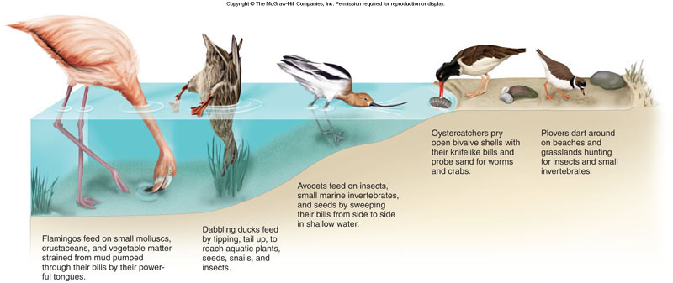
The niche concept
Each species plays a unique role within a community because of the unique combination of its spacial habitat and its interactions with other species
Within an ecosystem each species plays a unique role, called its ecological niche. This includes its spatial habitat, how it obtains its food and how it interacts with its environment. For a species to live in a certain habitat that habitat must provide it with the proper biotic and abiotic conditions within its limits of tolerance.

Slide 14
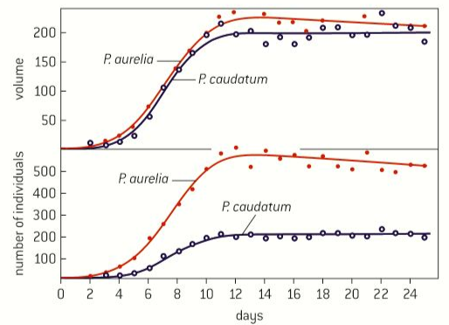
Competitive exclusion principle
Two species cannot survive indefinitely in the same habitat if their ecological niches are identical
In the 1930’s the Russian scientist Carl Friedrich Gauss investigated competition between two species of paramecium: P. caudatum and P. aurelium.
He quantified biomass by estimating the volume of the paramecium. When cultured separately the populations thrived but when cultured together the population sizes of both paramecium declined quickly, mainly of P. caudatum.

Slide 15
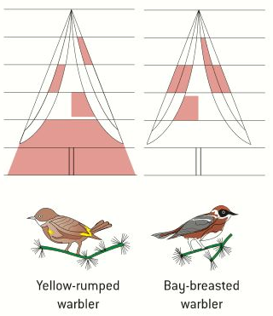
Competitive exclusion principle
Two species cannot survive indefinitely in the same habitat if their ecological niches are identical
The bay-breasted warbler and the yellow rumped warbler are migratory birds that appear to occupy the exact same niche as they feed on similar prey and they are found foraging in the same trees. Ecologists have done observations to find out how they are able to live in the same tree together without out competing each other. They found that they divide the tree in different areas and therefore never feed in the same part avoiding competition.
The conclusion from these two observations is that two species cannot coexist in the same habitat if their niches overlap, tis is known as the competitive exclusion principle.

Slide 16
Fundamental and realised niches
Analysis of a dataset that illustrate the distinction between fundamental and realised niches.
The fundamental niche of a species is the potential mode of existence, given the adaptations of a species. It refers to the broadest range of habitats it can occupy and roles it can fulfil. The realized niche is the actual mode of existence, which results from its adaptations and competition with other species.
Link to video

Slide 17
Interspecific interactions
Interaction between species within a community can be classified by their effects..
Within an ecosystem the interactions between the different species are very complex. We will discuss five common types of interactions:
Competition
Competition occurs when two species require the same resources and the amount obtained by one species reduces the amount obtained by the other.
Predation
Predation involves a consumer feeding on another consumer.
Parasitism When one organisms feeds of another without usually killing it. The predatory organisms is called the parasite and the prey the host. The host is harmed and the parasite benefits.

Slide 18
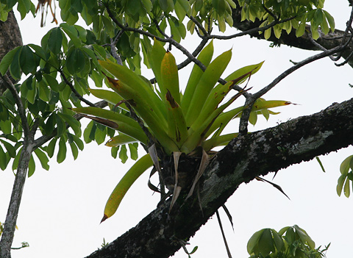
Interspecific interactions
Interaction between species within a community can be classified by their effects..
Mutualism
In mutualisms two species live very closely together and the relation is beneficial for both. The bacteria living in your organism are a good example of organisms living in symbiosis with you, they have a place to live and you are protected against pathogenic bacteria.
Commensalism
In commensalism one of the to organisms is benefitted and the other is not harmed nor has any benefit of the relation. Epiphytes like orchids are a good example of this, they live in trees which don’t notice their presence.

Slide 19
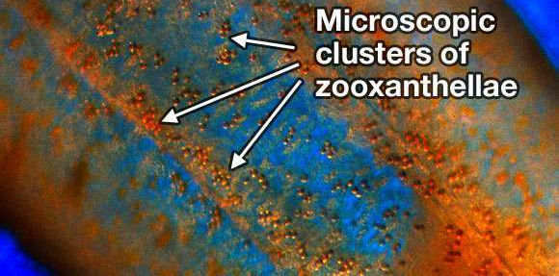
The role of zooxanthelae
The symbiotic relation between zooxanthelae and reef building coral reef species.
Most corals that build reefs contain photosynthetic algae called zooxanthelae. The coral provides the algae with a protected environment and a substrate that can hold it in place for photosynthesis to ocurr.
The zooxanthelae provides the coral with molecules such as glucose and amino acids. The association assures the recycling of nutrients which are in short supply in tropical waters.
Zooxanthelae are responsible for the unique coloration of many corals and make coral reefs one of the most biologically productie ecosystems.
LINK

Slide 20
Local examples of interspecific interactions
Local examples to illustrate the range of ways in which species can interact within a community
Introduction video
Task: Take 15 minutes to find as many examples you can on interspecific relations in South Spain

Slide 21
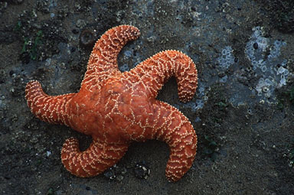
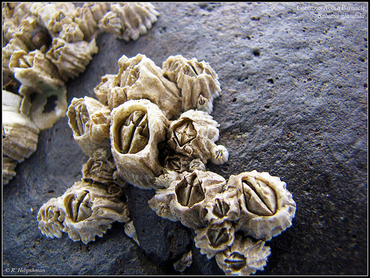
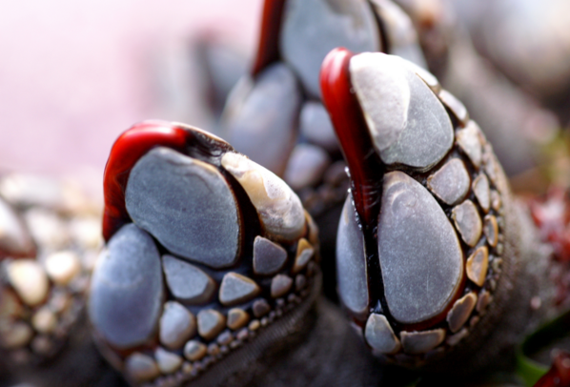
Keystone species
Community structure can be strongly affected by keystone species
Introduction video
A keystone species is one which has a disproportional effect on the structure of an ecological community. This word was first used by the scientist Robert Paine, and the sea star Pisaster. The example is very illustrative. He artificially removed the sea star from its ecosystem and observed the following:
The remaining members of the food chain immediately began to compete with each other to occupy the empty niche.
The prey of the Sea star became very abundant in the area.
Within only three months after removal the barnacle, Balanus glandula, had become dominant in the area.
Nine months later Balanus glandula had been replaced by another barbacle, Mitella, and he mussel Mytilus.
Succession continued until Mitella was the dominant species. The sea star is an important predator of Mitella .
Some species, such as the limpet, emigrated from the area because of a lack of food, and space.
Within a year after removal species diversity had been decreased from 15 to 8 in the area.

Slide 22
Option C Ecology and Conservation
C1 Species and communities

