Slide 1
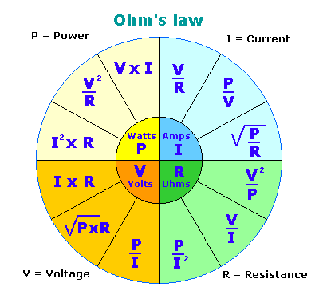
Electricity: Circuits and Ohm’s Law

Slide 2
Topics
Electrical circuits: basic elements.
Current.
Potential difference.
Resistance.
Ohm's law.
Effects of electrical resistors in series and in parallel.

Slide 3
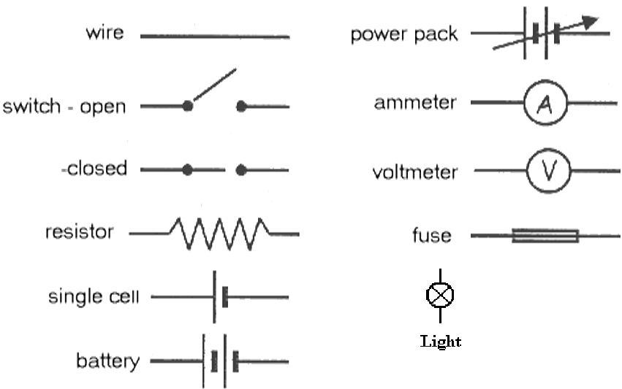
Electrical circuits: basic elements.

Slide 4
Current.
Current A flow of charge is called a current. The symbol ‘I’ is used to indicate ‘current’. A charge is the flow of electrons through matter. The SI unit to measure the strength of a current is ampere (A).
More or less 6.000.000.000.000.000.000 e- flow round a circuit per second to give a strength of 1 A.
For smaller currents milliamperes (mA) are used as a unit. 1000mA = 1A. The charge of electricity is measured in the unit coulomb (C).
There is a link between the charge and current:
If the charge flows at this rate: Then the current is:
1 coulomb per second 1 ampere
2 coulombs per second 2 amperes
Etc.
Charge = current x time
(C) = (A) x (s)
The equation is therefore the following:

Slide 5
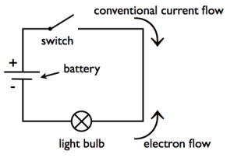
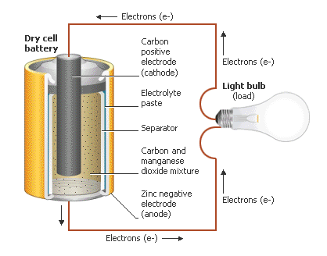
Current.
The current direction Most circuit diagrams, like the one below, have an arrow indicating the direction of the current flow. The current flow always goes from positive to negative round the circuit.
As electrons are negatively charged they are repelled by the negatively charged side of the cell and go therefore in the opposite direction as the current flow.

Slide 6
Potential difference.
Potential difference The scientific name for voltage is potential difference (PD). The higher the voltage the more energy a cell gives to the electrons it pushes out. The PD is measured in volt (V).
When a Coulomb of charge (or any given amount of charge) possesses a relatively large quantity of potential energy at a given location, then that location is said to be a location of high electric potential.
If the PD across a cell is 1 volt, then 1 joule of potential energy are given to each coulomb of charge. So 1 volt = 1 joule per coulomb 1V=(j/C)

Slide 7
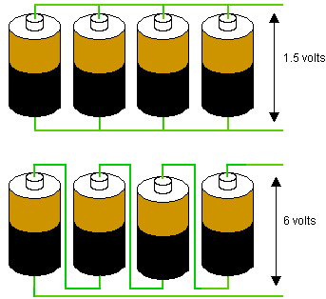
Potential difference.
To produce a higher PD, cells can be put in series. But the cells will lose their energy quickly. When batteries are connected in series you have to sum up their voltage.
When they are linked up in parallel they will give less energy through the circuit but will last longer. See what happens to the 1.5V batteries in the image below. The voltage (PD) tells you how much energy is given per Coulomb.
Cells in parallel and in series
LINK

Slide 8
Resistance.
The resistance of a material indicates how well it is able to prevent the electrons from flowing through it. The unit used for resistance is the Ohm (Ω).
As you learned in unit 3, different materials have a different resistance. The higher the resistance the lower the current, the higher the voltage the higher the current.
For example if a PD of 6 V is needed to make a current of 3A flow through a wire the resistance would be: 6V/3A= 2Ω
The resistance is calculated with the following equation:
Resistance ( Ω ) =
PD accros the conductor (V)
Current through conductor (A)

Slide 9
MAKE SURE TO COPY THIS TABLE

Slide 10
Ohm's law.
Ohm's law
For many conductors of electricity, the electric current which will flow through them is directly proportional to the voltage applied to them. The ratio of voltage to current is called the resistance. If the material can be characterized by such a resistance, then the current can be predicted from the relationship:
Example question: Calculate the resistance of a conductor through which a current of 2 A flows with a PD of 12V.
V/I=R so 12/2=6 Ω

Slide 11
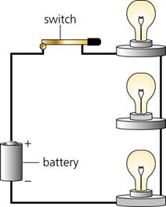
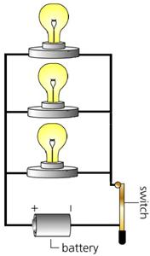
Ohm's law.
Parallel and series circuits
When light bulbs are connected in series then the bulbs share the PD (V) from the battery, and the bulbs glow dimly. If one bulb would be removed, the others would go out too because the circuit is broken.
When light bulbs are connected in parallel each one gets the full PD from the battery because they are all connected directly to it. If one bulb would be removed the others would keep on working because the circuit isn't broken.

Slide 12
TASK
Download the circuit construction kit from the website and construct a circuit in series and one in parallel, bot with 3 light bulbs.

Slide 13
Ohm’s law problems
Ohm’s law
Calculate the resistance of a conductor through which a current of 2 A flows with a PD of 12V.
Sol. 6Ω
Calculate the PD between the extremes of a conductor with a resistance of 10 Ω and a current of 7.5 A.
Sol. 75 V
Calculate the intensity of a current which circulates through a conductor with a resistance of 10 Ω, if the PD between its extremes 0.02 mV.
Sol. 2·10⁻⁶ A

Slide 14
Effects of electrical resistors in series and in parallel.
Circuits with resistors in parallel
Intensity/Current (A)
I_{T} = I₁ + I₂ + I₃ etc
PD (V)
V_{T} = V₁ = V₂ = V₃ etc
Resistance (Ω)
1 = 1 + 1 + 1 etc R_{T} R₁ R₂ R₃
Circuits with resistors in series
Intensity/Current (A)
I_{T} = I₁ = I₂ = I₃ etc
PD (V)
V_{T} = V₁ + V₂ + V₃ etc
Resistance (Ω)
R_{T}= R₁ + R₂ + R₃ etc

Slide 15
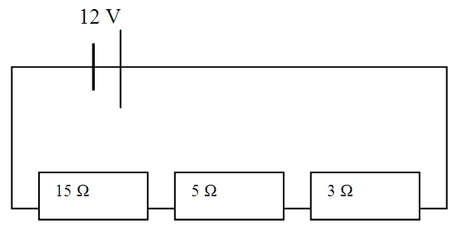
Effects of electrical resistors in series and in parallel.
Circuits with resistors in series
Intensity/Current (A)
I_{T} = I₁ = I₂ = I₃ etc
PD (V)
V_{T} = V₁ + V₂ + V₃ etc
Resistance (Ω)
R_{T}= R₁ + R₂ + R₃ etc
Total Intensity:?
Total PD: ?
Total Resistance: ?

Slide 16
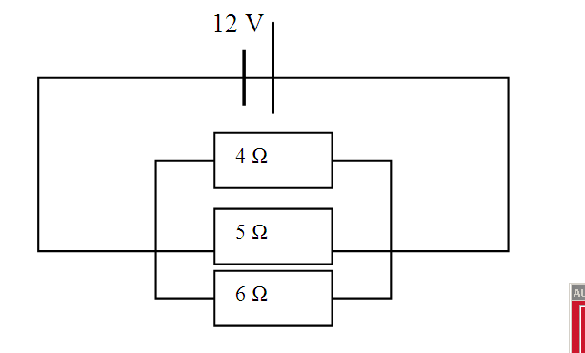
Effects of electrical resistors in series and in parallel.
Circuits with resistors in parallel
Intensity/Current (A)
I_{T} = I₁ + I₂ + I₃ etc
PD (V)
V_{T} = V₁ = V₂ = V₃ etc
Resistance (Ω)
1 = 1 + 1 + 1 etc
R_{T} R₁ R₂ R₃
1 = 1 + 1 + 1 etc
R_{T} 4 5 6
Or:
0.25 + 0.20 + 0.16 = 0.61
So:
1 = 1.64Ω
0.61
Total Intensity:?
Total PD: ?
Total Resistance: ?

Slide 17
7.5V
Problems with resistors in series and in parallel.
6 Ω
5 Ω
4 Ω
Total Intensity:?
Total PD: ?
Total Resistance: ?
I=V/R - 7.5/15 ≈ 0.5A
The total PD= 7.5V but…. It is divided over the three resistors the following way:
V= I x R so
Resistor 1: 0.5 x 6= 3V
Resistor 2: 0.5 x 5= 2.5V
Resistor 3: 0.5 x 4= 2V
TOTAL 7.5V
6+5+4= 15Ω

Slide 18
24V
Problems with resistors in series and in parallel.
14 Ω
6 Ω
7 Ω
Total Intensity:?
Total PD: ?
Total Resistance: ?
I=V/R - 24/27 ≈ 0.9A
The total PD= 24V but…. It is divided over the three resistors the following way:
V= I x R so
Resistor 1: 0.9 x 14= 12.6V
Resistor 2: 0.9 x 6 = 5.4V
Resistor 3: 0.9 x 7 = 6.3V
TOTAL 24.3V (0.3 more because of rounding up)
14+6+7= 27Ω

Slide 19
7,5V
Problems with resistors in series and in parallel.
4 Ω
4 Ω
10 Ω
I=V/R for each resistor. So R1: 7.5/4 = 1.88A
R2: 7.5/4 = 1.88A
R3: 7.5/10= 0,75A
TOTAL = 4.5A
Total Intensity: ?
Total PD: ?
Total Resistance: ?
The total PD= 7.5V
1 = 1 + 1 + 1
R_{T} 4 4 10
Or: 0.25 + 0.25 + 0.10 = 0.60
So R_{T} is: 1 = 1.67Ω
0.60

Slide 20
14V
Problems with resistors in series and in parallel.
6 Ω
8 Ω
12 Ω
I=V/R for each resistor. So R1: 14/6= 2.3A
R2: 14/8= 1.75A
R3: 14/12= 1.17A
TOTAL = 5.22A
Total Intensity: ?
Total PD: ?
Total Resistance: ?
The total PD= 14V
1 = 1 + 1 + 1
R_{T} 6 8 12
Or: 0.17 + 0.13 + 0.08 = 0.38
So R_{T} is: 1 = 2.63Ω
0.38

Slide 21
Electricity: Circuits and Ohm’s Law

