Slide 1
Electricity: Electrostatics

Slide 2
Topics
Electricity in history
Types of electricity
Electrical nature of matter
The electroscope
Conducting and isolating materials
Electrical charge and the ways to measure it
The law of coulomb

Slide 3
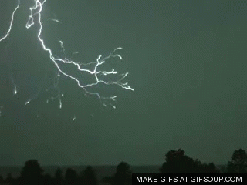
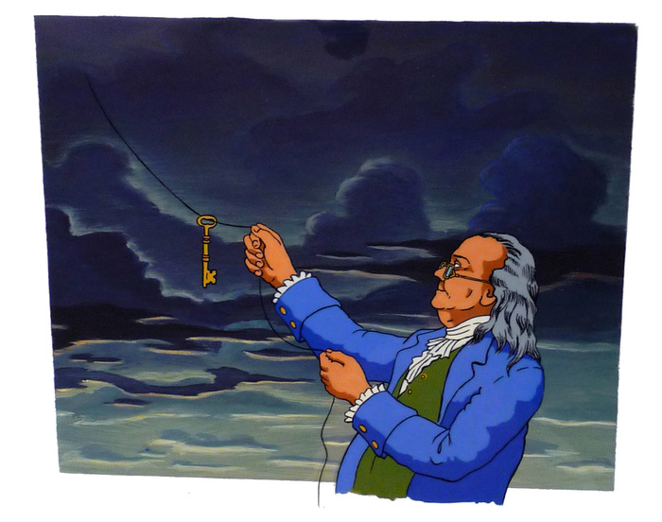
Electricity in history
The Ancient Greeks knew of the strange properties of amber. Tales de Mileto (625 a. C.-547 a. C.) proved that if amber was rubbed with wool it would attract dust and other small objects.
Our modern knowledge of electricity really began in the 1600s when scientists found that it was possible to produce repulsion as well as attraction, and that there were two different types of electric charge.
In 1752 Benjamin Franklin (1706-1790) carried out an extremely dangerous experiment in which he flew a kite in a thunderstorm and got sparks to jump from a key attached to the line. Here was evidence that lighting and electricity were the same thing.

Slide 4
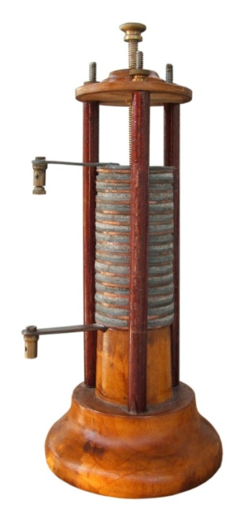
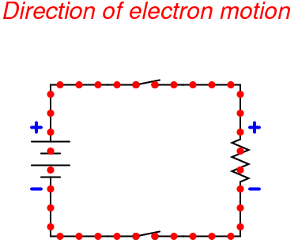
Electricity in history
In 1800 Alessandro Volta (1745-1827) discovered that two metals with salt water between them could cause a continuous flow of charge – in other words, an electric current. He had made the first battery.
It was not until J.J. Thomson discovered the electron in 1897, that there was any evidence to explain what electricity really was. From such discovery, we now know that the current in a circuit is a flow of electrons.

Slide 5
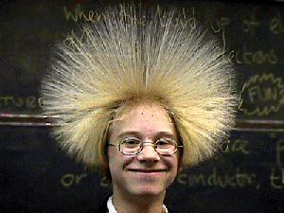
Electric charge
REMEMBER: There are two types of electrical charge, the positive (+) and the negative (-). Charges with different signs attract each other, and charges with the same sign repel each other.
When objects get charged them can either exert between them forces of attraction or forces of repulsion.
CLICK HERE FOR AN ANIMATION
The material has been charged by friction and has acquired another property; it has become electrically charged.
This property manifests itself through forces of attraction and repulsion. Just like there are two types of forces, there are two types of electric charge. We call them negative (-) and positive (+) charges

Slide 6
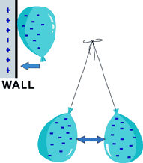
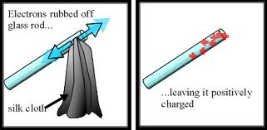
Electric charge
Electric charge or ‘electricity’, can come from batteries and generators. But some materials become charged when rubbed. Their charges is sometimes called electrostatic charge or ‘static electricity’.
Glass rods or amber rods can be charged by rubbing them with a silk cloth. When you rub rods of glass or amber with a silk cloth, the rods will be able to attract small objects.

Slide 7
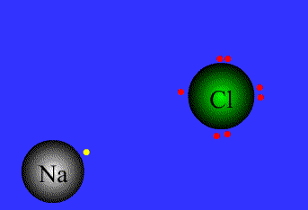
Electrical nature of matter
You remember that matter is constituted by small particles called atoms. Those atoms have three different subatomic particles with different charges: Protons (+), electrons (-) and neutrons (0)
Matter made up of neutral atoms has no net charge. However, when some atoms of a body lose or gain electrons because of friction with another body, the body is electrically charged:
If some atoms of a body gain electrons, there will be an excess of negative charges in these atoms and a total negative net charge in the body.
If some atoms of a body lose electrons, there will be an excess of positive charges in these atoms, and a total positive net charge in the body.

Slide 8
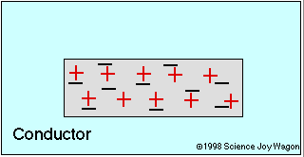
Electrical nature of matter
A body is charged when there is a break in the equilibrium between the two types of charges in its atoms.
The atoms are extremely small units. Therefore, the bodies mentioned in examples gain or lose millions of electrons.
Click here for a video to summarise it all!

Slide 9
Electrical nature of matter
Three different ways to charge an object:
By rubbing or friction, as we have already mentioned:
One of the objects gains electrons and the other one loses electrons. So both objects will have the same amount of charge but of different signs.
By contact or conduction:
When a neutral object is touched with a charged object (either positive or negative) and some of the charges move onto the neutral object. Both objects will end up with the same sign.
By induction:
Charges that appear on an uncharged object because of a charged object nearby are called induced charges. When placing a charged rod next to, but not touching, a neutral object this will become charged by induction. The neutral object will end up with an opposite charge to that on the rod.

Slide 10
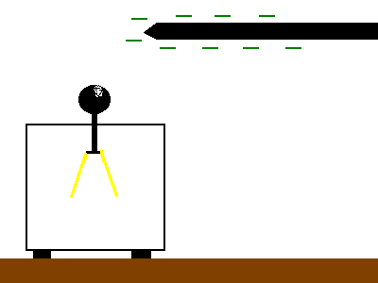
The Elecroscope
The electroscope, also known as an electrometer, is a device used to detect electrostatic charge
Electrostatic charge can be detected by using a leaf electroscope as the one shown here. If a charge object is placed near the cap, charges are induced in the electroscope. Those in the gold leaf and metal plate repel, so the leaf rises, the greater the movement, the stronger the charge.
It is not possible to directly find out the sign of the charge, as two positive as well as two negative charges will bring about the rising of the gold leaf.

Slide 11
Conducting and isolating materials
When some materials gain charges, like a glass or amber rod, these charges remain localized. However, this does not happen in other materials, such as metals. These other materials will lose the gain charges almost immediately. This is because electrons flow through them or the surrounding material until the balance of negative and positive charge is restored.
Conductors are materials that let electrons pass through them. Metals are the best electrical conductors. Some of their electrons are so loosely held to their atoms that the can pass freely between them. (These free electrons also make metals good thermal conductors).
Insulators are materials that hardly conduct at all. Their electrons are tightly held to atoms and are not free to move; although they can be transferred by rubbing. Insulators are easy to charge by rubbing because any electrons that get transferred tend to stay where they are.
Go to the website to download the circuit contruction kit

Slide 12
Electrical charge and the ways to measure it
Unit of Charge
When an object is charged it has gained or lost electrons. The electron is an extremely small unit of charge, and difficult to manage individually. That is why the SI unit of charge is a much bigger arbitrary unit, the coulomb (C). It is equal to the charge on about 6 million million million electrons.
The coulomb is defined as an electric charge equal to 6,24 · 10¹⁸ electrons.
Since a coulomb is a relatively large quantity of charge, we often measure charge in microcoulumbs. 1μC = 0,000001 C = 10⁻⁶ C (one millionth of a coulomb)
A body acquires a charge of +1 C if it loses 6,24 · 10¹⁸ electrons with respect to its neutral state, and gets a charge of –1 C if it gains 6,24 · 10¹⁸ electrons with respect to its neutral state.

Slide 13
The law of coulomb
The French physicist Charles A. Coulomb (1736-1806) studied the forces of attraction and repulsion between electric charges. In order to do this he used a torsion balance, which he invented. With this instrument, the force exerted can be measured through the torsion produced on a thin and rigid wire. The bigger the force, the bigger the torsion produced on the wire.
Two electric charges will attract or repel each other with a force that is directly proportional to the product of the charges and inversely proportional to the squared distance which separates them.

Slide 14
The law of coulomb
Abbreviation | Magnitude | Unit
F | Force | Newton (N)
K | Coulomb’s law constant (9x10⁹)
q | Charge | Coulomb (C)
d | Distance | Meters (m)

Slide 15
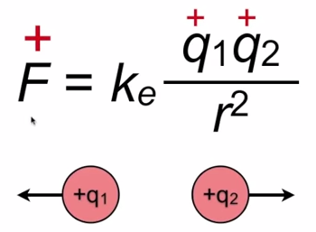
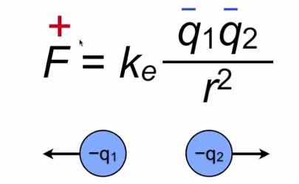
The law of coulomb
When both charges are positive, the force is positive. This means the charges will repell
When both charges are negative, the force is positive. This means again the charges will repell

Slide 16
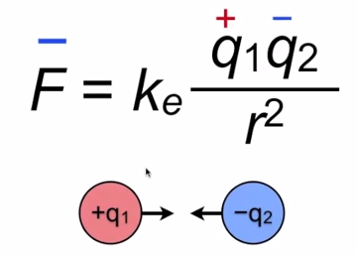
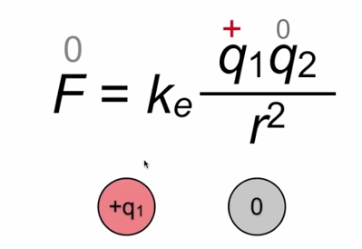
The law of coulomb
When one charge is positive and the other negative, the product will be negative. This means the charges will attract.
When one charge is positive or negative but the other neutral, the force will be zero too. This means there will be no attraction nor repulsion.
Review this with the video on the website!!

Slide 17
The law of coulomb
Problem 15. Determine the electrical force of repulsion of two charges with the same sign, one having a charge of 10⁻⁶ C and the other a charge of 10⁻⁹ C, if they are in a vacuum and separated a distance of 3 cm.
-
+
-
10⁻⁶
10⁻⁹
0,03m
DATA
K= 9·10⁹
F= ?
q1= 10⁻⁶C
q2= 10⁻⁹C
d= 3cm = 0,03m
d²⁼ 0,0009m² = 9·10⁻⁴
FORMULA
CALCULATIONS
=10⁻²N
9·10⁹ x 10⁻¹⁵
9·10⁻⁴
10¹³ x (10⁻¹⁵)= 10⁻²N

Slide 18
The law of coulomb
TASK FOR NOW: DO PROBLEM 16 ON PAPER!

Slide 19
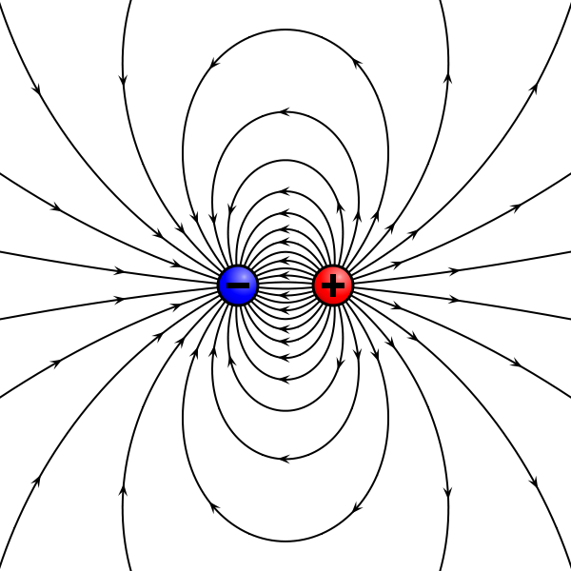
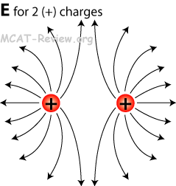
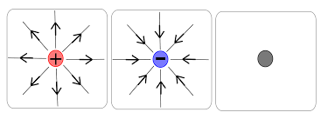
The law of coulomb
Electric Fields
To help visualize how a charge, or a collection of charges, influences the region around it, the concept of an electric field is used. If electric charges feel a force, then, scientifically speaking, they are in an electric field.
An electric field is a region or space where we can feel the influence of a charge that is making that field.

Slide 20
Electricity: Electrostatics

