Slide 1
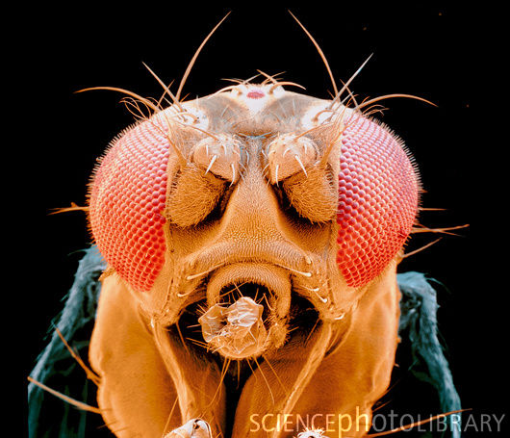
Genetics: Sex-linked genes
Añade aquí una imagen relacionada con el tema

Slide 2
Topics
Sex linkage
Colour blindness
Haemophilia
Tortoiseshell Cats
Lethal Genes
Questions

Slide 3
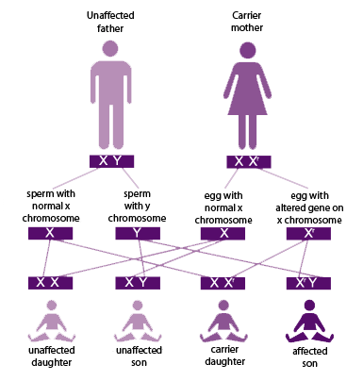
Sex Linkage and Lethal Genes

Slide 4
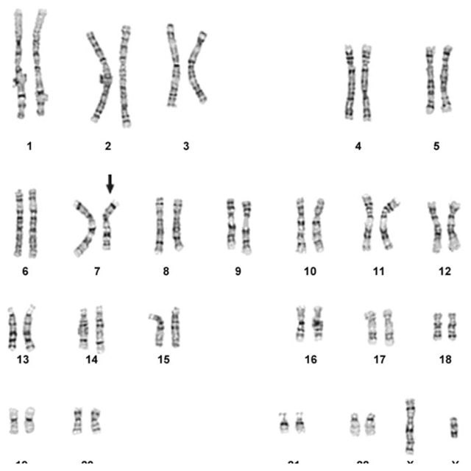
Sex linkage
Sex linkage occurs when the genes for a certain characteristic are carried on the sex chromosomes.
They do not determine the sex of the organism, they just happen to occur on the sex chromosomes.
The Y chromosome is shorter than the X chromosome, so it carries fewer alleles.

Slide 5
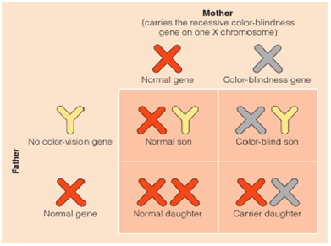
Colour blindness
The allele for colour vision is carried on the part of the X chromosome that is missing from the Y chromosome.
There is a recessive allele that causes colour blindness.
Females inherit 2 alleles for colour vision, one on each X chromosome, if they inherit one faulty allele, they are unaffected.
Males only inherit one allele from their mother, if they inherit the faulty allele they are colour blind.
As a result, colour blindness is more prevalent in males.

Slide 6
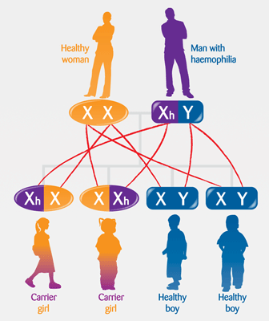
Haemophilia
Haemophilia is another example of sex linked inheritance, where females can be unaffected carriers, but males will suffer from the disease if they inherit the faulty allele.
Normal Carrier
Gametes | X^{H} | X^{h}
X^{H} | X^{H}X^{H} | X^{H}X^{h}
Y | X^{H}Y | X^{h}Y
Normal Sufferer

Slide 7
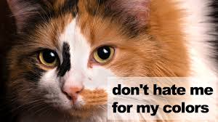
Tortoiseshell Cats
All tortoiseshell cats are female, this is because the allele for coat colour is carried on the X chromosome.
If a female cat inherits a black allele and a ginger allele she will be tortoiseshell.
X^{B} X^{G}
A male cat can only inherit one of these alleles so he will be either black or ginger.
X^{B} Y or X^{G} Y

Slide 8
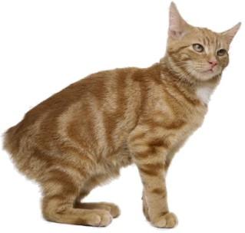
Lethal Genes
Some genes when expressed in the homozygous condition can be fatal for the developing embryo, e.g. the manx cat

Slide 9
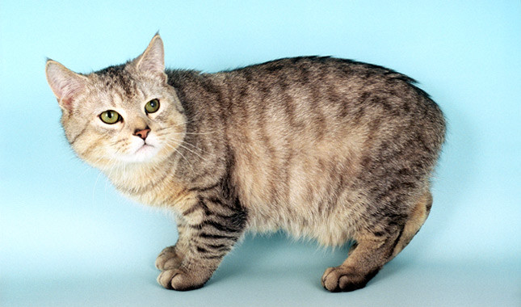
Lethal Genes
The Manx gene is dominant over the gene that produces a tail.
If the cat inherits a heterozygous allele combination the gene will be expressed and the cat will not have a tail.
If the cat inherits a homozygous dominant allele combination, the foetus will not survive.

Slide 10
Questions
The genotype and phenotype of certain cat coat colours are shown in the table:
Phenotype | Genotype
 | Male | Female
Black | X^{B} Y | X^{B} X^{B}
Ginger | X^{G} Y | X^{G} X^{G}
Tortoiseshell | - | X^{G} X^{B}
A breeder has a number of black, ginger, and tortoiseshell cats.
If she wants all the female kittens to be tortoiseshell, what are the genotypes and phenotypes of the parents she should use?
What will be the phenotypes of the male kittens in the crosses you have suggested?

Slide 11
Genetics: Sex-linked genes
Añade aquí una imagen relacionada con el tema

